Slide 1
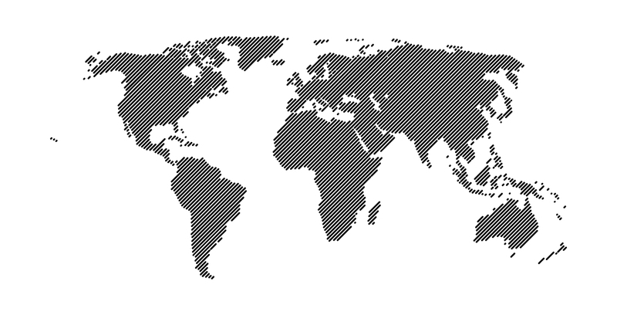

Slide 2
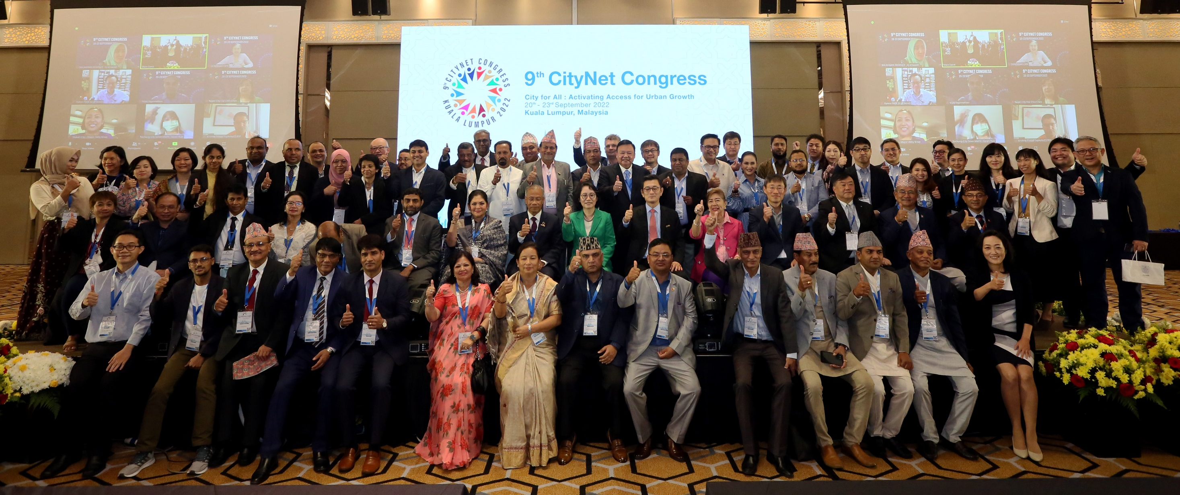
WHO WE ARE
CityNet is an association of urban stakeholders committed to sustainable development with a goal to connect urban actors and deliver tangible solutions for cities in the Asia-Pacific region and beyond

Slide 3
ABOUT CITYNET
Established in 1987

Slide 4
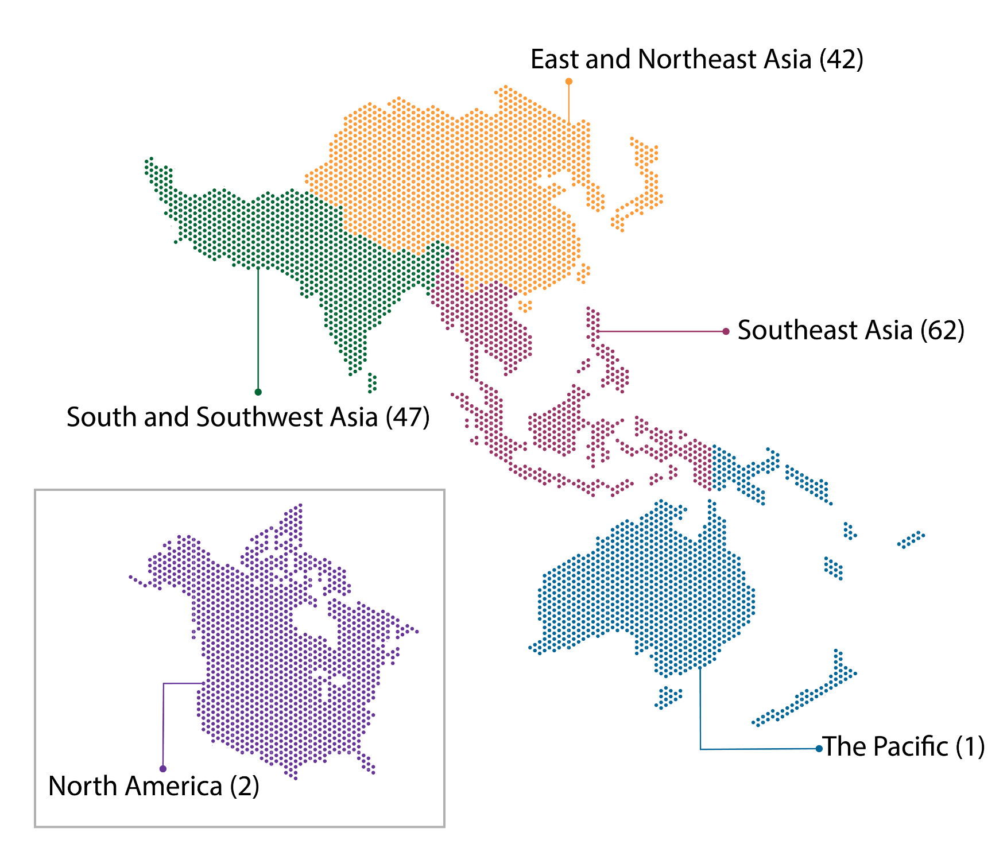
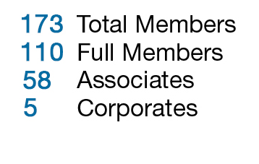
OUR MEMBERS
44
Total Members
162
Full Members
106
Associate Members
53
Corporate Members
3
64
Full Members
Local Authorities
(Cities, Provinces)
Associate Members
city networks, universities, think tanks, civil society organizations
51
Last month, we also admitted 3 new members from Europe, 1 new member from Central Asia, 1 new member from Hongkong SAR, and 2 new members from India.

Slide 5
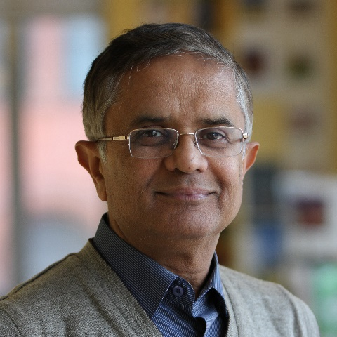
EXECUTIVE COMMITTEE 2023-2026 TERM
OFFICE | CITY / ORGANIZATION
Secretary General | Mr. Vijay Jagannathan
President | Seoul Metropolitan Government
President Emeritus | Yokohama City
First Vice President | Kuala Lumpur City Hall
Second Vice President | Makati City Government
Executive Committee | All India Institute of Local Self-Government
 | Busan Metropolitan City
 | Colombo Municipal Council
 | Denpasar City
 | Iloilo City
 | Incheon Metropolitan City
 | International Climate and Development Institute
 | Lalitpur Metropolitan City
 | Plus Arts
Auditor | Muntinlupa City
Vijay Jagannathan
Secretary General

Slide 6
CLUSTER PROGRAMMES
CLIMATE CHANGE
Jakarta
Climate Leadership Program
SDG Benchmarking Workshop
Disaster Cluster Seminar
SDGs
DISASTER
Seoul
Yokohama
Kuala Lumpur
Makati City

Slide 7
OTHER THEMATIC AREAS
DISASTERS &
RESILIENCE
SMART CITY
CLIMATE
CHANGE
WATER & WASTE
MANAGEMENT
TRANSPORTATION
URBAN
INFRASTRUCTURE

Slide 8
Our Services to members
Capacity Building Trainings
City-to-City Cooperation
Urban SDG Knowledge Platform
…and many more

Slide 9
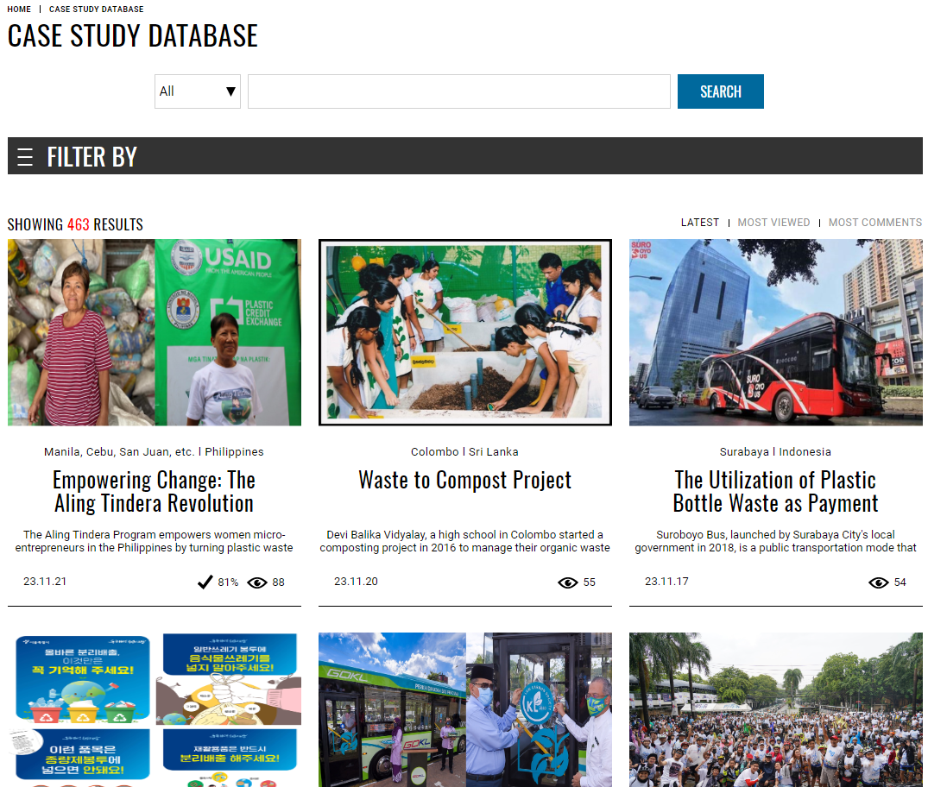
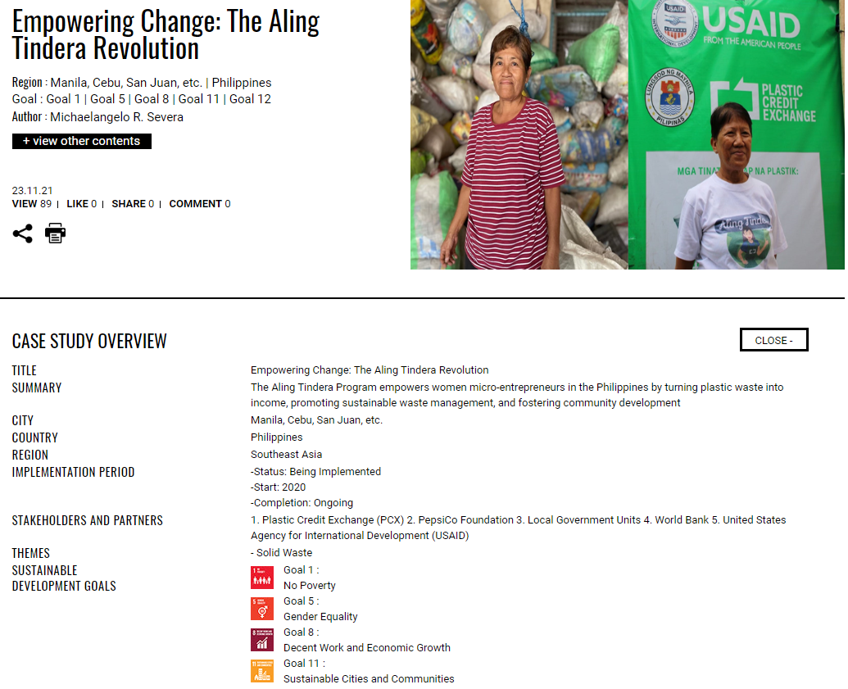
URBAN SDG KNOWLEDGE PLATFORM
Current
Total Case Studies
543
urbansdgplatform.org
Annual Awards Program
CityNet-ESCAP

Slide 10
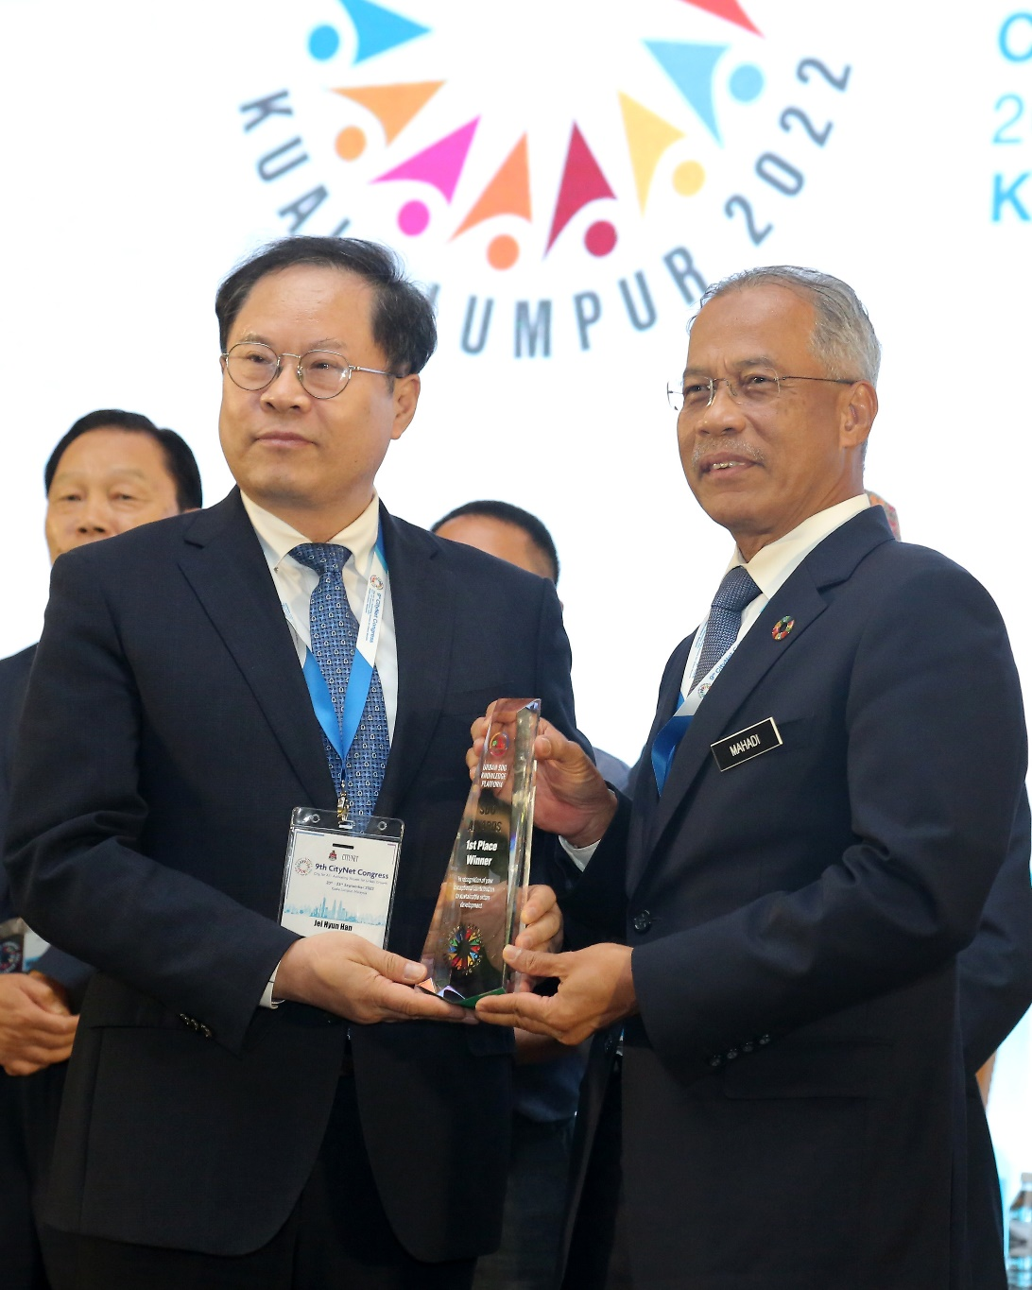
Annual Awards Program
Annual Awards Program to recognize work being done at the local government level to localize the UN SDGs
Cities upload cases under thematic categories that correspond to key challenges facing cities
Awards Ceremony in 2024 was held in Iloilo City during CityNet Executive Committee Meeting in Nov, 2024
Awards Ceremony in 2025 to be held in Seoul during 2nd Seoul Smart Life Week around Sep/Oct, 2025

Slide 11
Contact:
Ms. Hui Qian
Senior Program Officer
hui@citynet-ap.org

