Slide 1
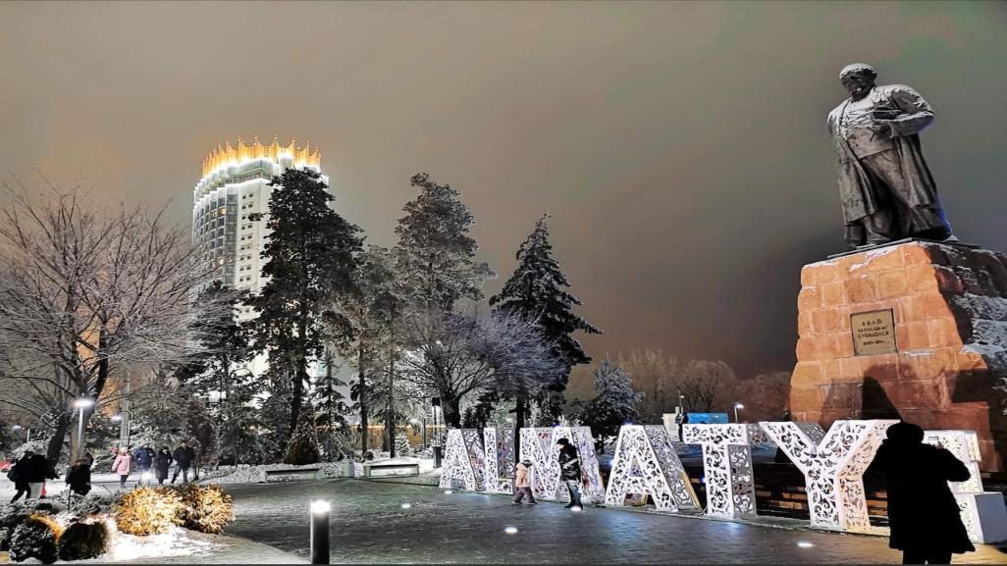


Almaty - environmental challenges
Sapporo, Dec 2024

Slide 2
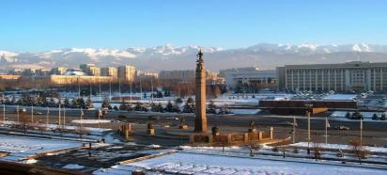
ALMATY CITY PROFILE
ECONOMY
GEOGRAPHY
Nearly 1/5 of the country's GDP
More than 1/4 of the country’s budget revenues
More than 36% of the country's trade operations
Share of production goods – 8,1%,
services– 83,3%
SMEs create 65.4% of employment and 47.5% of GRP
Almost 1/5 of the country's foreign trade
The largest airport in the country
More than 80 offices of international organizations and TNC
More than 400k foreign tourists
Lies in the northern foothills of the Trans-Ili Alatau mountain range at an elevation of 700–900 meters
Humid continental climate
Area of extensive geologic risk, subject to earthquakes and mudslides
The largest city in Kazakhstan, the core of the agglomeration with over 3 million people
1

Slide 3
DEVELOPMENT PRIORITIES
In 2022, the Maslikhat (City Council) of Almaty approved the “Almaty City Development Program up to 2025 and medium-term prospects up to 2030”
PRIORITY DEVELOPMENT AREAS:
1
COMFORTABLE URBAN ENVIRONMENT
NEIGHBORHOOD PLANNING WITH 15-MIN. INFRASTRUCTURE ACCESSIBILITY AND TRANSPORT CONNECTIVITY OF DISTRICTS
2
SUSTAINABLE ECONOMIC GROWTH
HIGH LABOR PRODUCTIVITY AND COMFORTABLE BUSINESS ENVIRONMENT
3
MANAGED URBANIZATION
BALANCED DEVELOPMENT OF THE CITY AND ALMATY AGGLOMERATION
4
SOCIAL SUSTAINABILITY AND STABILITY
AN INCLUSIVE CITY OF EQUAL OPPORTUNITIES WITH ACCESSIBLE AND QUALITY SOCIAL INFRASTRUCTURE
5
GREEN ALMATY
CLEAN AIR AND FAVORABLE ECOLOGICAL ENVIRONMENT
6
SMART CITY
A CITY MANAGED ON THE BASIS OF DIGITAL SOLUTIONS AND BIG DATA ANALYTICS
7
SAFE CITY
CITIZENS' CONFIDENCE IN SECURITY AND PREPAREDNESS FOR EMERGENCIES
Each area of the program is linked to one or more of the
Sustainable Development Goals.
2

Slide 4
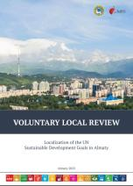
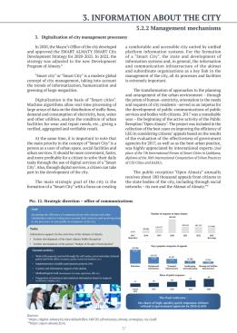

VOLUNTARY LOCAL REVIEW
DESCRIPTION OF THE MAIN SECTIONS
p. 37 Digitalization of city management processesy
1.
IMPLEMENTATION OF THE SDGS IN KAZAKHSTAN
2.
LOCALIZATION OF THE SDGS IN ALMATY
3.
METHODOLOGY AND APPROACH
4.
SUSTAINABLE DEVELOPMENT MANAGEMENT | Institutions
5.
SUSTAINABLE DEVELOPMENT MANAGEMENT | Mechanisms
VLR ALMATY 2023
6.
STRATEGIC DOCUMENTS ON THE DEVELOPMENT OF THE ALMATY CITY
7.
IMPLEMENTATION OF THE SDGS
VLR presents the institutional environment, organizations, and mechanisms that ensure the implementation of the SDG strategy.
3

Slide 5









ROLE OF THE ALMATY DEVELOPMENT CENTER IN SYSTEMIC INSTITUTIONAL CHANGES AND SMART CITY DEVELOPMENT
*Platform - a method of organization and a dialogue platform for bringing communities together (ADC, business, active caring citizens, academy, etc.)
Think Tank
Be a change agent
Communications office
Ideas
Develop innovative solutions
Projects
Provide a wide range of professional services
PLATFORM*
SUSTAINABLE SMART
CITY
Financing
Project office
Be adaptable to the needs of the akimat and residents

Slide 6
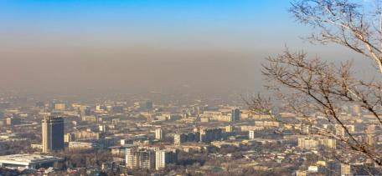





ALMATY WINTER:MAIN CHALLENGES
AIR POLLUTION
MAIN CONTRIBUTORS
60%
19%
Vehicle emissions
Industrial emissions
Basin-like topography and temperature inversion prevent the dispersion of pollutants
11%
9,7%
Residential heating
Energy production
8

Slide 7

ALMATY WINTER:MAIN CHALLENGES
AIR POLLUTION SOLLUTIONS
Greening Public Transport
Urban Development and Mobility
Gasification projects
TPP modernization
Transition to gas and electric public transport
Construction of infrastructure for gas-powered buses running.
Creation of a charging infrastructure network for personal and public electric vehicles
Gasification of residential houses in the city and agglomeration, including socially vulnerable families
Large-scale gasification in the agglomeration
Decommissioning of a coal boiler
Launching a new gas unit:
Reconstruction of TPP-2 and TPP-3 for emission reduction
Reducing commuter migration by creating new jobs within the agglomeration
Increasing BRT routes, launching LRT, and constructing 50 km of bicycle paths
Introducing low-emission zones
Increasing fees for parking.
9

Slide 8


Thank you for your attention!
Sapporo, 2024

