Slide 1
Notes:
Good morning everyone, before we start the presentation, I would like you first to imagine this:
You're visually impaired, stepping into the snow without clear markers to guide you.
Or you're an elderly individual, and the icy pavement makes every step feel like a risk. How would you feel?

Slide 2
Where?
どこ？
Notes:
In a city that experiences harsh winters like Sapporo, not everyone can easily adapt.
For some, the challenges of winter become obstacles that severely limit their independence and safety.

Slide 3
Hokkaido University
Nitobe College
みんなで楽しめる冬へ！
Inclusive Winter
Enhancing Safety and Accessibility
for Vulnerable Populations
不便者のために，安全性とアクセシビリティの向上
International Students
留学生
Notes:
Today, we’ll explore how we can address these challenges and create a more inclusive winter environment for everyone.

Slide 4
About our Team
メンバーズ
Kristine CASALA
Aishwarya DESHMUKH
Laboratory of Architectural Planning
Laboratory of Ram AVTAR, Graduate School of Environmental Science
Denise CORTEZ
Gefei HOU
Laboratory of Urban and Regional Design
Laboratory of Architectural Planning
Seralathan DILUSHI
Eman TOULIABAH
Laboratory of Reproductive and Developmental Biology
Laboratory of Architectural Planning
Konstantin KACHURIN
劉峻逍
Laboratory of Nanomaterials and Nanoscopy
Laboratory of environmental material engineering
Notes:
We are students from Nitobe College at Hokkaido University, representing different laboratories across various fields such as architecture, urban design, and environmental science.
We'd like to share our perspectives as international graduate students who didn’t grow up in winter cities.

Slide 5
なぜ冬のアクセシビリティは大事なのか？
Why does winter accessibility matter to everyone?
Notes:
For many of us presenters, coming from countries without harsh winters, the challenges of navigating a snowy landscape can be surprising, even overwhelming.
Imagine navigating icy sidewalks and snow-covered roads for the first time. Now think of the added difficulties faced by those with limited mobility or resources.

Slide 6
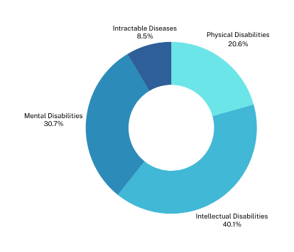
Sapporo
2022
Adult with disabilities
Adult with disabilities
80, 977
Children with disabilities
1, 382
2024
Elderly
559, 122
(28.6%)
Source: Sapporo 2024 Facts and Figures by International Relations Department City of Sapporo
Survey on the Living Conditions and Challenges of Persons with Disabilities in Sapporo
Notes:
Let’s have a quick look at some key statistics from Sapporo. In 2022, over 80,000 adults and 1,300 children had disabilities. By 2024, the elderly population grew to over 559,000.
When we add pregnant women and young children, it's clear that many face unique challenges during the harsh winter.
Ref:
International Relations Department City of Sapporo, Sapporo 2024 Facts and Figures 1–5 (2024). Sapporo, Hokkaido.
Chart: Survey on the Living Conditions and Challenges of Persons with Disabilities in Sapporo. The survey is linked to the revision of the Sapporo Disability Plan 2018.

Slide 7
ambulance transport to hospitals
600 - 800 a year
December 21, 2014
163 patients
Source：Sapporo Winter Road Guide (Winter Life Promotion Council);
Current state of pedestrian slip-and-fall accidents in winter in Sapporo and the characteristics of icy sidewalk surfaces (2013)
Notes:
Pedestrians who fell severely enough to require ambulance transport to hospitals in winter have numbered between 600 and 800 a year.
There were days when the number of fall accidents raised sharply, for example, on December 21, 2014, 163 patients were transported to hospital, but only 84 the next day.
https://ascelibrary.org/doi/abs/10.1061/9780784412978.058?download=true
Chapter
Jun 27, 2013
Current State of Pedestrian Slip-and-Fall Accidents in Winter in Sapporo and the Characteristics of Icy Sidewalk Surfaces

Slide 8
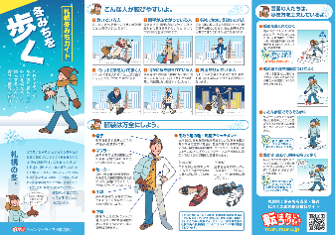
Anti-slip measures
滑り止め対策
Snow removal and disposal
除雪と処分
Public winter road guidelines
冬期の道路のガイドライン
Source：Sapporo Winter Road Guide (Winter Life Promotion Council); Sapporo Construction Bureau Snow Management Office Project Promotion Section
Notes:
Over the years, many solutions have been put in place, including anti-slip measures, snow removal and disposal, and public winter road guidelines.
Snow plows clear streets, grit reduces icy roads, and traffic management enforces winter tires.
The government also prioritizes monitoring and emergency response, keeping a close watch on weather conditions and having teams ready to handle accidents.

Slide 9
Aomori - 1st
Hokkaido - 2nd
largest number of deaths
90% of victims
over the age of 65
Source：Kyodo News, 2022
Notes:
Despite these efforts, casualties still occur each winter, highlighting the ongoing challenges of managing heavy snowfalls.
What’s most concerning is that over 90% of the victims are over the age of 65.
This highlights the urgent need to rethink how we protect our most vulnerable populations during the winter season.
So, how do we ensure winter in Sapporo is safer and more accessible for everyone?
https://english.kyodonews.net/news/2022/02/81d226d9475f-45-killed-in-3-months-in-accidents-while-clearing-snow-in-japan.html

Slide 10
Theme 1:
Infrastructure
インフラ

Slide 11
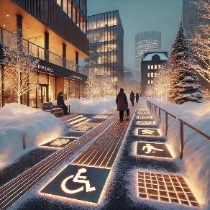
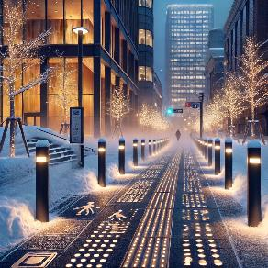
Heated anti-slip walkways
Focus on high-traffic and key city areas
Schedule by weather and traffic
Reduce demand for snow removal and disposal
Anti-slip walkways
Tactile blocks

Slide 12
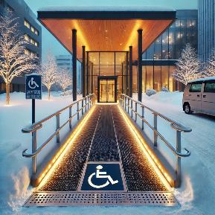
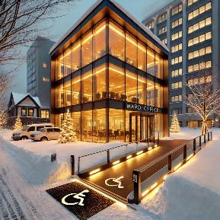
Heated anti-slip walkways
Use renewable energy
Smart sensors for monitoring conditions
Enhanced lighting to improve visibility
Ramps

Slide 13
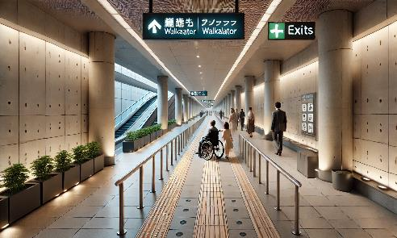
PWD-exclusive lane at Chi-Ka-Ho
Accessibility Lane
Designated lanes to ensure safety and comfort
Reduce collision risks with other pedestrians
Staff deployment during peak hours for guidance and enforcement

Slide 14
Theme 2:
Physical and Mental Health
体と心の健康

Slide 15
Mental Health
メンタルヘルス
冬の心と体の負担に対処する
Notes:
Winter can also significantly impact mental health, especially for vulnerable populations like seniors, people with disabilities, and those with mobility challenges.

Slide 16
Why does it matter?
なぜ重要なのか？
Seasonal Affective Disorder (SAD)
季節性感情障害
Social Isolation
社交的な孤独
Stress and Anxiety
ストレスと不安
Coping with Physical Barriers
体の障害
Notes:
The long, dark days often worsen Seasonal Affective Disorder (SAD), leading to depression, while harsh conditions increase social isolation, leaving many feeling trapped at home due to inaccessible roads and transportation.
For individuals with mobility issues, icy sidewalks and inaccessible public transport can cause frustration and feelings of helplessness.
Addressing these accessibility challenges not only improves physical safety but also helps reduce the emotional and psychological toll that winter takes on these vulnerable groups.

Slide 17
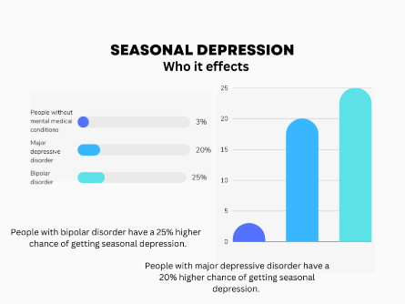
Therapy cafe for SAD patients
It is a condition in which people experience consistently low moods during fall and winter.
Treatment: Get outside and get sunlight, continue regular exercise, talk with family or friends, light therapy, and drug treatment.
(opsnorthstar.com)
Notes:
SAD is a type of depression that’s related to changes in seasons. Symptoms of SAD start in the fall and continue into winter months and consuming your energy and making you feel moody.
It is caused by Lack of sunlight reduces secretion of serotonin in the brain.
Symptoms - low energy, sadness, difficulty in concentrating, overeating and weight gain, and having thoughts of not wanting to live.
SAD can also occur in spring and summer.
Common among people living in high latitude areas.
Graph in the left shows who can be get affected by SAD. People who have bipolar disorder are at increased risk of SAD.

Slide 18
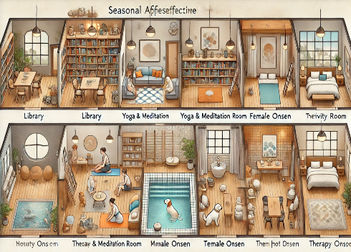
What we can do?
Therapy cafe with many infrastructures such as cafe, pet therapy room, activity room, meditation and yoga room, counseling, and special onsen with therapy lamps.
Who can do?
Government, NGO, private funding, members of the cafe (membership fee).
Notes:
This cafe can be a perfect treatment not only for SAD patients but also for other people who are suffering with any kind of depression. Therapy lamp in cafe and onsen will be the best treatment for SAD patients. Playing with pets, doing activities like painting/crafting/cookin, meditation,yoga and reading books will increase the serotonin secretion in the brain.

Slide 19
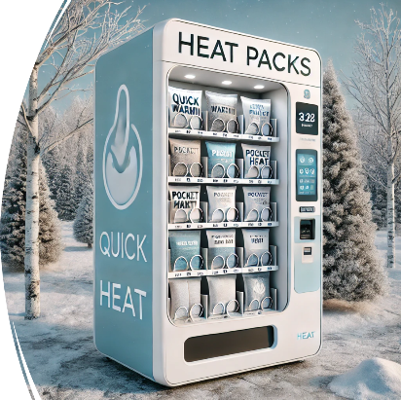
Vending machine for heat pads.
What we can do?
Vending machines for heat packs, especially in tourist areas.
Who can do?
Government and companies that manufacture heat packs.
Notes:
Tourists visiting Hokkaido during winter may be unaware of the region's harsh climatic conditions and may not be adequately prepared. This puts them at a higher risk of hypothermia or frostbite. Installing vending machines that dispense heat pads could be highly beneficial in helping tourists stay warm and help with pain relief and avoid these dangerous conditions.

Slide 20
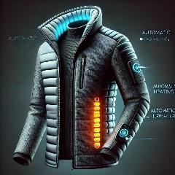
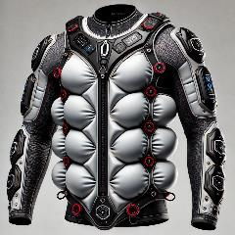
Smart clothing for winter
Outdoor activities are inconvenient and can be risky in winter.
What we can do?
Propose ideas and designs for smart clothing that can regulate temperature and prevent slip-related injuries.
Who can do?
Companies and institutions capable of developing such devices.
Notes:
During winter, there is a significant difference between the temperature outside and inside buildings. Additionally, the risk of slips and falls increases considerably due to icy and slippery conditions, making outdoor activities particularly challenging. These inconveniences can be especially problematic for vulnerable groups such as the elderly, pregnant women, and individuals with disabilities, limiting their ability to comfortably and safely enjoy outdoor activities during the winter season.
To address these challenges, we propose the development of smart clothing equipped with advanced features. This innovative clothing would include a temperature control system that can be adjusted via a smartphone or smartwatch, ensuring optimal warmth in varying environments. Furthermore, the clothing would integrate an airbag system designed to activate upon detecting a fall, reducing the risk of injuries and enhancing safety.
This smart clothing solution aims to provide comfort, safety, and freedom for individuals to enjoy the winter season without worry.

Slide 21
Theme 3:
Winter Technology
冬の技術

Slide 22
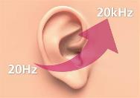
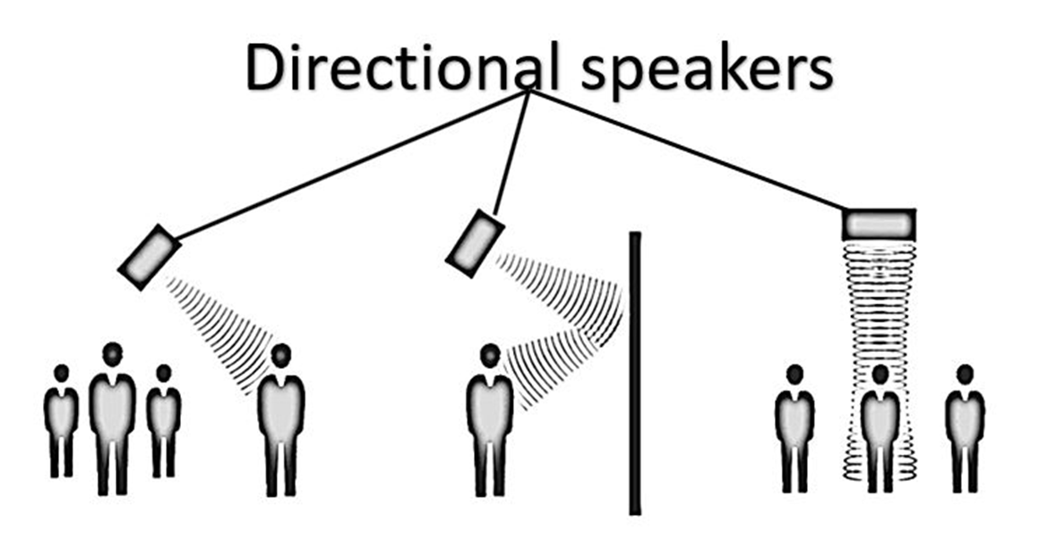
Audio-Signal Guides
Human hearing range
Source: ramesh4sps.blogspot.com
A quartz-like mineral vibrates at 200000 Hz (Ultrasonic wave)
Source: how2shout.com
Signal goes receiver only
CoCo: designed by Keio University students (recent development)
Notes:
https://digitalcommons.calpoly.edu/eesp/635
https://doi.org/10.1007/978-3-540-73354-6_58
What are directional speakers? How directional sounds can be useful?

Slide 23
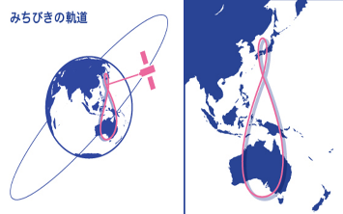
Geospatial Data Applications
Navigation with satellite navigation technologies
Emit signal towards receiving devices
Ex. Smartphones, GPS devices
Source: digitalconstruction.jp
3 satellites need for location
GNSS Satellite for Japan: Michibiki (みちびき)
© qzss.go.jp
Notes:
【GNSS測量とは？】測位システムの基礎を解説〜 GPSと何が違う？仕組みや活用例も紹介！〜【測量のことイチから解説】 | デジコン
https://qzss.go.jp/overview/services/tech01_orbit.html
are a big invisible map in the sky that helps us find our way around.

Slide 24
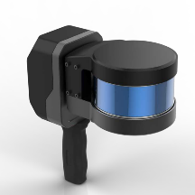
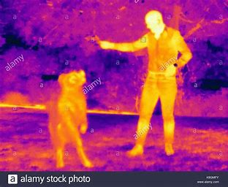
Real-time movement
Thermal Camera and peripheral scanners
LiDAR, or RGB camera for real-time navigation.
©lieschen lidar
For low visibility around roadside ice heaps.
Children, PWD and wildlife are difficult to see.
Notes:
LiDAR 3D Mapping Sensors | LiDAR Mapping System | LS Rider

Slide 25
Conclusion
まとめ
Hokkaido University
Nitobe College
Addressing problems from various angles and perspectives．
様々な視点から問題に取り組む。
Innovative and creative ideas．
革新的で創造的なアイデア。
Practical and efficient strategies．
実践的で効率的な戦略。
Creating new solutions and optimizing on existing ones．
新しい解決策を生み出し、既存の解決策を最適化する。
Diversity and interdisciplinary collaboration．
多様性と学際的なコラボレーション。
Notes:
We approached urban winter problems open-mindedly, from multiple angles perspectives.
Presented creative and innovative solutions to tackle winter-specific challenges.
Focused on practical and efficient strategies tailored to winter city needs.
Proposed new approaches while enhancing and optimizing existing solutions.
Highlighted the importance of teamwork and diverse expertise in developing comprehensive solutions.

Slide 26
Inclusive Winter
みんなで楽しめる冬へ！
Thank you for listening!
ご清聴ありがとうございます．

Slide 27
References:
International Relations Department City of Sapporo, Sapporo 2024 Facts and Figures 1–5 (2024). Sapporo, Hokkaido.
Kaneda, Y., Nagata, Y., Kawamura, F., & Narita, H. (2013). Current state of pedestrian slip-and-fall accidents in winter in Sapporo and the characteristics of icy sidewalk surfaces. ISCORD 2013, 607–617. https://doi.org/10.1061/9780784412978.058
Sapporo Construction Bureau Snow Management Office Project Promotion Section. (2023, December 21). Measures and preparation for heavy snowfall. Sapporo City. https://www.city.sapporo.jp.e.ain.hp.transer.com/kensetsu/yuki/contact/chuo.html
45 killed in 3 months in accidents while clearing snow in japan. (2022, February 24). Kyodo News. Retrieved from https://english.kyodonews.net/news/2022/02/81d226d9475f-45-killed-in-3-months-in-accidents-while-clearing-snow-in-japan.html.
https://digitalcommons.calpoly.edu/eesp/635
https://doi.org/10.1007/978-3-540-73354-6_58
What are directional speakers? How directional sounds can be useful?
GNSS測量とは？】測位システムの基礎を解説〜 GPSと何が違う？仕組みや活用例も紹介！〜【測量のことイチから解説】 | デジコン
https://qzss.go.jp/overview/services/tech01_orbit.html
Applications of modern digital mapping systems to Assist inclusion of persons with disabilities in geoscience education and research - ScienceDirect
Notes:
APA Style

