Slide 1
Oriental Consultants Co., Ltd.
FY2024 Commissioned Project for the City-to-City Collaboration for Zero-Carbon Society Program
Promotion of Environmental Infrastructure Development in Ulaanbaatar’s Cold Climate
December 19, 2024
Oriental Consultants Co., Ltd.

Slide 2
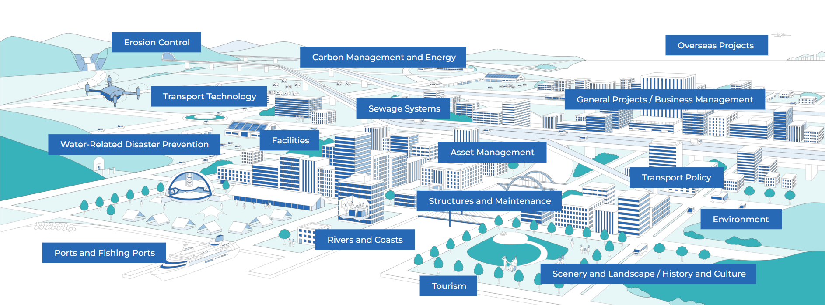
Oriental Consultants Co., Ltd.
We aim to create new social value through infrastructure development and business creation by leveraging our expertise and knowledge gained over half a century.
Establishment: December 24, 1957
Head Office: Sumitomo Fudosan Nishi-Shinjuku Building No. 6, 3-12-1 Honmachi, Shibuya City, Tokyo
Capital: 500,950,000 yen
President: Hidenori Nozaki
Employees: 1,296 (as of September 2022)
Business segments (social value creation for the entire community)
Notes:
我々オリエンタルコンサルタンツについてご紹介致します。
私たちオリエンタルコンサルタンツは、1957年に創業してから60年以上の間、
社会インフラ整備を通して、魅力ある持続可能な社会づくりに貢献する
新たな価値を創造し、提供し続ける会社を目指しています。
As a leading comprehensive consulting firm in Japan, we aim to be a company that continues to respond to new social values in order to bring about a society that is safe, secure, comfortable, vibrant, appealing and sustainable based on our high-quality technologies.

Slide 3
Oriental Consultants Co., Ltd.
Projects have been implemented with five cities under the Ministry of the Environment’s City-to-City Collaboration for Zero Carbon Society Program.
2017 – Present:
Osaka & Quezon (Philippines)
2017 – 2018:
Osaka & Ho Chi Minh (Vietnam)
2020 – Present:
Sapporo & Ulaanbaatar (Mongolia)
2021 – 2023:
Kawasaki & Bandung (Indonesia)
2024 – Present:
Sakai & Da Nang (Vietnam)
Example 1
Sapporo & Ulaanbaatar
Support Project for Creating a Zero Carbon Society through the Promotion of Cold-Climate Architecture and Renewable Energy
Ulaanbaatar
Sapporo
Example 2
Osaka & Quezon
Support Project for Creating a Zero Carbon Society to Realize Climate Change Mitigation Actions
Example 3
Kawasaki
Bandung
Quezon
Osaka
Kawasaki & Bandung
Support Project for Creating a Zero Carbon Society through the Promotion of Energy Saving and Mobility Improvements

Slide 4
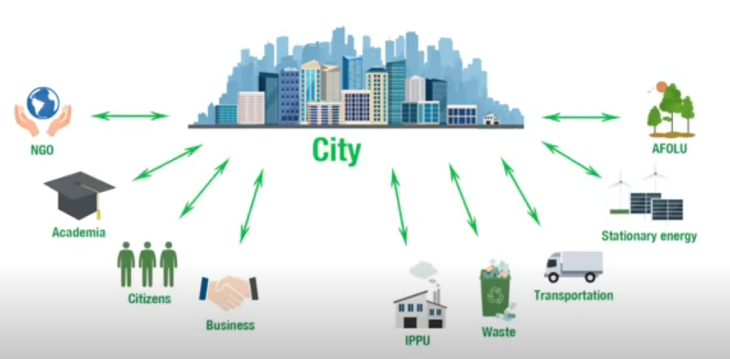
City-to-City Collaboration for Zero-Carbon Society Program
Approx. 70% of global greenhouse gas (GHG) emissions come from cities. To achieve the 1.5-degree target set in the Paris Agreement, the acceleration of climate action in cities is essential.
Planning and Implementation
Cities collaborate with various stakeholders
to plan and implement measures.
https://www.youtube.com/watch?v=sb_TZe5ZuCo

Slide 5
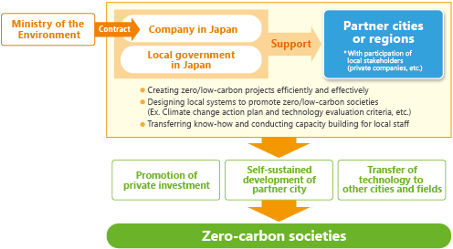

City-to-City Collaboration for Zero-Carbon Society Program
Supporting the transfer of Japanese cities’ experience and expertise in creating zero-carbon societies to other cities around the globe through collaboration between Japanese and overseas municipalities
Horizontal deployment of domestic success stories to overseas municipalities (utilizing JCM Equipment Subsidy Program, etc.)
49 cities and regions in 13 countries, participation by 20 Japanese municipalities

Slide 6
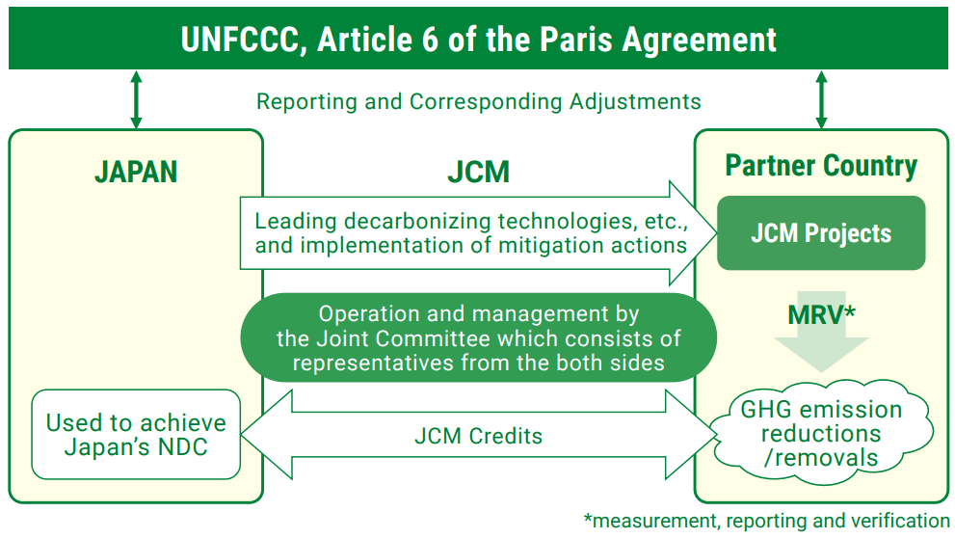
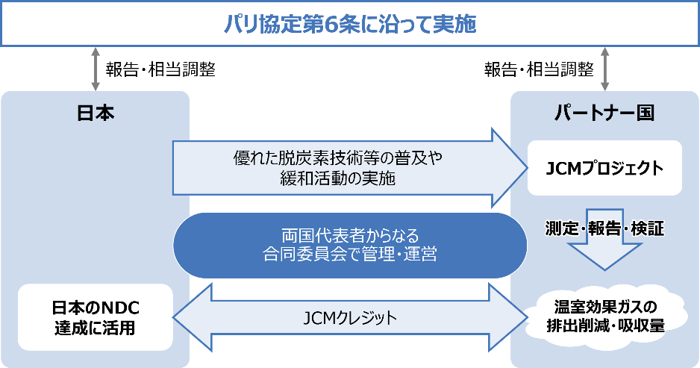
Joint Crediting Mechanism (JCM)
To contribute to global GHG emission reductions and sequestration, Japan operates the JCM by transferring technologies and establishing mechanisms for implementing mitigation actions in developing countries and regions.
Japan signed its first JCM agreement with Mongolia in 2013, and the mechanism has since expanded to include 29 countries.

Slide 7
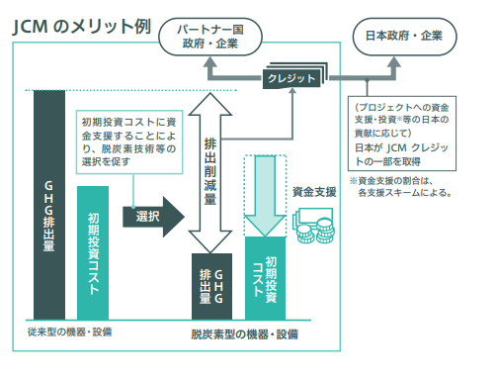
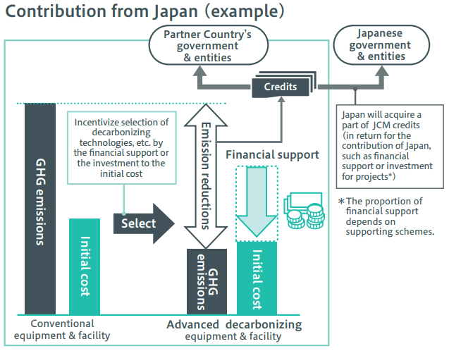
Joint Crediting Mechanism (JCM)
The JCM Equipment Subsidy Program utilizes decarbonization and other technologies to support the introduction of equipment with low GHG emissions in JCM partner countries and conducts measurement, reporting, and verification (MRV) for the installed equipment.
・ To ensure efficient project implementation, an international consortium consisting of Japanese and foreign entities is formed.
・ Up to half of the initial investment cost is subsidized for the project.
Ministry of the Environment’s JCM Financial Support Program (2013–2024)
Total No. of projects: 246 (in 29 partner countries)
In Mongolia, 10 projects have been implemented, including those for the
introduction of solar power generation systems and high-efficiency heat supply boilers.

Slide 8
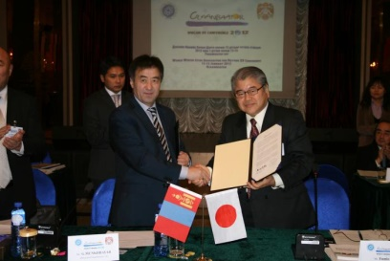
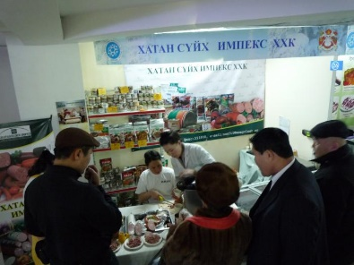
Sapporo and Ulaanbaatar: History of City-to-City Collaboration
Ulaanbaatar joined the World Winter Cities Association for Mayors (WWCAM) in 1998.
The Ulaanbaatar Declaration was adopted at the 2012 Mayors Conference, advocating the efficient use of energy and heat.
Technical Exchanges as Cities in Cold Regions
・ Mongolia became a JCM partner country on January 8, 2013.
・ Under the Japan-Mongolia Mid-Term Action Plan, it was decided that JCM projects would be implemented through close public-private collaboration.
Ulaanbaatar Declaration 2012
City-to-City Collaboration Projects (2016)
・ An energy project involving mining and industrial facilities and heat supply equipment to reduce air pollution
・ Promotion of effective utilization of renewable energy (solar and wind) to support decarbonization
・ An electricity generation project utilizing waste from areas surrounding the city
Exhibition booth at the Winter Expo held in Ulaanbaatar City in 2012

Slide 9
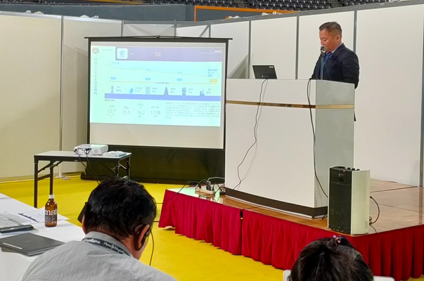
Sapporo and Ulaanbaatar: History of City-to-City Collaboration
Other Technical Exchange Activities
JICA Partnership Program
・ Sapporo City Fire Bureau: Ulaanbaatar City Firefighting Technical Support Project (FY2013 to FY2015)
・ Sapporo City University: Parenting Guidance for High-Risk Children with Congenital Hip Dislocation (January 2014 to March 2016)
・Sapporo City Waterworks Bureau: Water Transmission and Distribution System Improvement Project for Water Supply in Ulaanbaatar City (January 2016 to December 2018)
JICA Technical Cooperation
・ Sapporo City Urban Renewal & Development Bureau: Ulaanbaatar City Master Plan
Development and Implementation Capacity Building Project (2016 and 2017)
Major Visits to Sapporo from Ulaanbaatar City
2012: Mayor, Director of the Investment Bureau, and a Mongolian Tourism Delegation
2014: Director of the Strategic Policy and Planning Division, Mayor’s Office
2016: Director of the Strategic Policy and Planning Division of Ulaanbaatar City
2018: Director of the Administrative Management Division, Governor’s Office
2020: Ulaanbaatar City Administrative Delegation
2023: General Manager
部署名と肩書のご確認をお願いします。
Kankyo Hiroba Hokkaido 2023 Mongolia Seminar

Slide 10
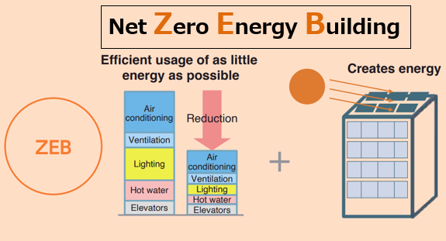
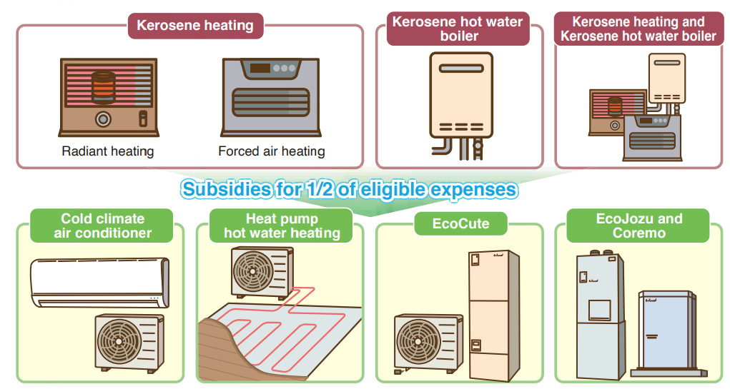
Sapporo and Ulaanbaatar: City-to-City Collaboration in Cold Regions
Expanding decarbonization initiatives tailored to Sapporo’s local characteristics in Ulaanbaatar
Local characteristics: cold, snowy climate
Promoting Net-Zero Energy Housing (ZEH) and Zero Energy Buildings (ZEB) to significantly reduce heating energy consumption
Promoting energy transition from kerosene heaters and hot water boilers
Observation tour
Constructing energy-efficient buildings and apartment buildings
Transition to energy-saving equipment using electricity or gas
Ulaanbaatar
Introducing the ZEB concept into buildings
Introducing high-efficiency heat supply systems
Promoting energy saving
and renewable energy
Energy transition
Model projects for facilities, apartment buildings, hospitals, factories, etc. (utilizing JCM)

Slide 11
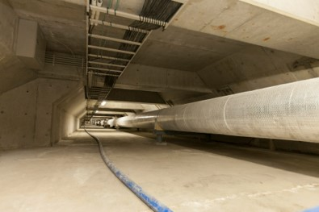
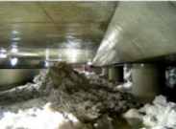
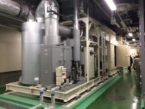
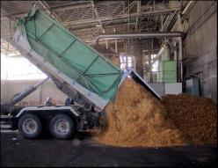
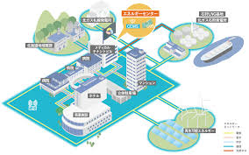
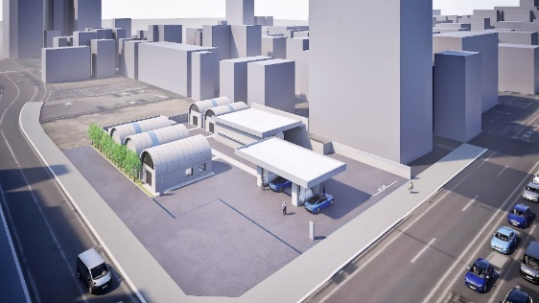
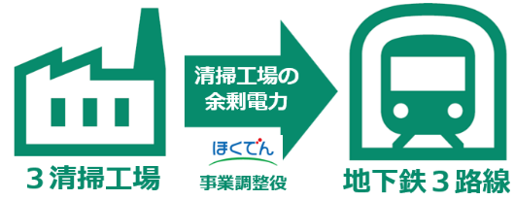
Sapporo and Ulaanbaatar: City-to-City Collaboration in Cold Regions
Sharing knowledge on advanced initiatives tailored to Sapporo’s local characteristics with Ulaanbaatar
熱導管の整備
雪氷熱の利用
Local characteristics: concentration of population and urban functions
Observation tour
Observation tour
Utilizing surplus electricity from waste incineration plants
Expanding and upgrading district heat supply systems
Hydrogen model
city district
Low-carbon
smart city
コージェネレーションシステム
木質バイオマス利用
Surplus electricity
Installation of
heat conduits
Utilization of snow and ice heat
Three waste incineration plants
Hokkaido Electric Power Co. project coordinator
Three subway lines
Stationary hydrogen stations
Shin Sapporo Energy Center
Cogeneration system
Utilization of woody biomass
Supplying surplus electricity from waste incineration heat to the subway system
Developing heat supply systems in central Sapporo
Ulaanbaatar
Utilization of resources and waste
Creation of a low-carbon city
Maximum utilization of natural energy sources for local production and local consumption
Energy transition
Enhancement of the resilience of urban functions

Slide 12
下記の理解で翻訳しております。
COP3 「京都議定書] （１９９５）→
（１９９７）
「世界中で低酸素の流れが加速」→「世界中で低炭素の流れが加速」
「地球熱供給」→「地域熱供給」
Sapporo and Ulaanbaatar: City-to-City Collaboration in Cold Regions
Sharing Sapporo’s experience of using the 1972 Winter Olympics as an opportunity to transition from a coal-dependent society with Ulaanbaatar, which is promoting air pollution countermeasures
Joining the ranks of international cities following the Olympics
COP22 Adoption of the rules of procedure (2016)
City planning
Addressing urban issues caused by urban expansion and population growth
Adapting to internationalization and the information age
Creating attractive urban spaces
Addressing societal changes such as population decline and the globalization of environmental issues
Future
Post-war reconstruction
Present
Arrival of a time to transform the city by improving quality in both tangible and intangible aspects
Infrastructure development to address rapid urban expansion
Planned control of urban expansion
Creating a compact city through the integration of functions
Developing a distinctive city to respond to intensifying inter-city competition
Sapporo Olympics (1972)
Great Hanshin Earthquake (1995)
COP3 Kyoto Protocol (1997)
Green Capital Sapporo Declaration (2008)
Great East Japan Earthquake (2011)
COP21 Paris Agreement (2015)
COP22 Adoption of the rules of procedure (2016)
Sapporo Winter Olympics and Paralympics (2026)
World-class decarbonization (Target: 2050)
Renewable Energy Feed-in Tariff System (2012)
Hokkaido Shinkansen extension (End of FY2030)
*Bidding in progress
DNA of Innovation
Toward GHG emission reductions
Accelerating global momentum for decarbonization
Addressing air pollution through district heating
Expanding the use of renewable energy
Smog
Coal
Energy Center (EC)
Energy-saving measures for buildings
Energy
Period of high economic growth
Networking of high-temperature
water systems
Transitioning approximately half of the high-temperature water fuel to woody biomass
Utilizing low-carbon energy sources
Peak of the coal industry
Cities with
few natural disasters
Increasing awareness of safety and security
Reaffirming the importance of continuity in business and daily life
Further strengthening
disaster response capabilities
Promoting the use of decentralized, self-reliant energy systems
A city with a pleasant climate and rich natural environment
Environmental changes in city centers
Growing preference for quality-focused lifestyles and workstyles
The wave of office automation (OA)
Rising temperatures in city centers
Energy utilization that supports pedestrian-friendly and comfortable urban spaces
Progression of the heat island effect
Increased adoption of district cooling systems and air conditioning
The DNA of Innovation stemming from the Olympics
Continuing
Air pollution was once a serious problem.
The introduction of district heating in time for the Winter Olympics improved the urban environment.
Energy linking people and cities
Connecting
Energy centers have been developed in tandem with urban hub development projects.
A heat conduit network has been established alongside underground walkway spaces.
Passing on to the next generation
Moving forward

Slide 13
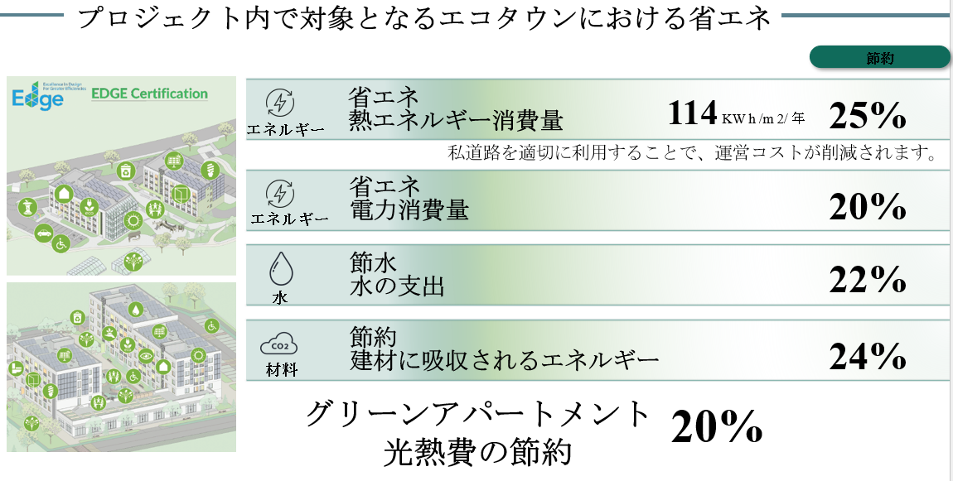
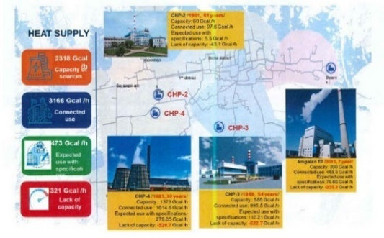
Sapporo and Ulaanbaatar: City-to-City Collaboration in Cold Regions
Developing model projects utilizing JCM to contribute to future large-scale plans
Small-scale model projects (utilizing JCM)
Contribution to Ulaanbaatar’s Large-Scale Plans
Introducing the ZEB concept into buildings
・Feasibility study for introduction in the planned new city hall building and apartment buildings
・ Optimization study for indoor environments
・ Proposal for rooftop solar power generation (private factories, hospitals)
・ Feasibility study for the introduction of geothermal heat pumps (demonstration project)
Green Development Plan Project
Energy saving in an eco-town covered by the project
Transition to low-carbon housing and facilities
Saving
Energy
Energy saving
Heat energy consumption: 114 kWh/m²/year
Proper utilization of private roads reduces operating costs
Energy
Energy saving
Electricity consumption
Water
Water conservation
Water expenses
Materials
Resource conservation
Energy absorbed in construction materials
Green apartments
Reduction in utility costs
Energy transition for heat supply systems
District Heating Improvement Project
Introduction of high-efficiency boilers
・Proposal of LPG boilers for factories
Maximum utilization of natural energy sources
・Feasibility study on ice shelters, biogas, and other natural energy sources proven effective in cold regions like Sapporo and Hokkaido
Utilization of resources and waste

Slide 14
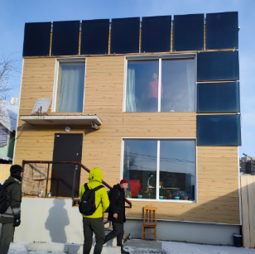
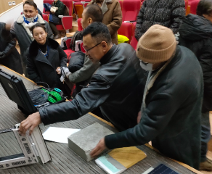
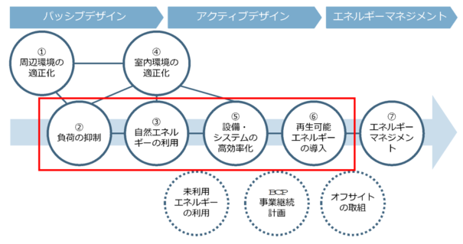
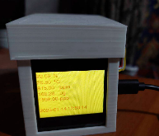
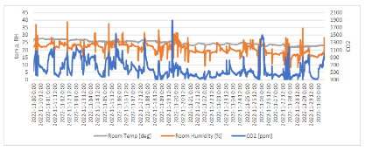
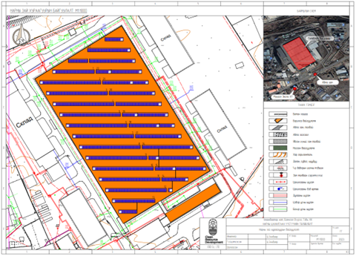
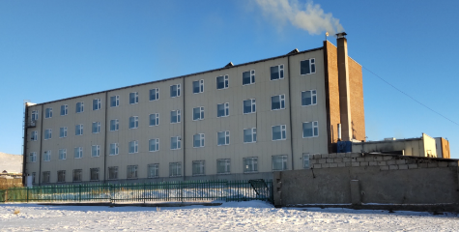
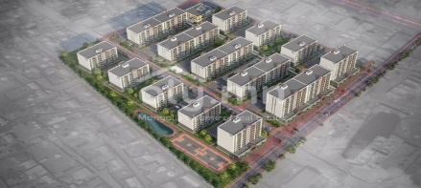
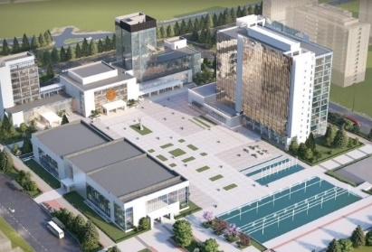


Sapporo and Ulaanbaatar: City-to-City Collaboration in Cold Regions
Initiatives for transition to low-carbon housing and facilities
Process for introducing the ZEB concept
Passive design
Active design
Energy management
Lecture on and visit to a passive house (December 2022)
Optimization of surrounding environments
Optimization of indoor environments
Utilization of natural energy
Improvement of the efficiency of equipment and systems
Introduction of renewable energy
Energy management
Load reduction
Indoor environment measurement survey (October 2022–January 2023)
Utilization of unused energy
Business Continuity Planning (BCP)
Off-site initiatives
Proposal for rooftop solar power generation for private factories and hospitals (from August 2024)
Geothermal heat pump demonstration project for schools (from December 2022)
Case study on low-carbon model buildings for the planned new city hall building and apartment buildings (October 2021–December 2022)

Slide 15
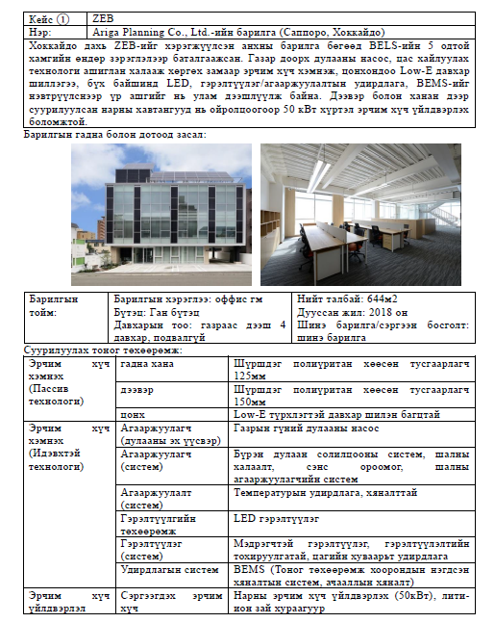
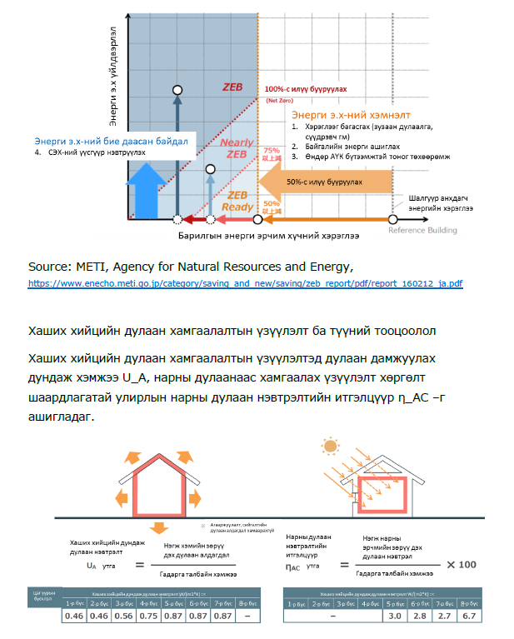
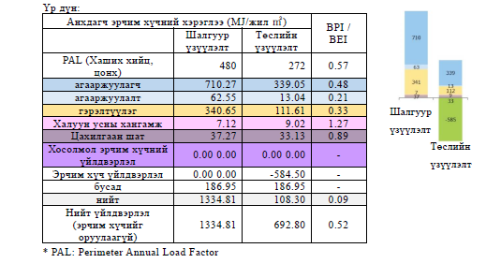
Sapporo and Ulaanbaatar: City-to-City Collaboration in Cold Regions
Dissemination of the ZEB Concept
Overview of energy-saving performance calculations in Japan
Examples of Japan’s cold-climate technologies

Slide 16
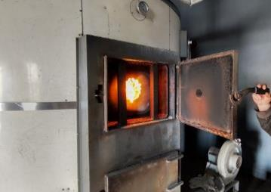
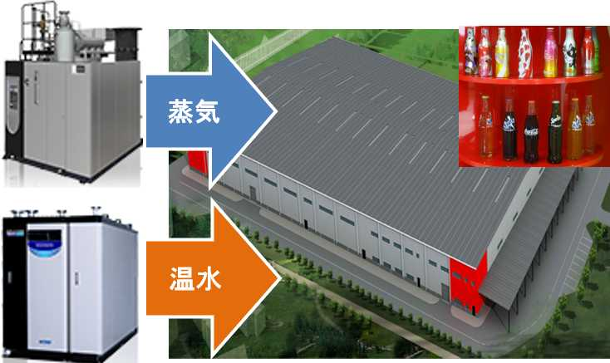
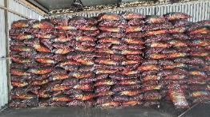
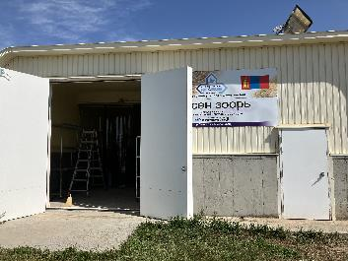
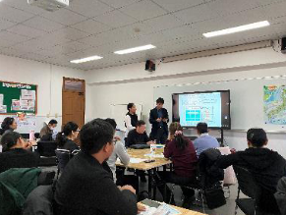
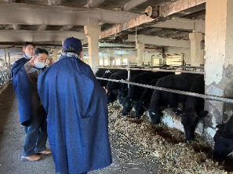
Sapporo and Ulaanbaatar: City-to-City Collaboration in Cold Regions
Initiatives for energy transition for heat supply systems
Introduction of high-efficiency boilers
Steam
Hot water
An existing coal-fired boiler
(food factory for convenience stores)
Heavy use of coal
Proposal based on JCM achievements involving the introduction of an LPG boiler in a beverage factory
Initiatives for resource and waste utilization
Maximum utilization of natural energy sources
Study on biogas equipment using manure from cow sheds
(dairy company)
On-site investigation by the Mongolian University of Science and Technology and Japanese companies (October 2024)
Ice shelter for trial introduction in Mongolia
Seminar and observation tour (October 2024)

Slide 17
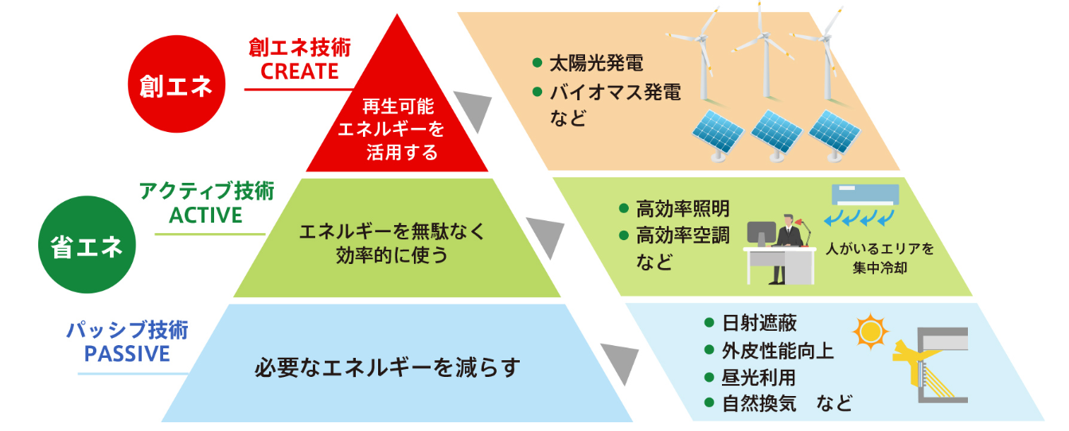
Sapporo and Ulaanbaatar: City-to-City Collaboration in Cold Regions
The City-to-City Collaboration Program, which builds on the relationship developed through the WWCAM and was officially launched during the COVID-19 pandemic, aims to contribute to Ulaanbaatar’s carbon neutrality through technical and human resource cooperation as well as knowledge sharing.
Sapporo’s knowledge and experience
City-to-City
Collaboration Program
Contribution to Ulaanbaatar
Energy creation
Energy creation technologies
Utilizing renewable energy
Energy transition for
heat supply systems
Improvement of district heating (LPG)
Energy saving
Active design technologies
Utilizing energy efficiently without wasting it
Utilization of resources and waste
Solid fuel production
from resources
Passive design technologies
Reducing the need for energy
Transition to low-carbon housing and facilities
Green Development Plan (energy saving)
Technical cooperation
・ Promotion of ZEB initiatives (rooftop solar power generation)
・Waste-to-fuel conversion
・High-efficiency heat supply (LPG boilers)
・Utilization of JCM Projects (private sector)
・Utilization of JICA, ADB, Green Climate Fund (GCF), etc.
Human resource development
・ Cooperation in capacity building for construction and heat supply-related personnel
・Utilization of the JICA Partnership Program
Knowledge sharing
・ Site visits for decarbonization technologies
・ Sharing knowledge on policy initiatives
・ Collaboration on initiatives for achieving carbon neutrality
https://www.env.go.jp/earth/zeb/detail/06.html

Slide 18


Oriental Consultants Co., Ltd.
Маш их баярлалаа
Хамтран ажиллана уу

