Slide 1
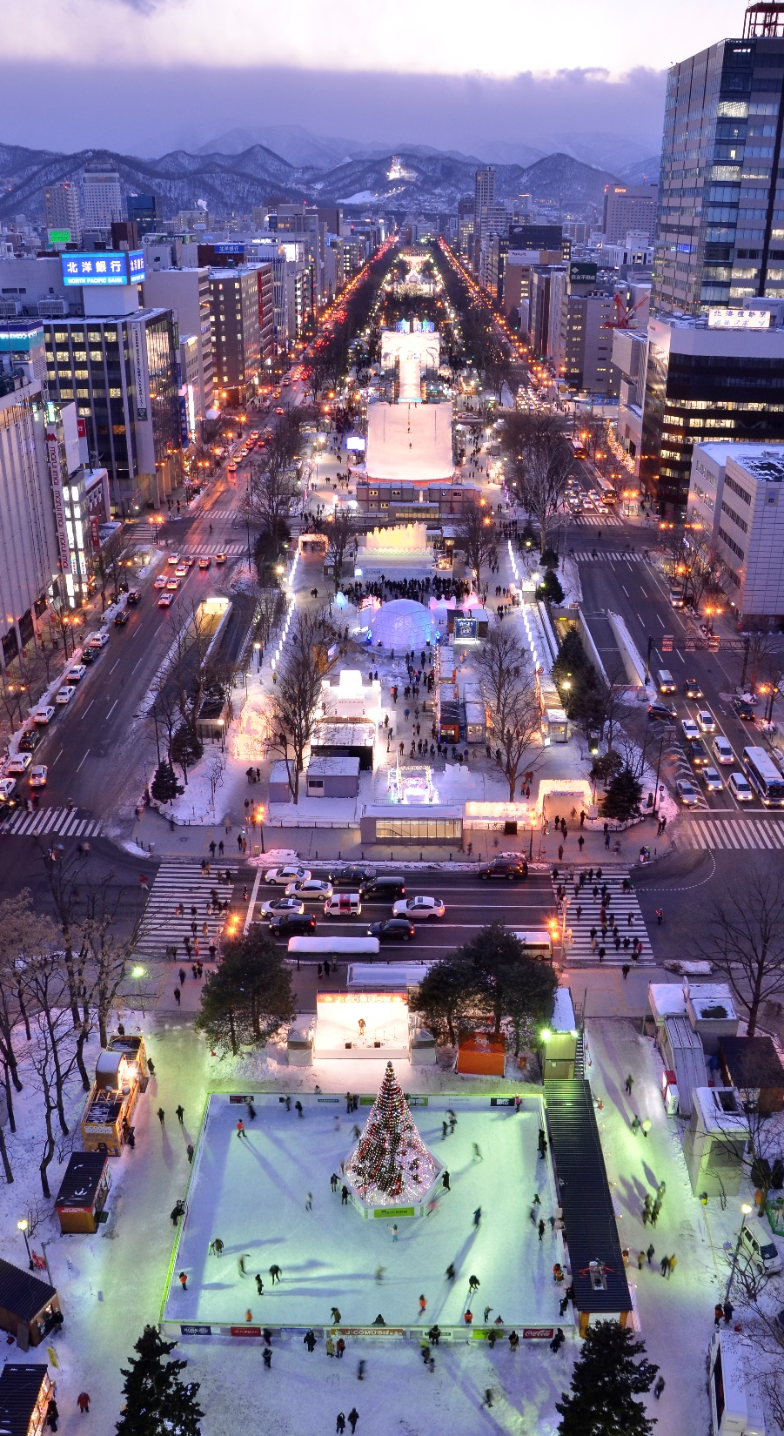
20th World Winter Cities Conference for Mayors
Group session: Environmental Policies for Winter Cities
Decarbonization initiatives for
Sapporo’s future
Dec. 17th, 2024
Mayor of Sapporo, AKIMOTO Katsuhiro

Slide 2
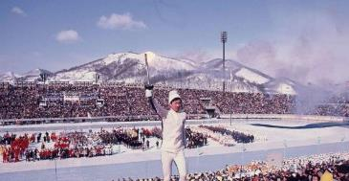
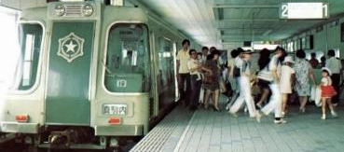
History of Sapporo City and the Progression of Environmental Issues
City center in the late 1950s
(Sapporo City Archives)
・1950s～1970s
Due to the use of coal and oil, and the rapid increase in number of automobiles
pollution becomes more severe.
1922
・Sapporo established as a city
・1960s～1980s
Due to regulations by law/ordinance
and the development of new
infrastructure such as district heating
and subways
there is a dramatic
improvement in air quality.
1950s
1971: district heating begins in the city center
・Population surpasses 500,000
Development of city infrastructure accelerates
1970s
・Population surpasses a million
・Sapporo Olympics are held
・Sapporo becomes an
ordinance-designated city
1972: Sapporo Olympics are held
1971: Nanboku Subway Line opens

Slide 3
Amount of dust fall by fiscal year
History of Sapporo City and the Progression of Environmental Issues
Sulphur dioxide concentration by fiscal year
（環境基準）
Environmental standard
Winter (October – March) value,
central part of Sapporo City
Annual average value,
central part of Sapporo City

Slide 4
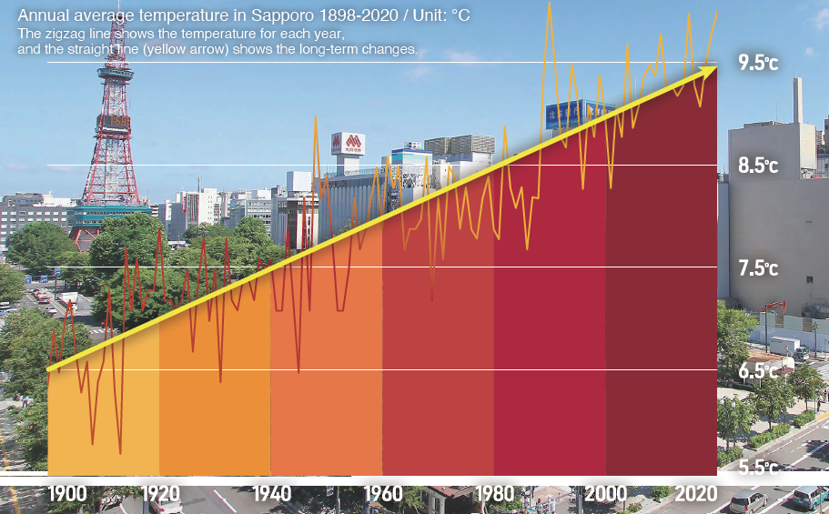
History of Sapporo City and the Progression of Environmental Issues
Sapporo’s annual average temperature has been increasing at a rate of about 2.5℃ per 100 years.
・1990s
Through global warming and the loss of biodiversity
environmental problems become apparent
1990s
・Population surpasses 1.8 million
2000s
・Population surpasses
1.9 million
・2008
With the aim of becoming a world-class
environmental city, ‘Green Capital, Sapporo’ is declared.
・2020
The ambition to be a ‘Zero carbon city’ is declared.
・2023
On the occasion of the G7 summit, the Hokkaido/Sapporo Declaration is announced to pave the way for a decarbonized future through local energy production for local consumption, and contributions to economic revitalization.
2020s
・ 100-year anniversary of city
establishment
・ G7 Ministers’ Meeting on Climate, Energy
and Environment is held in Sapporo
City renewal acceleration

Slide 5
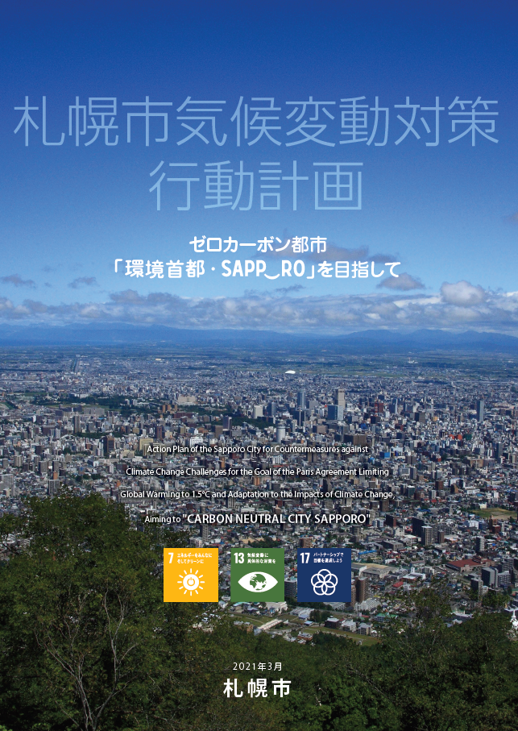
Sapporo City’s objective to reduce Greenhouse Gas emissions
With the intention of becoming a zero-carbon city by 2050, Sapporo aims to have reduced emissions by 55% by 2030 (in comparison to 2016 levels).
Sapporo city’s Climate Action Plan (March 2021) was created based on the scientific findings of the IPCC in keeping with the ‘1.5℃ target’ of the Paris agreement.
Aims to meet this target through initiatives capitalizing on the special characteristics
of the region.
55％ reduction from 2016
537
Target
Net Zero

Slide 6
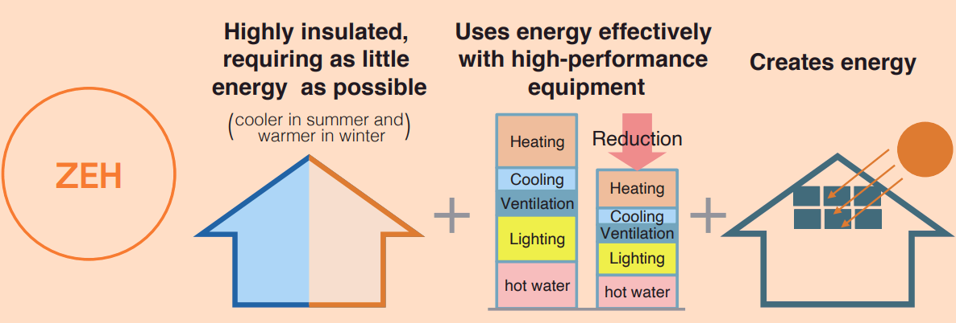
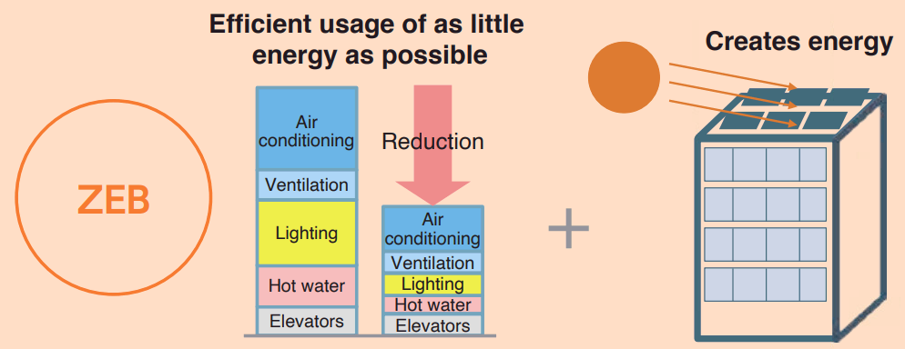
Decarbonizing initiatives utilizing Sapporo’s special regional characteristics (snowy, cold winter climate)
Promotion of ZEHs and ZEBs in order to substantially reduce heating energy consumption
Establishment of ‘Sapporo’s Next Generation Housing Standards’, with certification and subsidy programs for well-insulated and airtight houses.
Providing support for the additional design costs required for the construction of ZEB and ZEH-M (apartment) high energy-saving buildings and condominiums.
Net Zero Energy House
Net Zero Energy Building

Slide 7
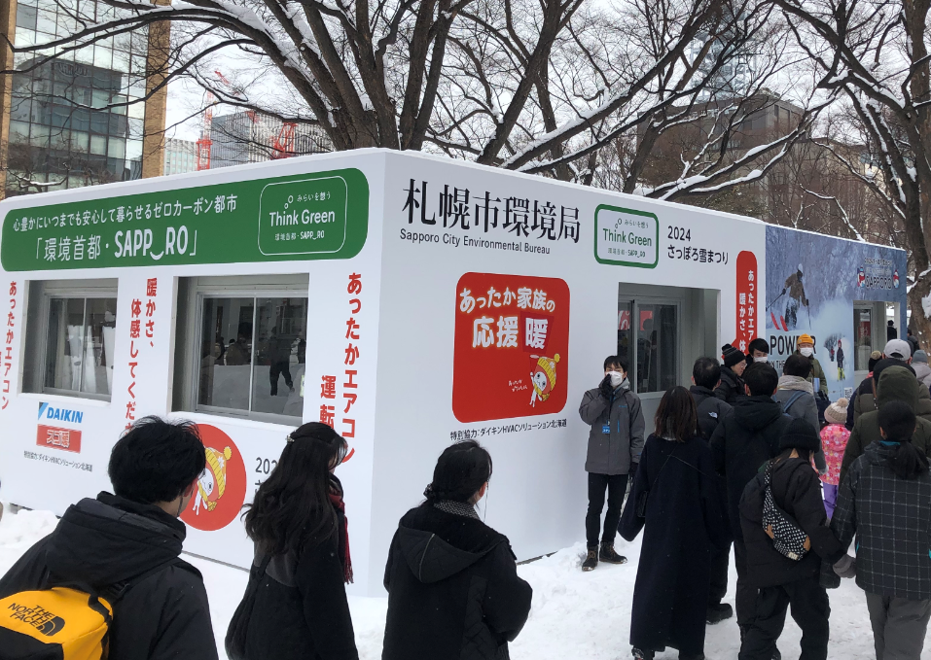
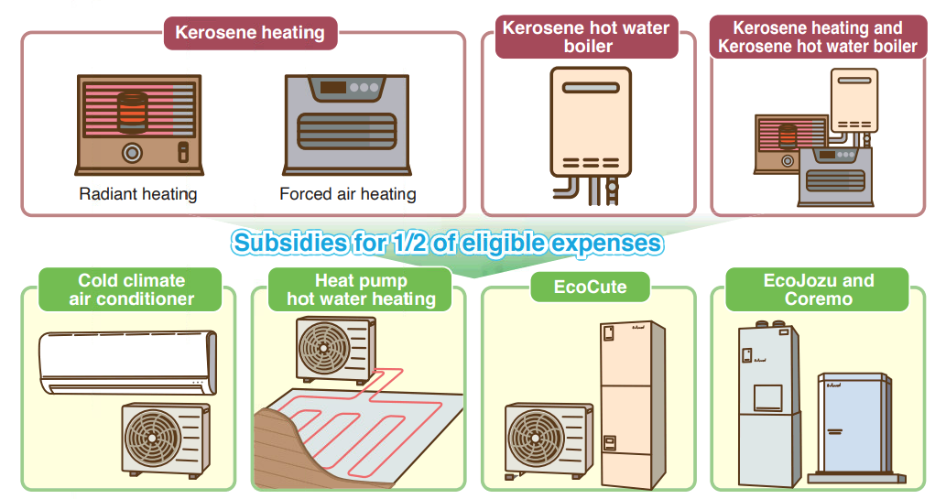
Decarbonizing initiatives utilizing Sapporo’s special regional characteristics (snowy, cold winter climate)
Promoting energy source transitions from kerosene-based heaters and boilers
In order to encourage people within the city to transition from widely-used kerosene-based heaters and boilers to electric or gas-based ones, which produce fewer CO2 emissions, we provide subsidies and collaborate with businesses to raise awareness.
PR Booth at the 74th Sapporo Snow Festival

Slide 8
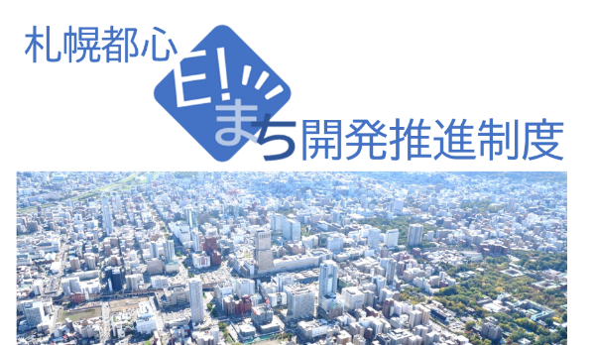
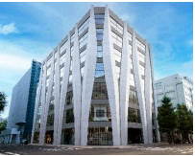
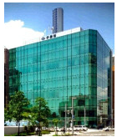
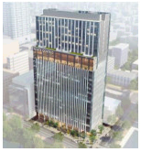
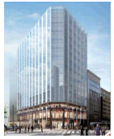
Decarbonizing initiatives utilizing Sapporo’s special characteristics (city renewal)
Using the opportunity of city renewal to make progress with decarbonization
In 2022, a discussion system between the government and businesses in Sapporo was set up to make efforts to prioritize ‘decarbonization’, ‘resilience’ and ‘comfort’ in the early planning stages of any new-builds and renovations in the city center.
If a company relocates its head office from outside of Hokkaido to a ‘Zero Carbon Building’ which meets the criteria and has been certified as such, they are eligible for preferential treatment, including for example having two years’ rent 100% subsidized.
ゼロカーボン推進ビル（2024年1１月時点 ４件認定）
Zero Carbon Building (four buildings certified as of November 2024)

Slide 9
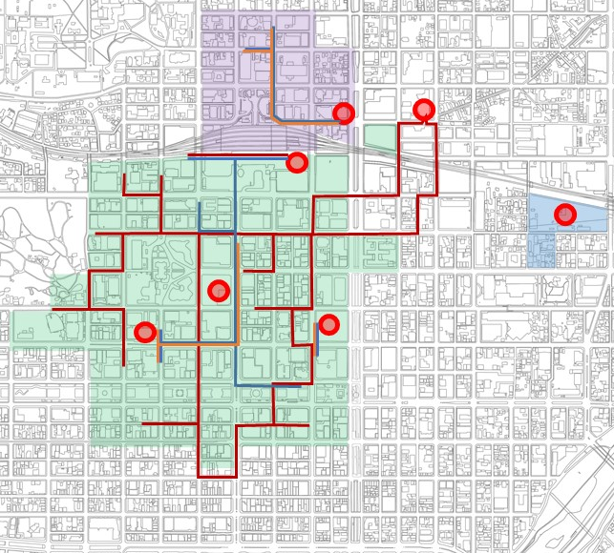
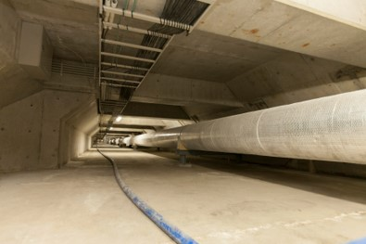
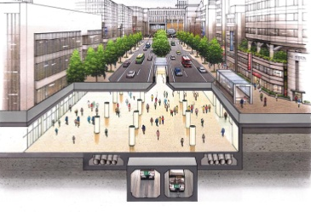
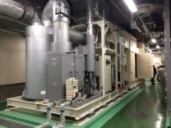
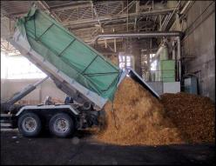
Decarbonizing initiatives utilizing Sapporo’s special characteristics (city renewal)
Using the opportunity of city renewal to maintain and expand district heating
Using the opportunity of large-scale city redevelopments to carry out the simultaneous development of district heating plants.
Taking the opportunity of city renewal projects to expand the network of heating conduits.
Through district heating in the city center, we can actively utilize untapped and renewable energy sources.
Alongside large-scale redevelopments, plans are in place to develop new energy centers
Kita 5 Nishi 1-2 zone
Usage guide
Energy centers in operation
Development of heat conduits in underground walkway spaces
Planned energy centers
Zones with local redevelopment ventures underway
Odori Nishi 4 Minami zone
Existing mainline hot water conduits
Planned mainline hot water network expansion
Existing mainline cold water conduits
Planned mainline cold water network expansion
Cogeneration system
Wood biomass utilization
Status of district heating in Sapporo city center

Slide 10
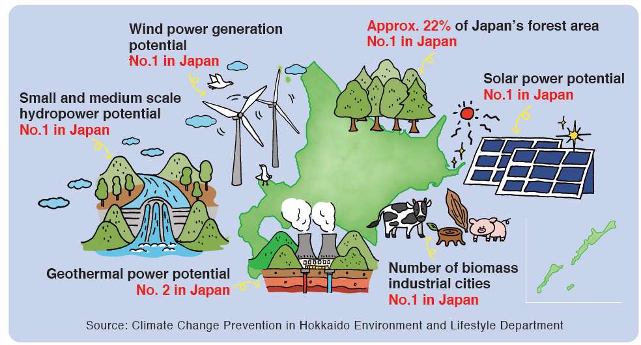
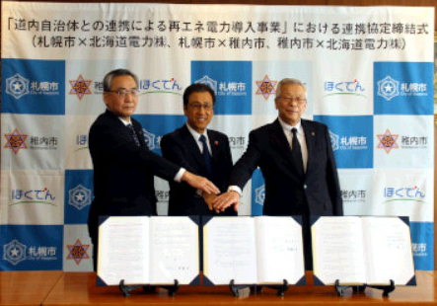
Decarbonizing initiatives utilizing Sapporo’s special characteristics (population, infrastructure)
Expansion of Renewable Energy Use Through Collaboration in Hokkaido
While it is difficult for Sapporo, a large city with dense urban infrastructure, to meet all of its electricity needs from renewable energy produced internally, Hokkaido has the greatest potential for renewable energy in the entire country.
In order to promote the utilization of renewable energy in cooperation with those regions of Hokkaido with high renewable energy potential, we are working on a system to supply surplus electricity from those regions to customers in Sapporo.
Partnership Agreement Signing Ceremony

Slide 11
Decarbonizing initiatives utilizing Sapporo’s special characteristics (population, infrastructure)
Using excess electrical power from waste incineration plants to supply the city-managed subways
Since April 2024, surplus electricity produced from the heat emitted when burning of refuge at three waste incineration plants has been supplied to the three city-managed subway lines, according them a non-fossil fuel certificate known as ‘environmental value’.
Approximately 70% of the electricity consumed is carbon zero, and ‘local production for local consumption’ also results in a significant reduction in CO2 emissions (CO₂ reduction: around 45,000 tons/year).
⇒It is planned to reach 100% zero carbon in April 2025.
(With new waste incineration plants, power generation capacity will be tripled.
First ‘local energy production for local consumption’ subway initiative in Japan.
Waste incineration plants give surplus electrical energy and ‘environmental value’
3 waste incineration plants
3 subway lines
Business coordinator

Slide 12
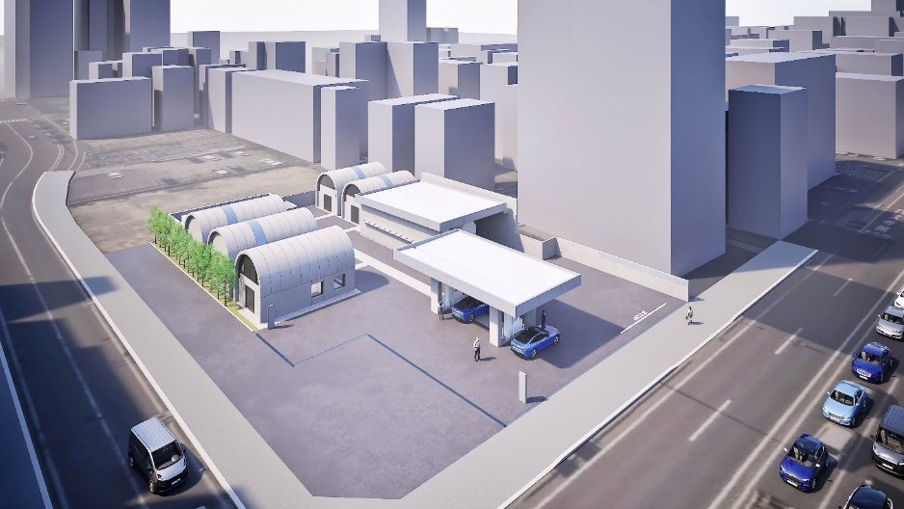
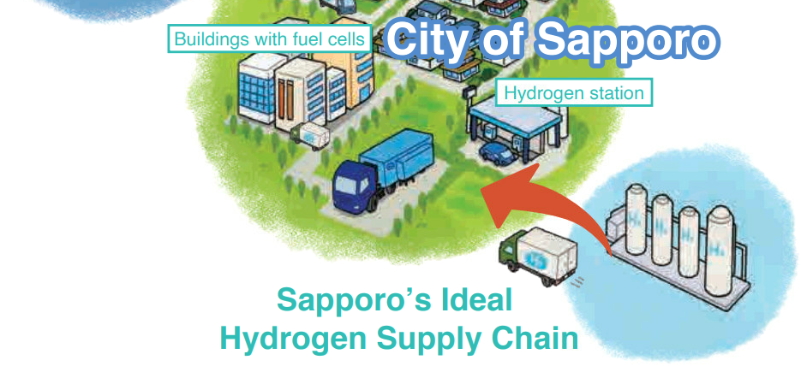
Decarbonizing initiatives utilizing Sapporo’s special characteristics (population, infrastructure)
Model area for hydrogen utilization
In anticipation of a hydrogen-based society, a stationary hydrogen station capable of supporting large vehicles is being prepared.
In addition, we plan to develop hospitality facilities which integrate initiatives such as pure hydrogen fuel cells and ZEB.
Research is being undertaken on the development of a supply system for hydrogen produced using renewable energy in order to meet growing hydrogen demands in Sapporo city.
(Image shown is for illustration purposes only and may not be an exact representation)
Water
Electric power from renewable energy
H
Hydrogen
H
O
H
H
H
H
H
O
O
O
Oxygen
H

Slide 13
Decarbonization initiatives for the future of Sapporo
‘Green Capital Sapporo’
Passing on the rich environment to the next generation and communicating the attractiveness of Sapporo
Pride in being the ‘green capital’ thanks to a culture of affluent living
Strengthening the Sapporo brand by spreading the word about the attractiveness of Sapporo domestically and internationally
Daily Life
Society
Promoting economic circulation and industrial development in Hokkaido by using local resources and energy
Economy
The ripple effects of our initiatives can be felt on the economy, in society, and on daily life.

Slide 14
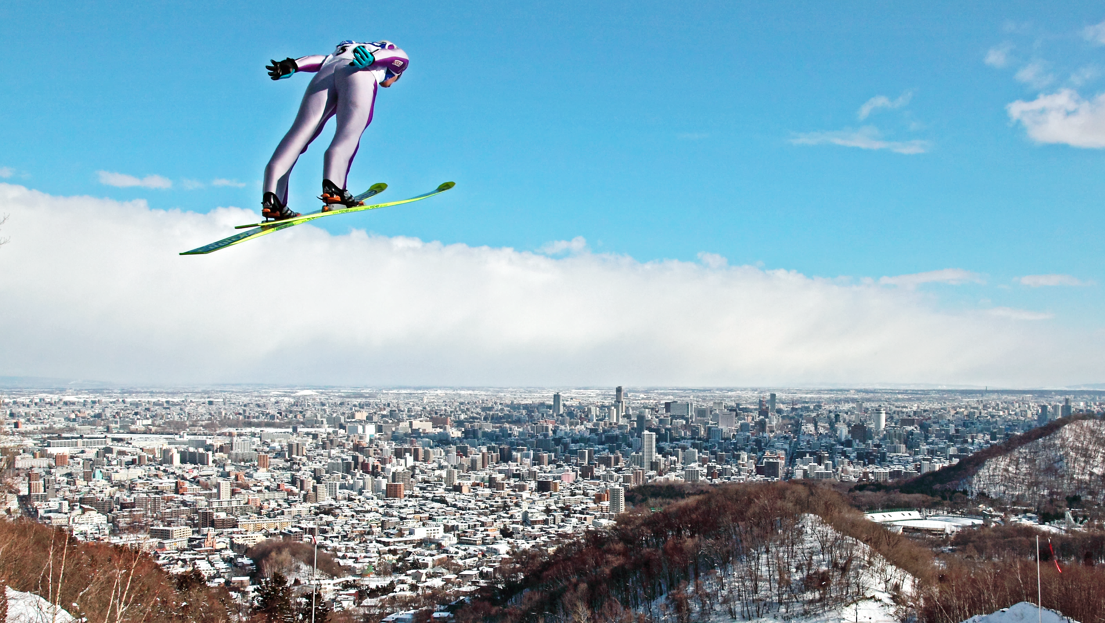
THANK YOU
THANK YOU
Notes:
○ご清聴ありがとうございました。

