Slide 1
Arctic Capital

Slide 3
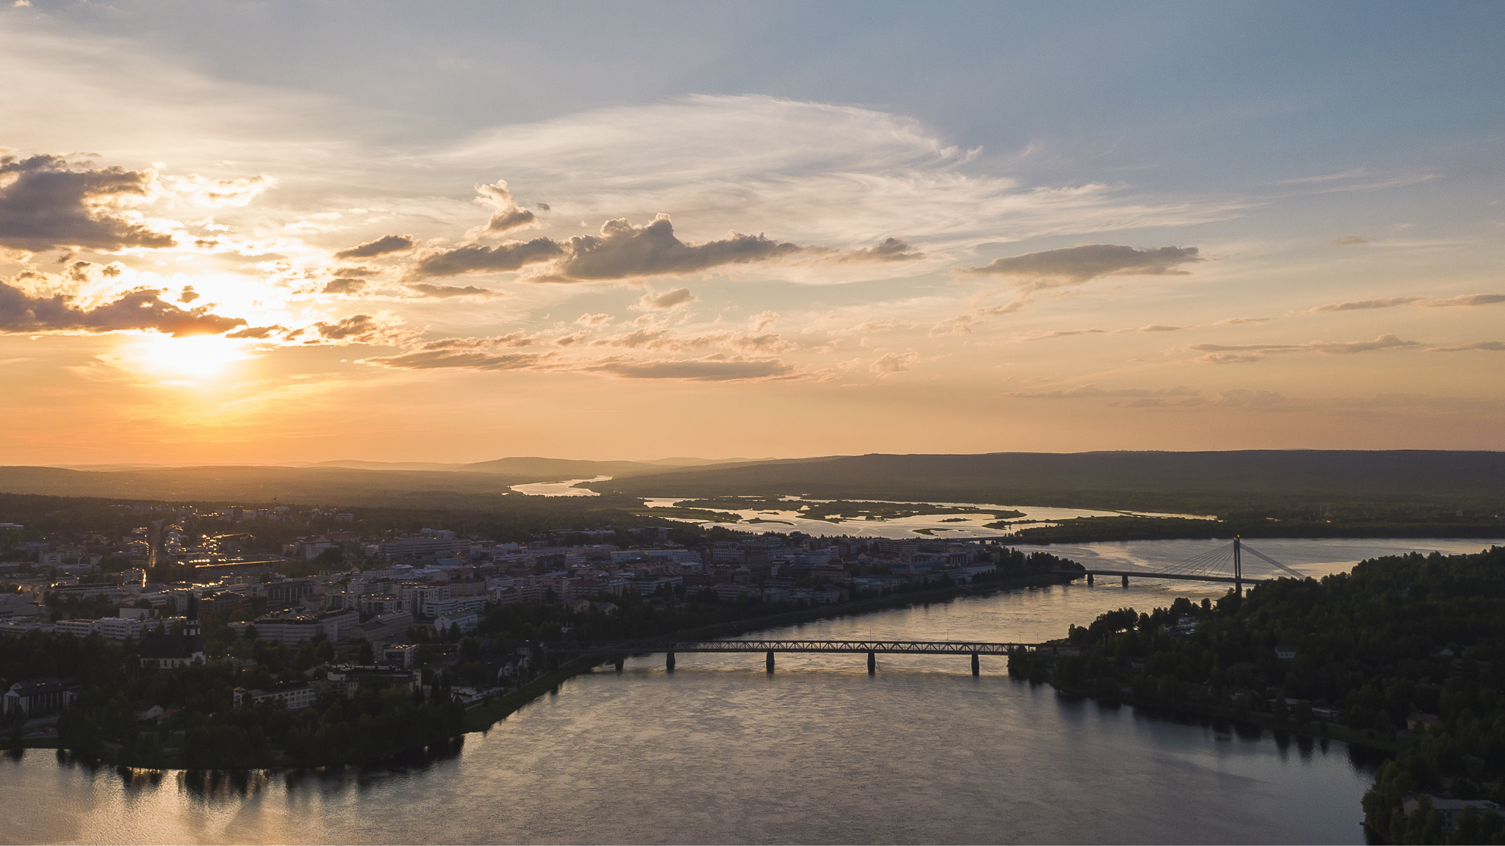

Slide 4
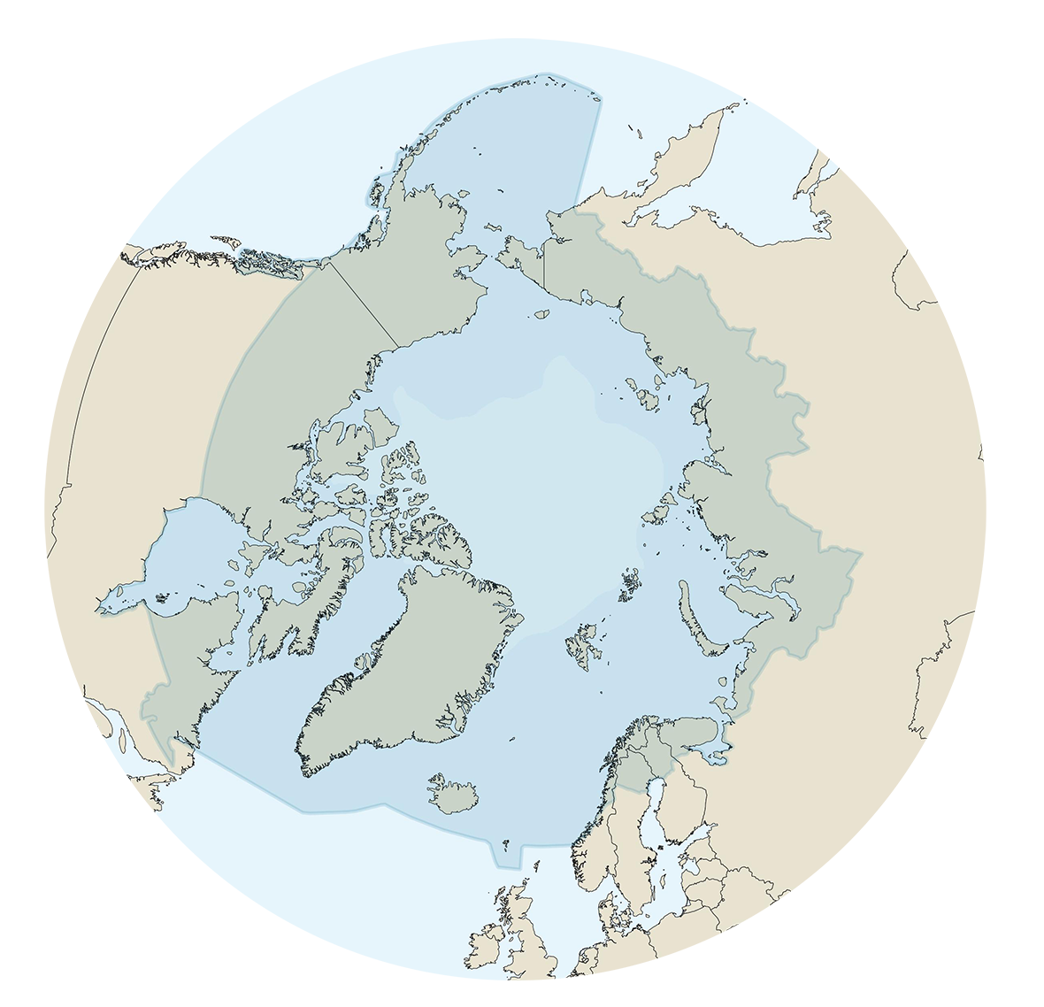
Rovaniemi Facts and Figures
Population in Rovaniemi about 65 000 and in Lapland about 178 000
4,1% of population with foreign background from 90 different countries
Located on the Arctic Circle
The largest city in Europe by area, covering over 8000 square kilometres

Slide 5
Rovaniemi Tourism Facts and Figures
More than 1,2 million overnights annually
70 % of visitors come from abroad
70 % of visitors come in winter time
Economical impact of tourism is around 590 million euros
Number of tourism related manpower years is around 4000

Slide 6
Rovaniemi Tourism Facts: Growth and Connectivity
Direct Flights
Starting from the winter season 2024-2025, Rovaniemi will offer direct flight connections to over 40 cities.
Tourism Demand
The total tourism demand in Rovaniemi was estimated to be approx. €590 million in 2023.
Overnight Stays
The total number of overnight stays in 2023 exceeded 1.2 million, marking a 29% increase compared to the previous year.
67% of these were registered stays.
33% were unregistered stays, such as those booked through Airbnb.
This growth highlights Rovaniemi’s increasing popularity as a travel destination, especially during the winter months.

Slide 7
International registered overnights in Rovaniemi, relative distribution by nationality 2023
Europe 71 %
Asia 19 %
Americas 6 %
Oseania 3 %

Slide 8
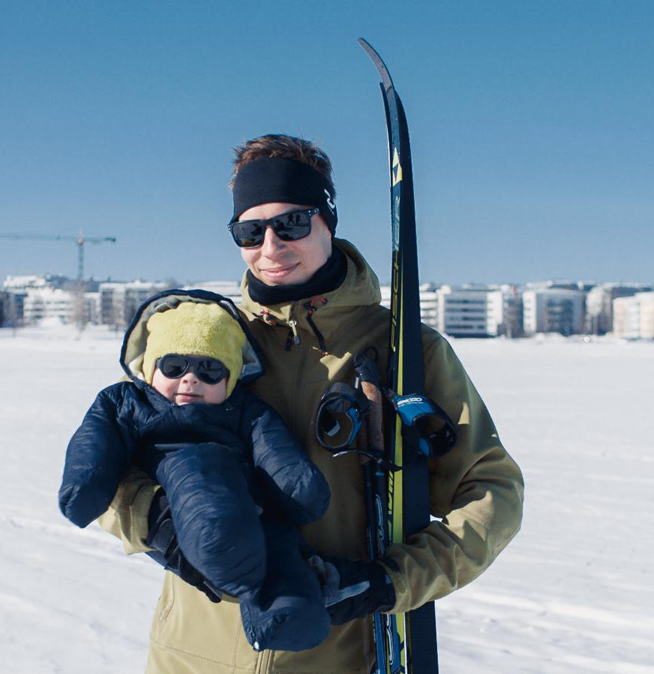
Cold winters
Kuva tai tekstiä tälle puolelle

Slide 9
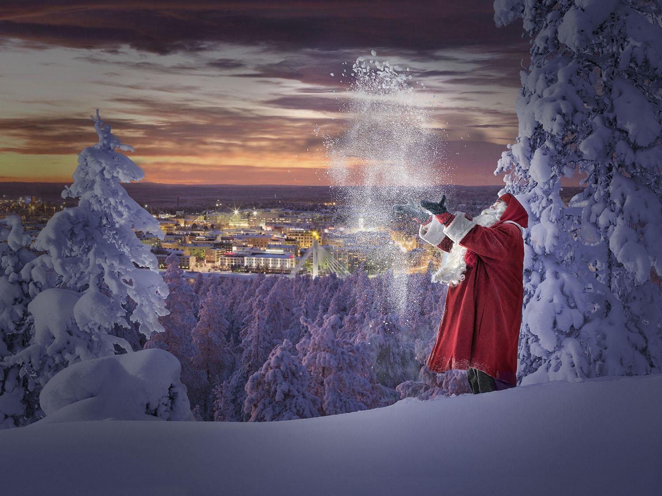
The Official Hometown of Santa Claus®
Kuva tai tekstiä tälle puolelle

Slide 10
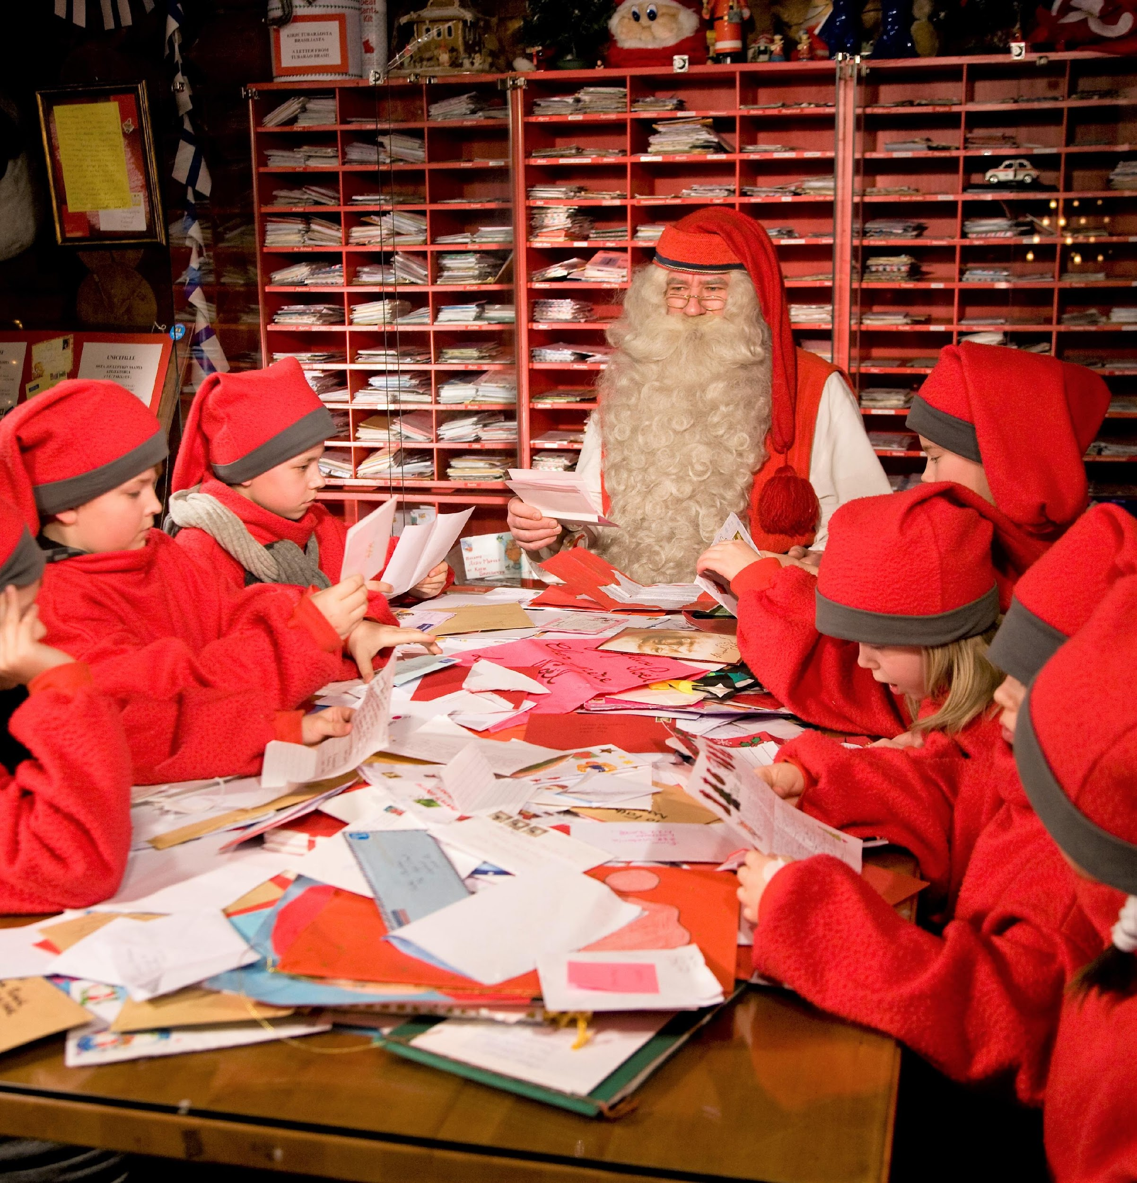
Christmas
season
Kuva tai tekstiä tälle puolelle

Slide 11
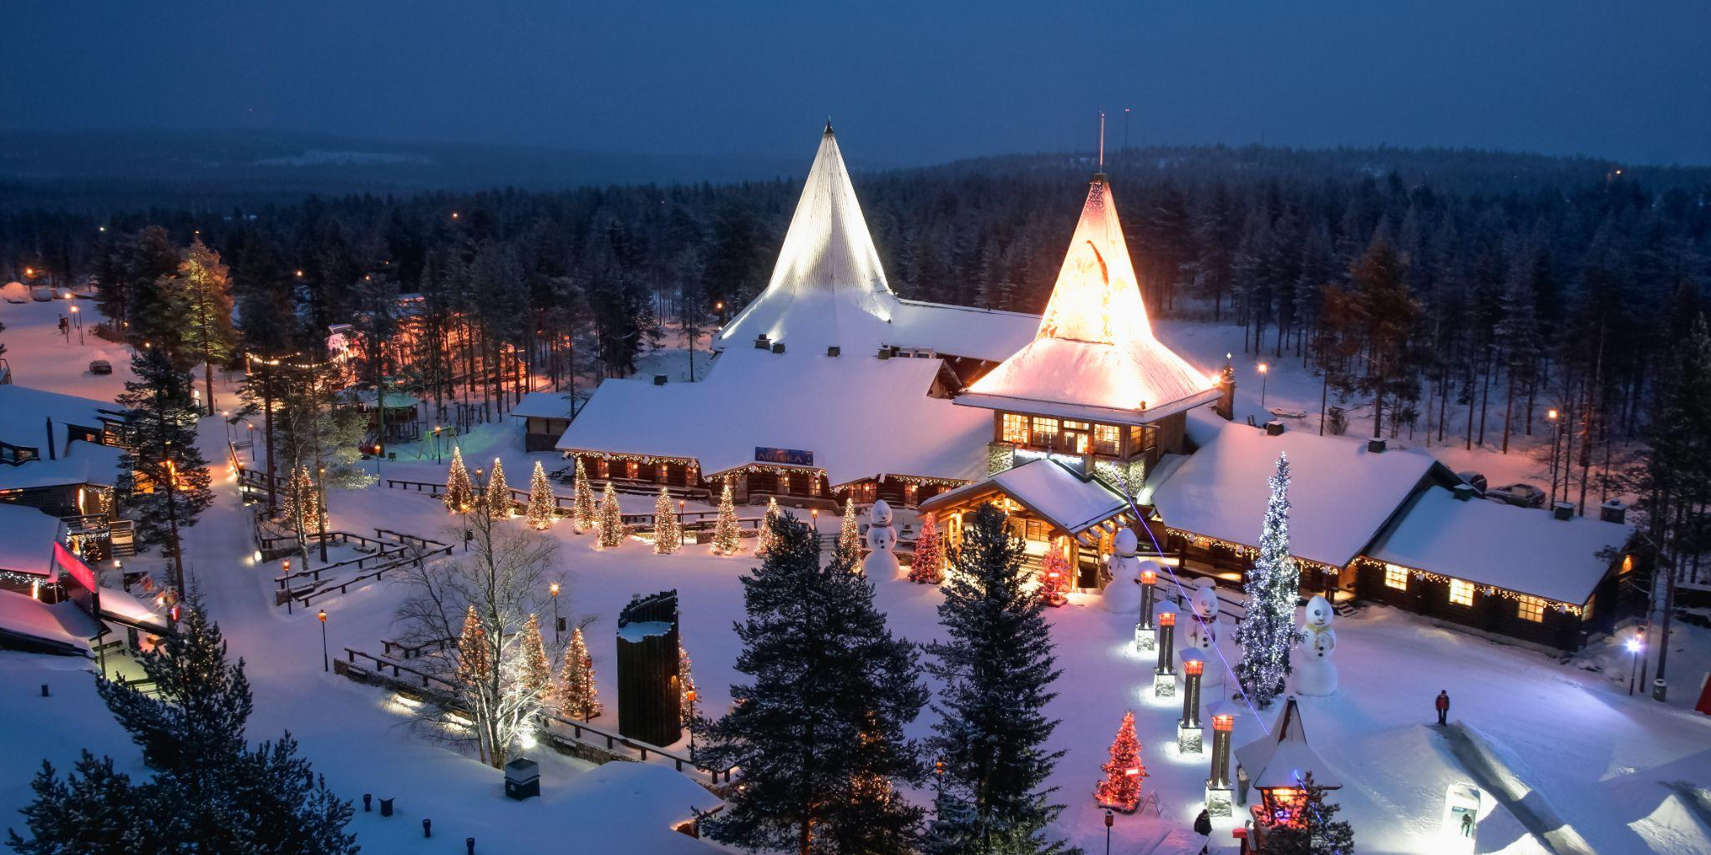

Slide 12
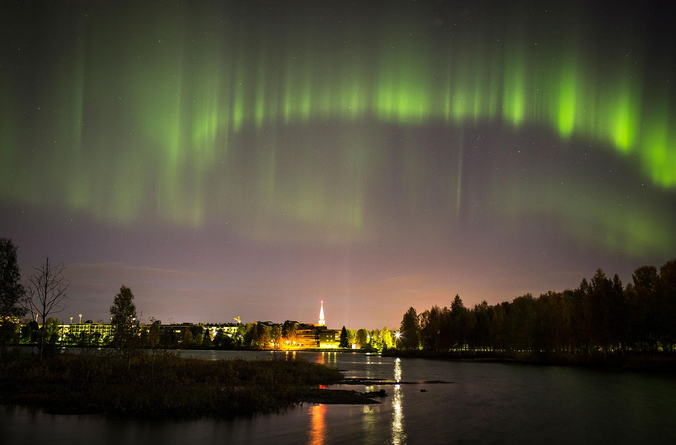
Magnificent
nature phenomena Northern Lights
Kuva tai tekstiä tälle puolelle

Slide 13
Year-round Tourism and Sustainability
A significant challenge related to sustainable tourism development is the notable differences between various tourist seasons.
Before the pandemic, 63 % of all tourism was concentrated in the winter season. In 2023, the share of the winter season was 70 %.
Achieving sustainable tourism needs year-round tourism.

Slide 14
Workforce Availability in the Tourism Sector
The availability of skilled workforce is critical for the renewal and growth of the tourism sector.
There is a shortage of skilled workers, especially in roles such as restaurant managers, fast food workers, tour guides, and hotel receptionists. At the same time, there are open positions in the industry.
Behind the mismatch problem is e.g. atypical employment relationships, wage level and location. Efforts are being made to address these challenges, including improving the match between job seekers and available positions, and enhancing training programs to equip workers with the necessary skills.
Labor shortage and employee orientation require a lot of work from the responsibility perspective. Year-round tourism is seen as one of the solutions to improve this - it brings permanent employment to local residents and enables tourism products based on local culture.

Slide 15
Sustainable Tourism in Rovaniemi
Rovaniemi is committed to sustainable tourism, ensuring that visitors can enjoy its natural beauty while minimizing their environmental impact.
Commitment to Sustainability
Visit Rovaniemi has been awarded the Sustainable Travel Finland (STF) label, which highlights their dedication to sustainable and responsible tourism. This includes providing guidance to local businesses and encouraging them to adopt sustainable practices.
Visitors are encouraged to make responsible choices, such as using local products, recycling, and respecting nature. Simple actions like switching off lights, picking up trash, and avoiding bottled water (as tap water is excellent in Finland) contribute significantly.
Eco-friendly Activities
Visitors can engage in various eco-friendly activities such as hiking in designated areas, midnight sun canoeing, Northern Lights tours and other nature-friendly tours designed to minimize environmental impact.
It is important to respect nature by staying on marked trails, picking up trash, and avoiding disturbance to wildlife.

Slide 16
Sustainable Tourism in Rovaniemi
Sustainable Accommodation
Visitors can choose from a variety of eco-friendly accommodations including hotels, resorts, and chalets that prioritize reducing their environmental footprint.
Support Local Businesses
Choosing local, responsible businesses helps support the local economy and reduces the environmental impact of tourism. Many local companies participate in the STF program and offer responsible tours and services.
Cultural and Environmental Respect
Understanding and respecting local customs and traditions is a key part of sustainable tourism. Visitors can learn about the local way of life through cultural centers and traditional activities like sauna experiences.
It is important to stick to public hiking areas and respect private properties to preserve the natural environment.
By choosing sustainable options, visitors can help preserve Rovaniemi’s unique Arctic ecosystem for future generations.

Slide 17
Rovaniemi as a Summer Destination
Rovaniemi is a fantastic summer destination with a unique blend of natural beauty, cultural experiences and outdoor activities. Here are some highlights:
Activities and Attractions
Experience the magical Midnight Sun, where the sun doesn’t set for several weeks. This phenomenon allows for activities like hiking, canoeing, and even golfing at any hour.
Enjoy outdoor adventures like river cruises, swimming, horseback riding and hiking.
Visit reindeer and husky farms to learn about traditional Lappish lifestyles.
Cultural Experiences
Meet Santa Claus at Santa Claus Village any day of the year and cross the Arctic Circle.
Participate in summer events and the Midsummer Eve celebration.
Try traditional Lappish food in local restaurants or by a campfire.
Nature and Scenery
Explore the beautiful landscapes of nearby natural reserves.
Engage in wildlife watching and safaris.

Slide 18
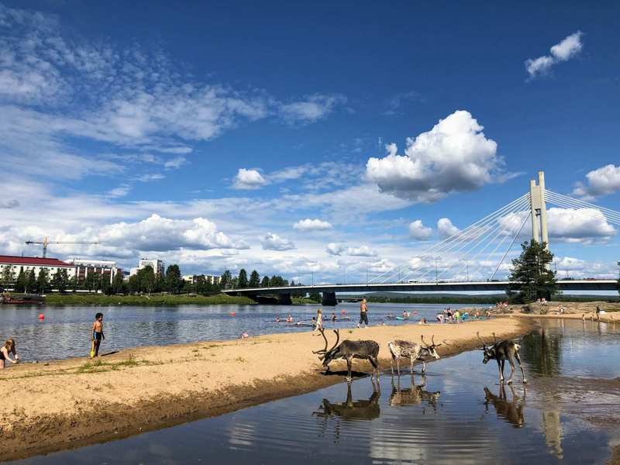
Warm
summers
Kuva tai tekstiä tälle puolelle

Slide 19
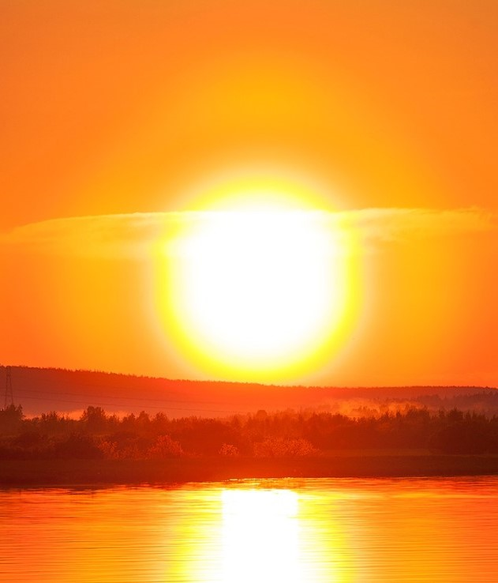
Midnight sun
Kuva tai tekstiä tälle puolelle

Slide 20
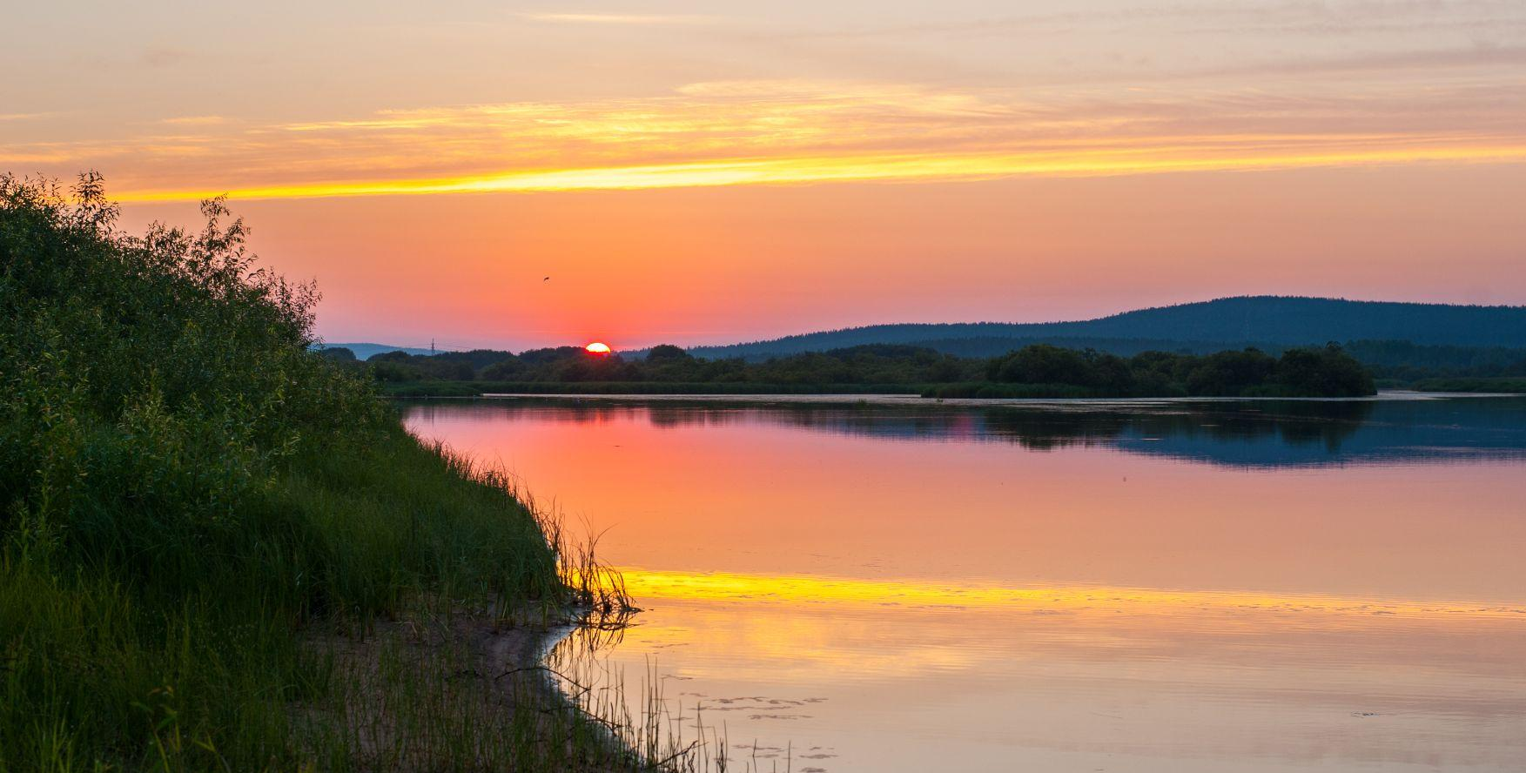

Slide 21
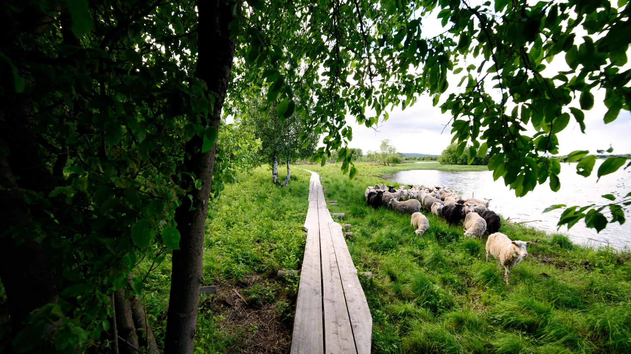
tähän aurinkoinen kesäkuva esim. pitkospuut

Slide 22
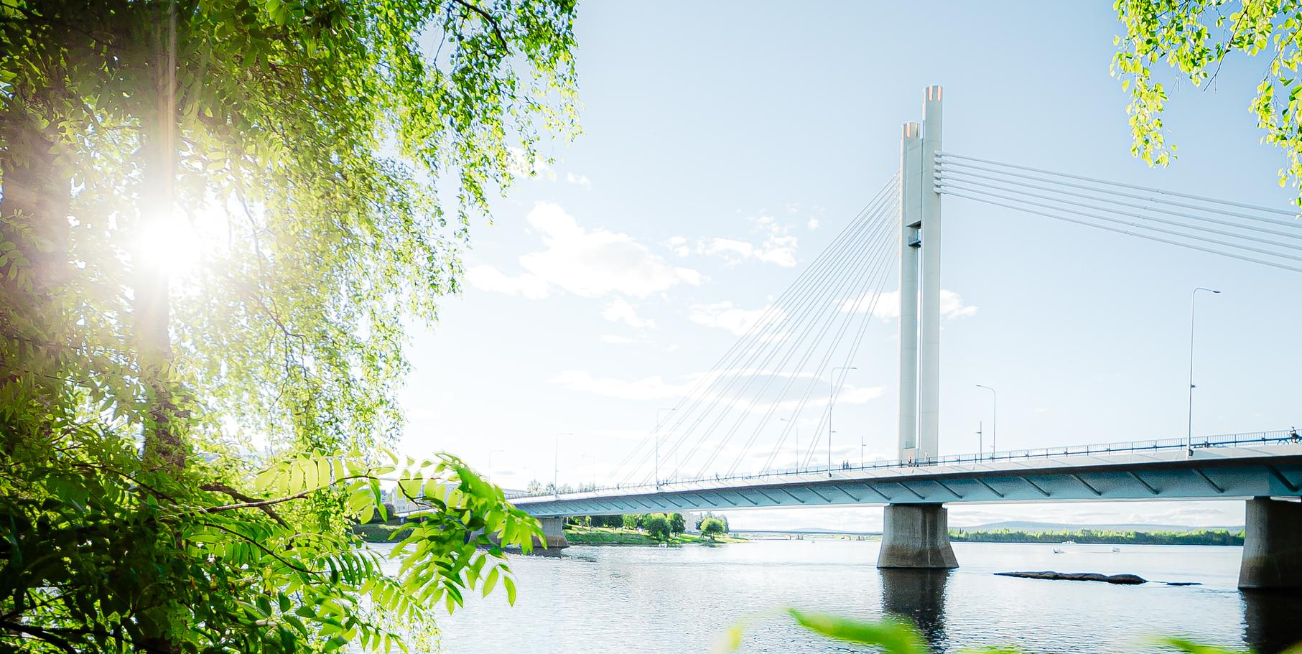
tähän aurinkoinen kesäkuva esim. pitkospuut

Slide 23
Autumn in Rovaniemi
Autumn in Rovaniemi is a magical time too, offering a variety of activities and experiences.
The autumn colors in Rovaniemi are stunning, with leaves turning vibrant shades of yellow, orange, and red. This natural spectacle usually peaks in mid to late September.
Autumn marks the beginning of the Northern Lights season. From late August, the darkening nights provide a great opportunity to witness this breathtaking phenomenon.
The cooler autumn weather is perfect for outdoor activities like hiking, biking and canoeing. You can also visit reindeer farms and husky kennels. In autumn, huskies often pull carts instead of sleds due to the lack of snow.
Autumn is the harvesting season - time for berry and mushroom picking.
Engage with the local culture through various events and activities. You can explore traditional Lappish cuisine, visit museums, and participate in cultural tours.

Slide 24
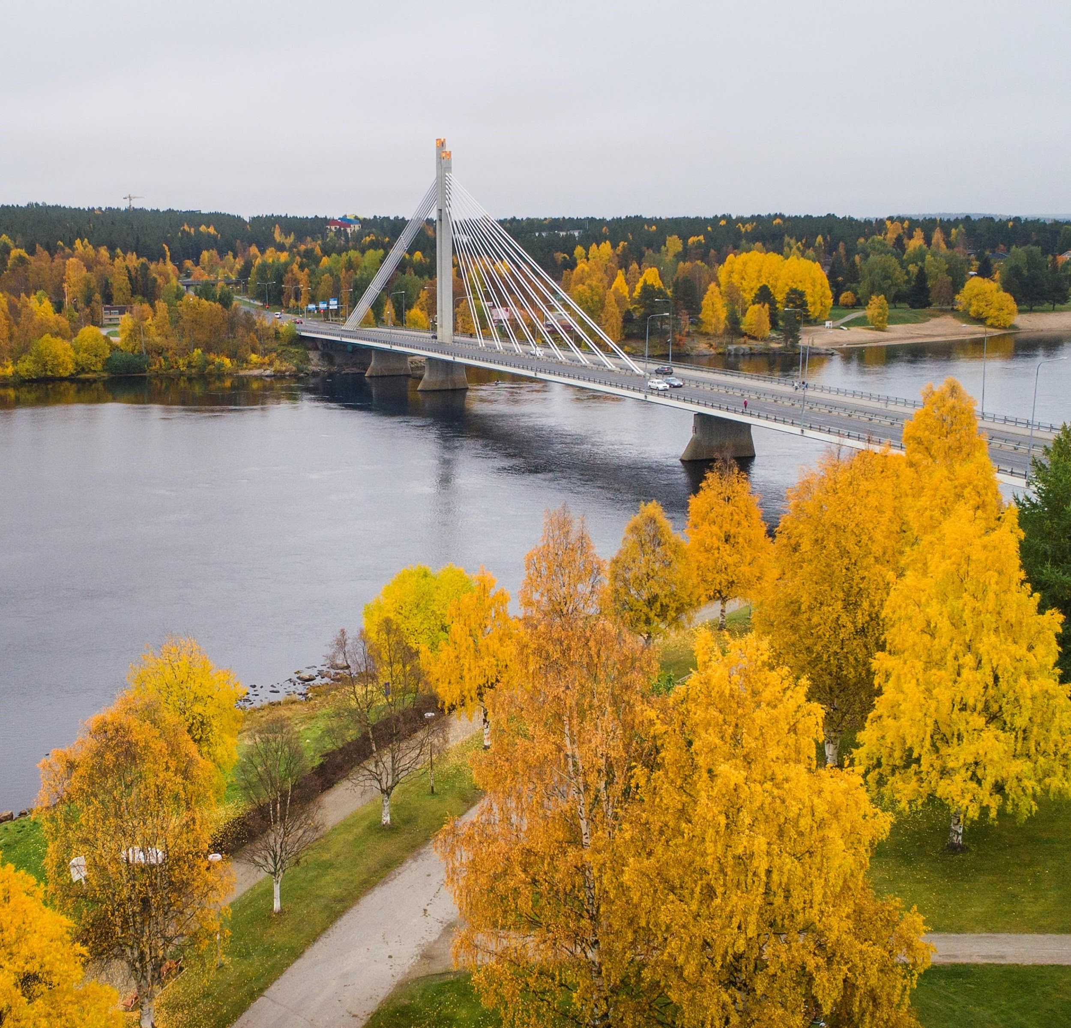
Colourful
autumn
Kuva tai tekstiä tälle puolelle

Slide 25
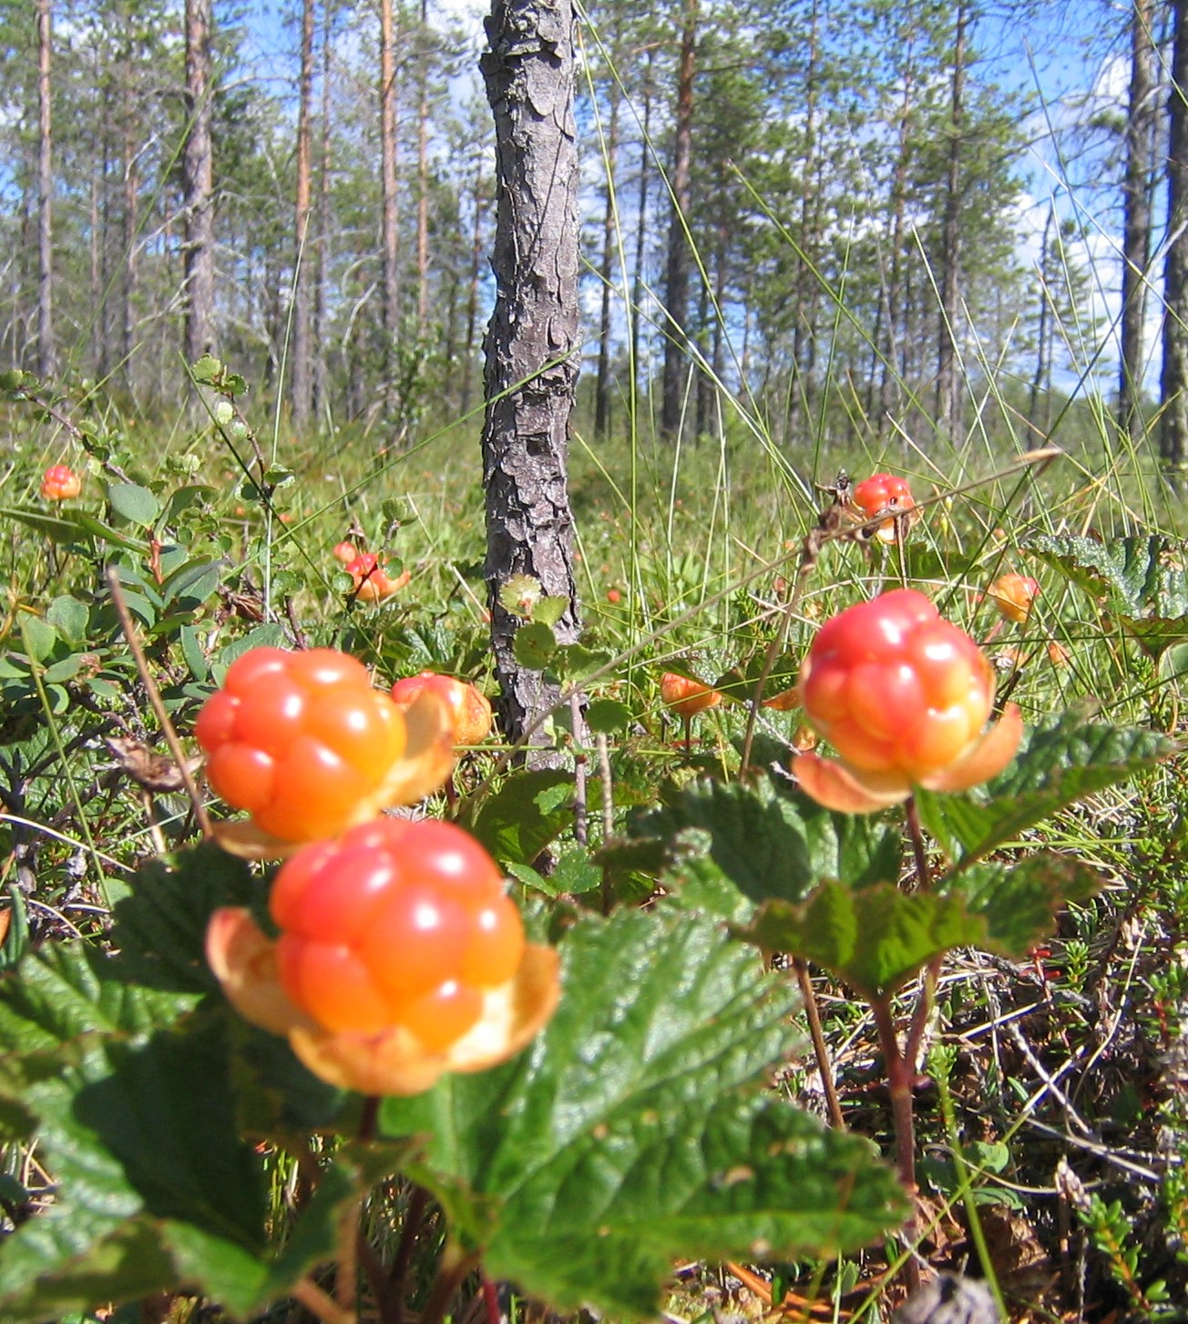
Harvesting
season
Kuva tai tekstiä tälle puolelle

Slide 26
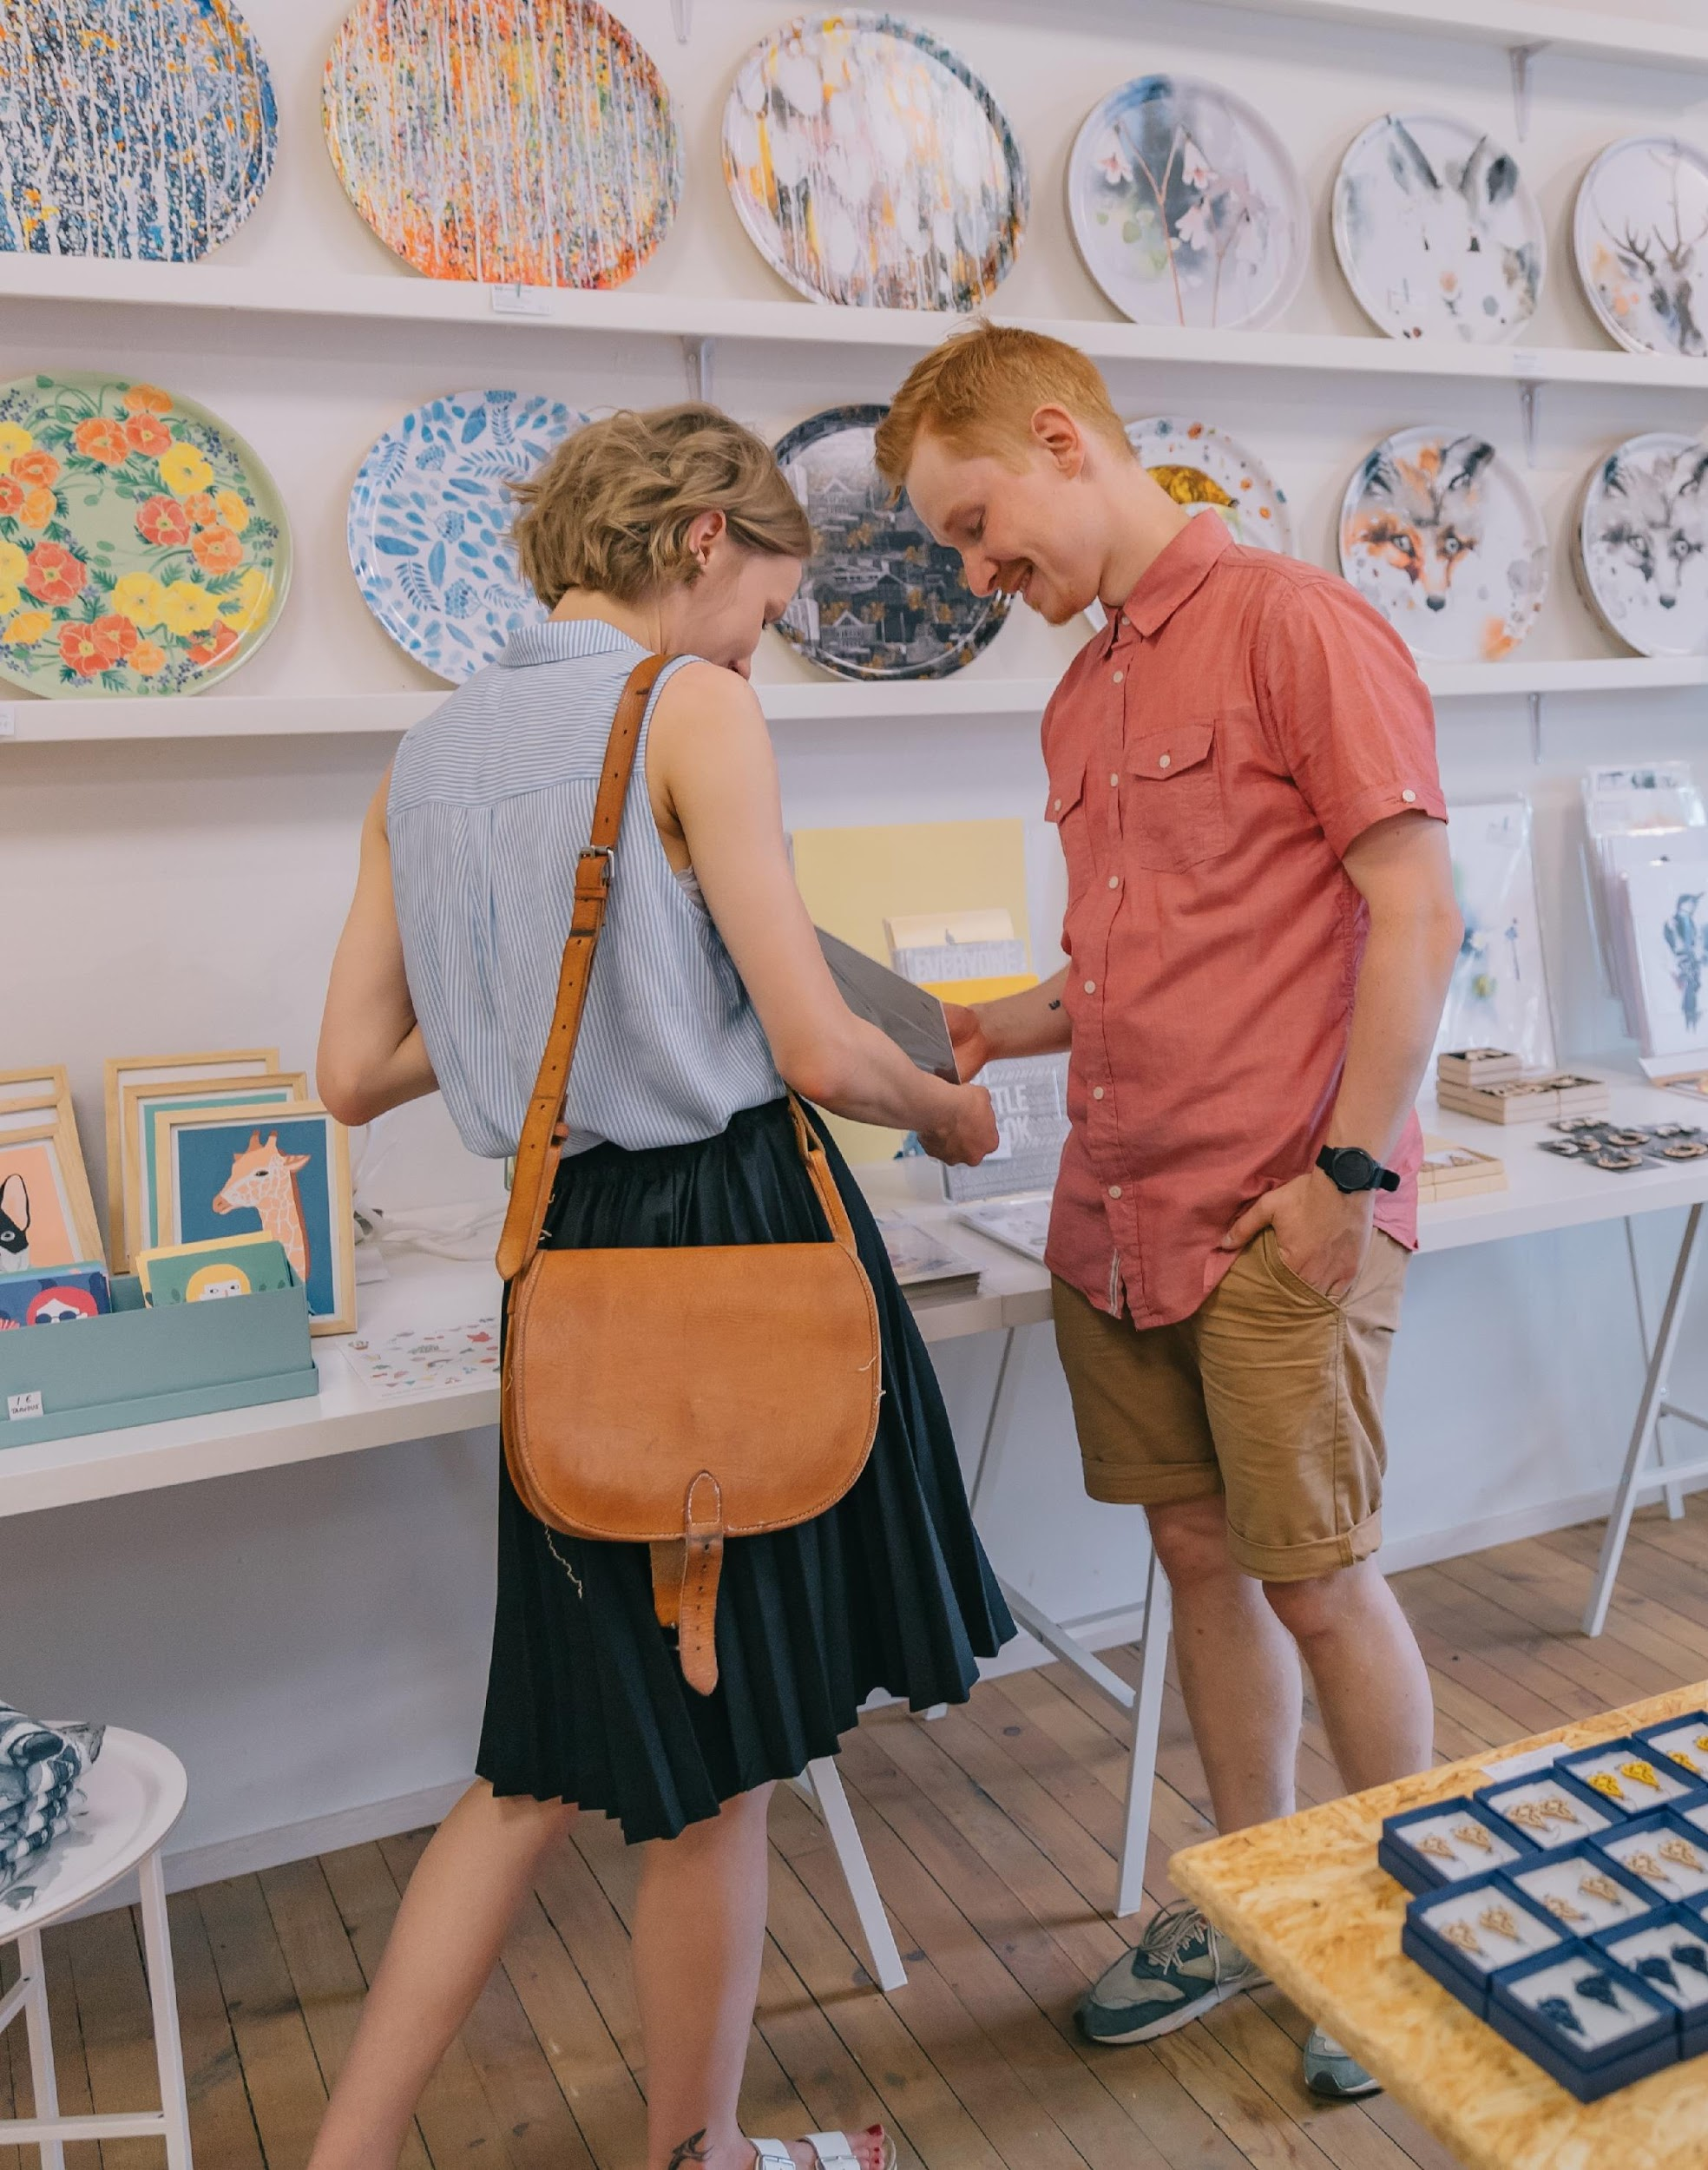

Slide 27
