Slide 1
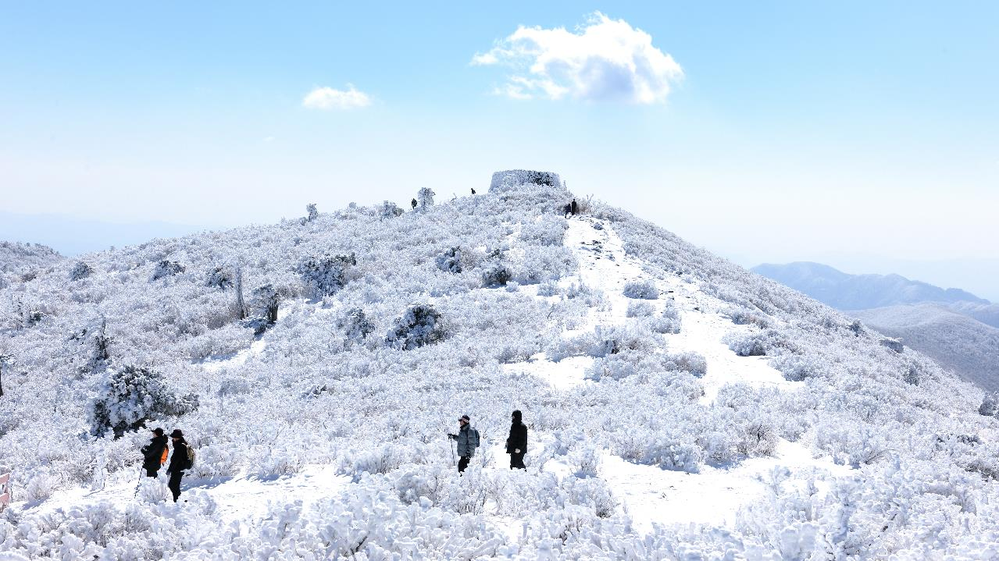


Taebaek City
Notes:
I’m sincerely pleased to meet you all, the people from WWCAM and also member cities.
I’m Insug Jeong, The Director of Economy of Taebaek City, Gangwon state, The republic of Korea.
From now on, I’ll give a presentation on Taebaek’s Winter Tourism.

Slide 2

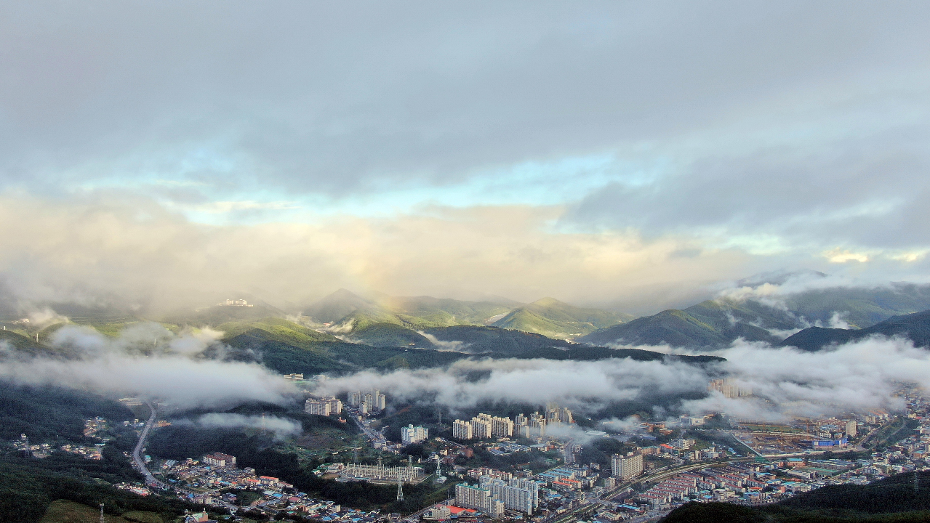

CONTENTS
○ Overview
  - Background
  - Goals
3
3
3
○ Major Achievements
  - Budget Allocation
  - Key Achievements
4
4
5
○ Main Content
  - Taebaek Mountain Snow Festival
  - Scenic Snowscapes of Taebaek Mountain and Hambaek Mountain
  - Jijirigol Birch Urban Forest
  - Taebaek Mountain Sky Observatory
  - Winter Sports in Taebaek
6
6
7
8
9
10
2
Notes:
I’ll introduce simple outlines of my presentation.
First, I’d like to speak about the background and the purpose of Taebaek’s Winter Tourism,
Second, will explain the budget allocation and key accomplishments,
For the last, I’ll talk about main cases of winter tourism of Taebaek city.

Slide 3


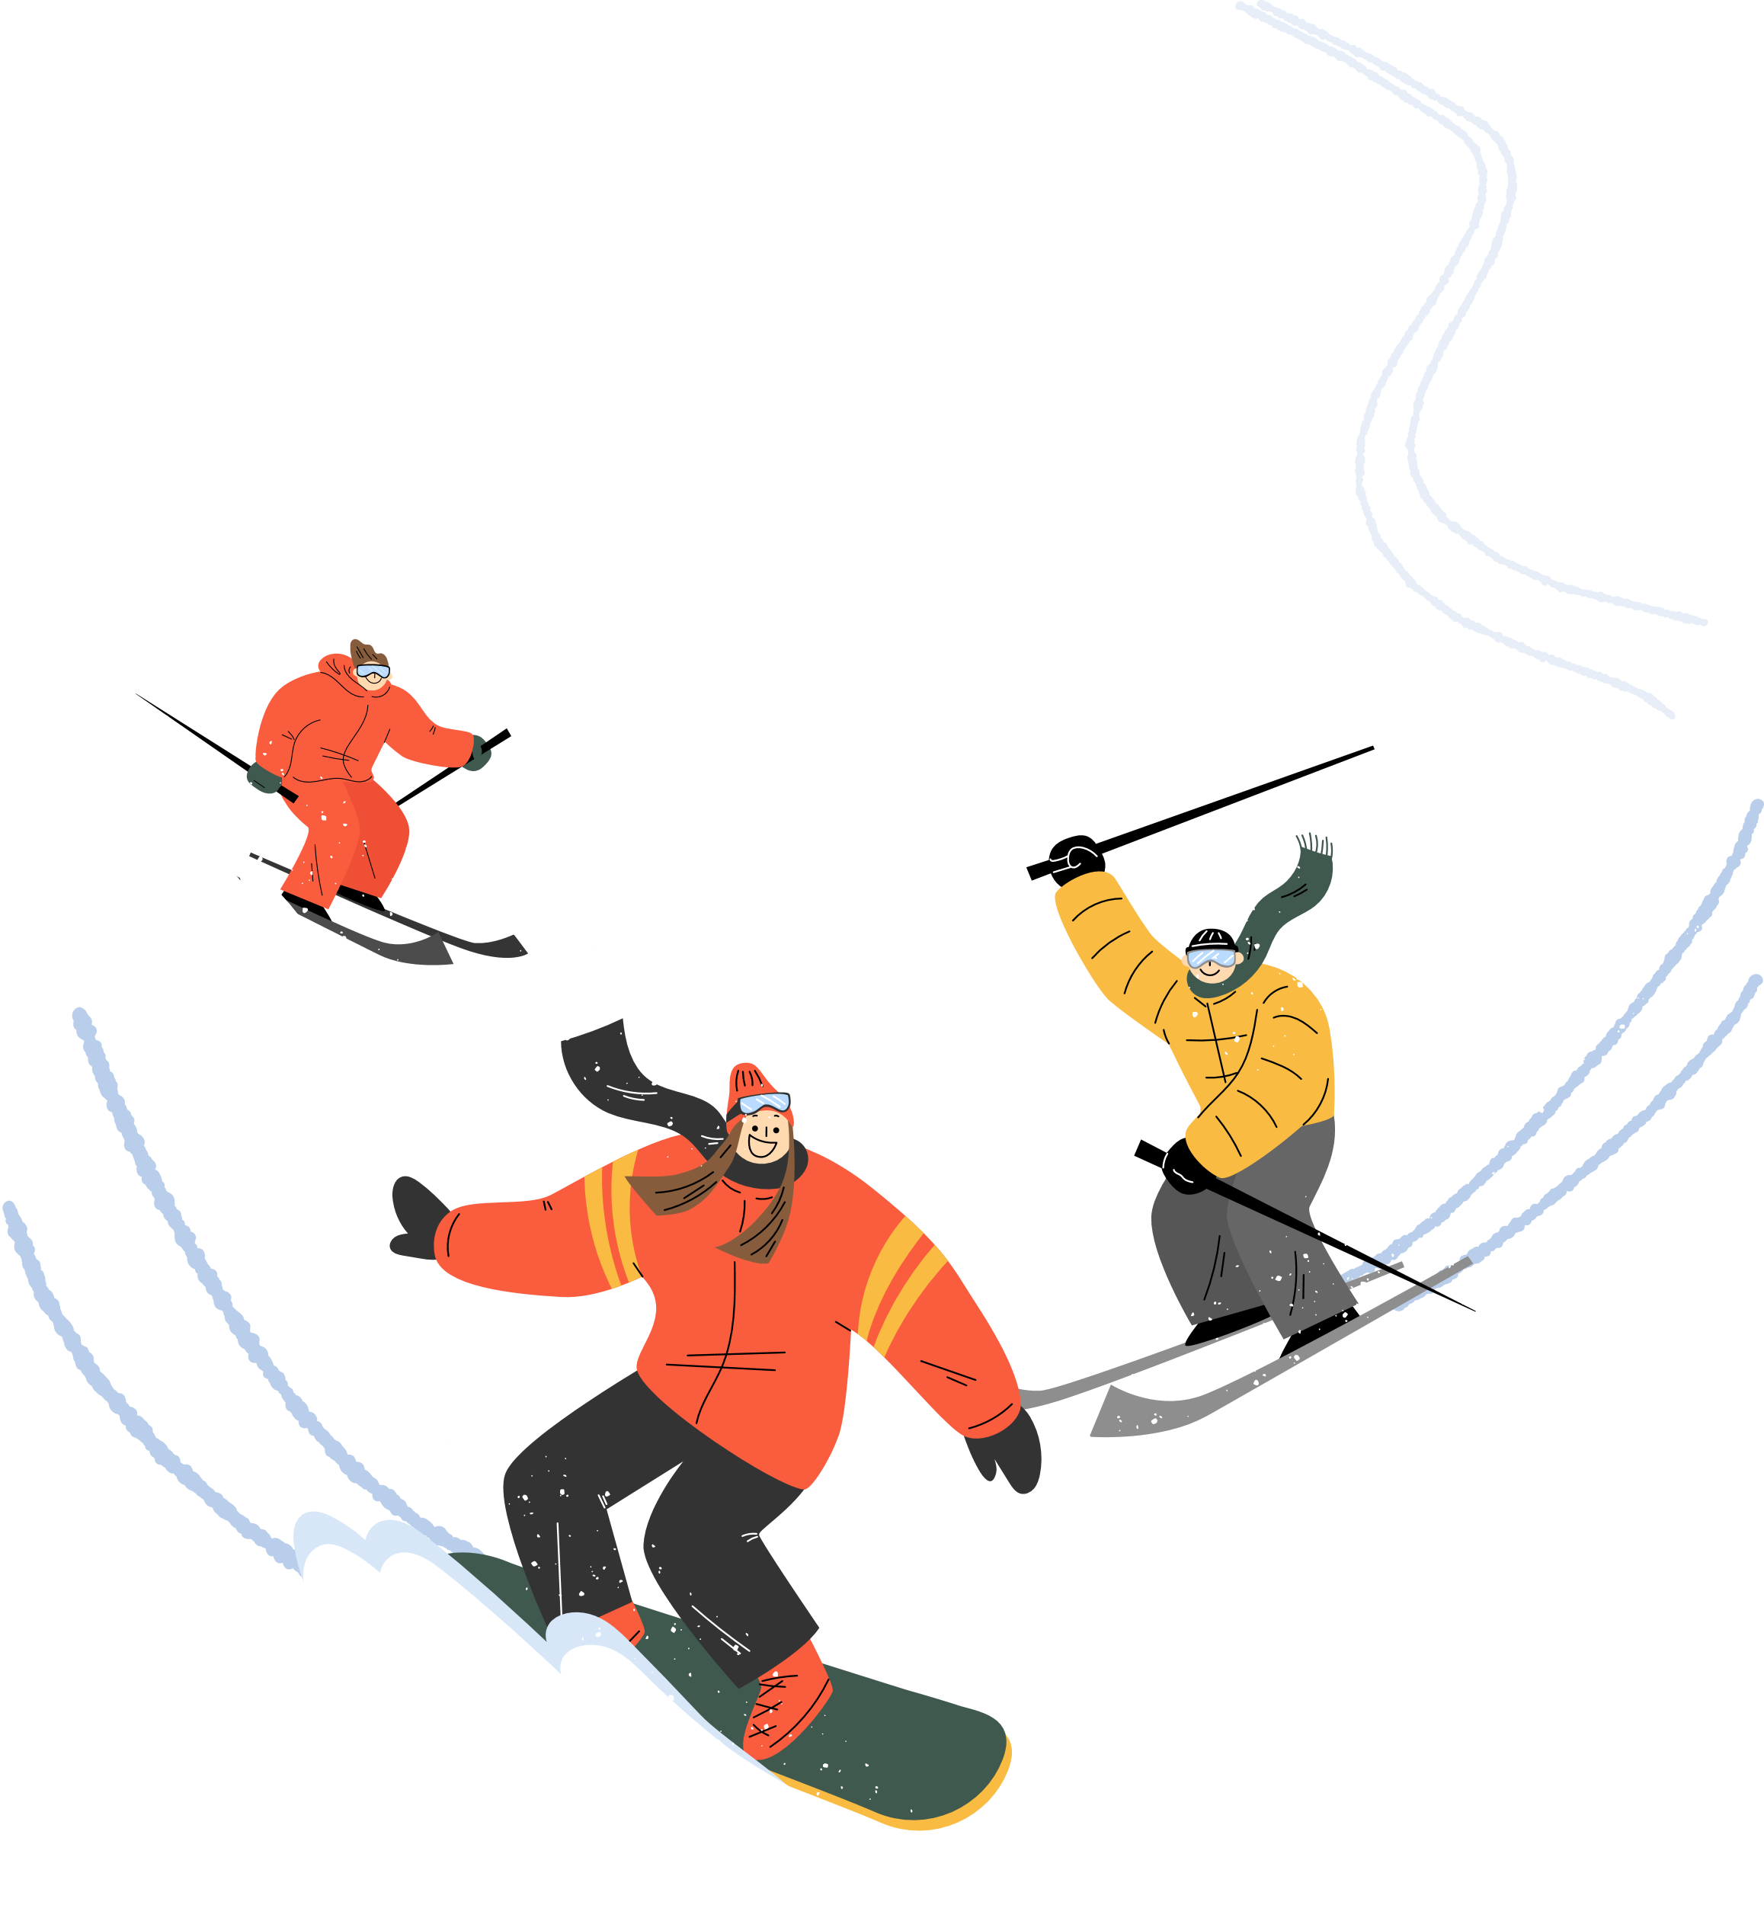
Winter City Economic Activities:
Taebaek's Winter Tourism
○ Overview
Background
In Taebaek City, the traditional coal mining industry was shut down due to the Coal Rationalization Project, leading to efforts to invigorate tourism and sports businesses based on the pristine winter nature.
Goals
To invigorate the local economy by attracting tourists through the development and promotion of winter tourism items.
3
Notes:
First, I’d like to talk about the background and purpose of Taebaek’s winter tourism.
In Taebaek city, The traditional coal mining industry had been shut down in the past due to the coal rationalization project by our national government.
As efforts to solve this situation, Taebaek City decided to activate winter tourism and sports businesses based on the pristine winter nature.
According to this, to invigorate local economy as well as to attract tourists, exploring winter tourism ideas became our goal.

Slide 4

Winter City Economic Activities:
Taebaek's Winter Tourism
○ Major Achievements
Budget Allocation:
Total of KRW 11.664 billion for 2024
01
02
Taebaek Mountain Snow Festival
Jijirigol Birch Urban Forest
KRW 1.558 billion
KRW 500 million
04
Winter Sports in Taebaek
03
Taebaek Mountain
Sky Observatory
KRW 443 million
KRW 9.176 billion
4
Notes:
Budget allocation in 2024 for Taebaek’s winter tourism is in total 11.6billion won.
Among this, budget for Taebaek Mountain Snow festival is 1.6billion won.
Budget for Jijirigol birch Urban Forest is 500million won.
Budget for Taebaek Mountain Sky Observatory is 9.2billion won.
For the last, Budget for Winter Sports is 400million won.

Slide 5



Winter City Economic Activities:
Taebaek's Winter Tourism
○ Major Achievements
Key Achievements:
Economic impact of the festival: KRW 44 billion
Total of 832,915 visitors to festivals and tourist sites
Participation of 950 individuals in winter sports competitions
The biathlon team won 3 gold medals among a total of 10 medals at the 22/23 Winter Games
Taebaek Mountain Snow Festival
Visitors: 585,364 /
Economic impact: KRW 44 billion
Scenic Snowscapes of Taebaek Mountain and Hambaek Mountain
Winter hikers: 217,551
Taebaek Mountain Sky Observatory
Visitors: 30,000
Winter Sports in Taebaek
* Santa Run Snow Trail Run Competition
* National Snowboarding Championship by Category
* Taebaek Mayor’s Cup National Youth Alpine Ski Competition
* Operation of the Workplace Sports Department (Biathlon Team)
4
Notes:
Next, The Key achievements of Taebaek’s winter tourism.
2024 Taebaek Mountain snow festival attracted 59K visitors and created economic impact as 44billion won .
Next, Scenic Snowscapes of Taebaek Mountain and Hambaek Mountain attracted 22k hikers in 2024.
Next, Taebaek Mountain Sky Observatory was built newly on April, 2024 and attracted 3k visitors only for the 6 months.
For the last, By holding the winter sports competitions, 950 sports players visited Taebaek City and
By operating Taebaek city biathlon team, City achieved 10 medals including 3 gold medals.

Slide 6
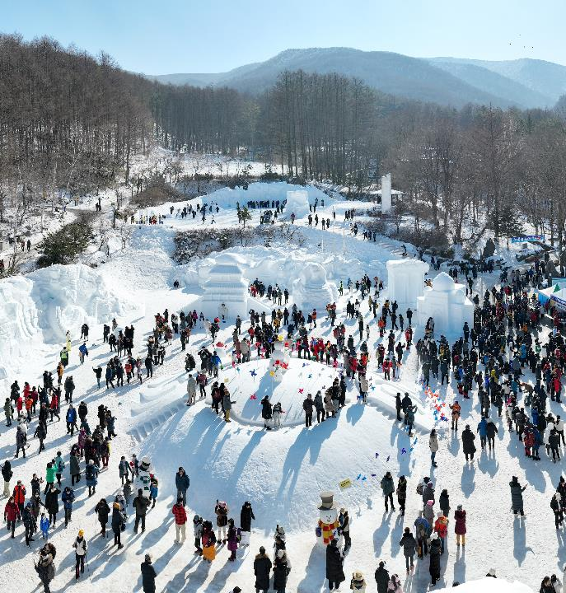
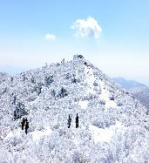
Winter City Economic Activities:
Taebaek's Winter Tourism
Main Content
Taebaek Mountain
Snow Festival
Timing: Held annually at the end of January
<Started in 1994 / 31st edition held in 2024: 1.26.~2.4.2024>
Location: Taebaek Mountain National Park,
Taebaek Culture Square, and Hwangji Pond
Theme: (2024 Theme) NOW AND NEVER - Here and Now, Taebaek
Content
Host/ Organizer: City of Taebaek, Taebaek City Cultural Foundation
Notes
40-meter-long mega snow sculpture exhibition, national college student snow sculpture competition, snow lantern festival, large snow slide, Carrie and Friends Kids Park, Challenge! Winter Sports Competition, MBC Gangwon Yeongdong special radio broadcast (1/27/2024)
Ranked 1st nationally in festival image, 3rd in festival preference, and 5th in intention to revisit according to the 2023 Cultural Tourism Festival Comprehensive Evaluation Report.
5
Notes:
From now on, I would show you actual cases of Taebaek’s winter tourism.
Most of all, I will introduce Taebaek Mountain snow festival.
It is held annually at the end of January since 1994.
In this year, the 31th snow festival had been held from 26th of January to 4th of February, 2024, with the theme of “ Here, now, Taebaek”
And we provided various programs such as giant snow sculpture display, traditional winter play, Taebaek Mountain climbing competition and etc.
We endeavors to create good festival together with the Taebaek city cultural foundation and
Especially in 2023, We’ve taken the first place in the field of image of festival from the comprehensive assessment report of south Korea.

Slide 7
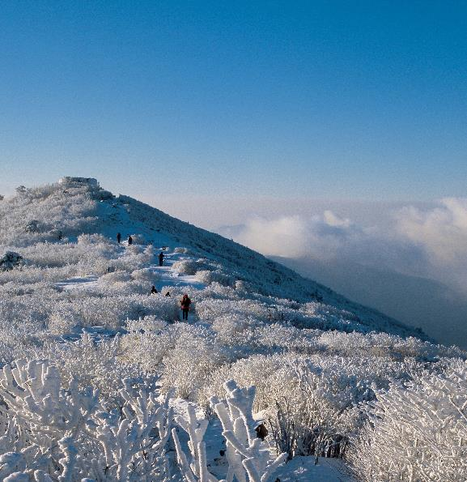
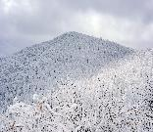
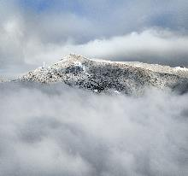
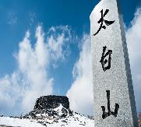
Winter City Economic Activities:
Taebaek's Winter Tourism
Main Content
Scenic Snowscapes of
Taebaek Mountain and Hambaek Mountain
Taebaek Mountain was designated as a South Korea's 22nd national park in 2016.
centered around Youngbong (1,560m) which houses Cheonjedan(traditional alter), with Janggunbong (1,567m) to the north and Munsubong (1,517m) to the east, and Busoebong (1,546m) between Youngbong and Munsubong.
Taebaek Mountain has known for nation people’s sacred mountain.
Hambaek Mountain is representative mountain in gangwon state(1,573m) which is the highest mountain in Taebaek national park.
Especially Mt. Hamabaek’s Mahangjae road is located at the center of the boundaries of 3 cites of Gangwon state(Jeonseon, Yeongwol and Taebaek), the hightest boundary road and it’s famous for beautiful milky way spot.
Mt. Taebaek and Mt. Hambaek has beautiful scenic snowscapes with snowflakes flowers only blooming in winter season.
Numerous people constantly visit these mountains to see it.
6
Notes:
Next I’d introduce the scenic snowscapes of Taebaek Mountain and Hambaek Mountain.
Taebaek Mountain was designated as 22nd national park in 2016 and the height of it is 1,567m.
It has many peeks suck as youngbong which houses cheonjedan, the Traditional Korean alter for praying to sky, janggunbong, general peek, and Munsubong and it has been already known for nation people’s sacred mountain.
Hambaek Mountain is also representative mountain in Gangwon state with the highest height of 1,573m.
Especially Mt. Hambaek’s Manhangjae is the highest boundary road in Korea which is located at the center of the boundaries of 3 cities of Gangwon state(Jeongseon, Yeongwol, Taebaek).
Also it is popular for its amazing milkyway watching spot.
Mt. Taebaek and Mt. Hambaek has beautiful scenic snowscapes with snowflakes flowers blooming in winter season and
Numerous people constantly visit these mountains to see it.

Slide 8
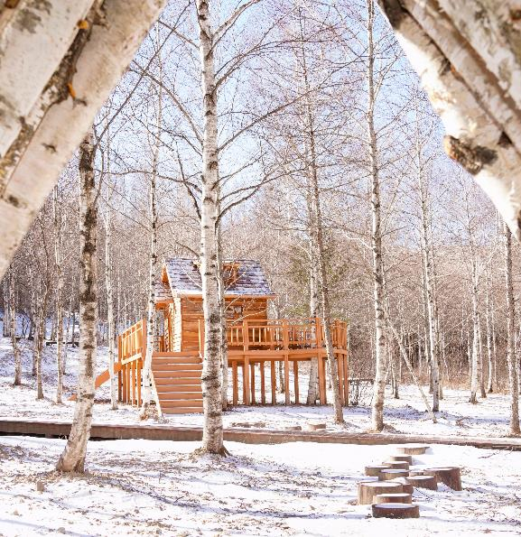
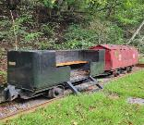
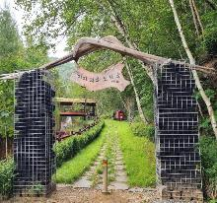

Winter City Economic Activities:
Taebaek's Winter Tourism
Main Content
Jijirigol Birch Urban Forest
Opening: November 27, 2023
Location: 13 Jijirigol-gil, Taebaek City, Gangwon
Management: Taebaek National Forest Office
Features:
1. A birch forest planted in 1998 as part of a mine reclamation project
2. Installations appropriate for the coal mine image, including a statue of
a mining village boy and a mine cart photo zone
3. Part of the sixth course of the Ountangodo 1330 trekking trail
(originally created in 2000 as part of the forest restoration project following the closure of Hamtae Mine due to coal mine damage)
(Untan Godo 1330: A trekking course connecting Yeongwol, Jeongseon, Taebaek, and Samcheok, cities with a forest coverage rate of over 80%)
7
Notes:
Next, I’ll explain Jijirigol Birch Urban Forest.
Jijirigol Birch Urban Forest started to be forested in 1998 from the mine reclamation project and
It is completed in 2000.
On November 2023, Taebaek national forest office newly built urban forest, installing structures such as statue of boy in mining town, mining trails, wooden shelter bridge and so on.
Especially Jijirigol Birch Urban Forest is included in the untangodo 1330, the tracking walk path connecting 4 cities in gangwon state, Yeongwol, Jeongson, Taebaek, Samcheok and numerous people are using this walk path.

Slide 9
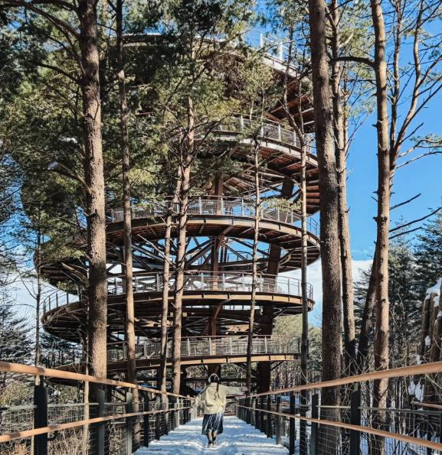
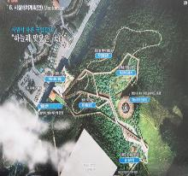
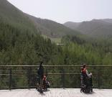
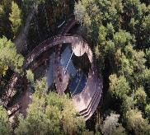
Winter City Economic Activities:
Taebaek's Winter Tourism
Main Content
Taebaek Mountain Sky Observatory
Opening: May 2, 2024
Location: 181 Cheonjedan-gil, Taebaek City, Gangwon
Height: 33m
Management: Taebaek Mountain National Park
Features:
Provides views of the major peaks and surrounding natural
landscapes of Taebaek Mountain.
2. Low-altitude barrier-free exploration facilities (average incline of 3.6 degrees, distance 1km) making it accessible for wheelchair and stroller users.
8
Notes:
Next, I’d talk about the Taebaek Mountain Sky Observatory, newly built in 2024 by Taebaek mountain national park.
The height of Sky observatory is 33m, from the center to the observatory 500m, swirling observatory itself 500m, totally 1km.
At the top of the observatory, you can see all the main peeks of Taebaek mountain and
The average incline of it is 3.6 degree so even people who use wheelchairs or strollers can access easily, which make this place as new tourism landmark.

Slide 10
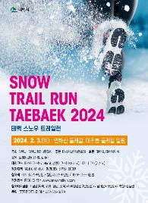
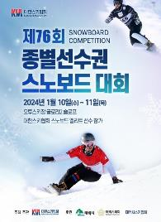
Winter City Economic Activities:
Taebaek's Winter Tourism
Main Content
Winter Sports in Taebaek
Santa Run Snow Trail Competition
Purpose
To enhance the image of Taebaek as a mountain city through a snow trail marathon utilizing Taebaek’s long winters and heavy snowfalls.
Event Date: February 3, 2024
Total Budget: KRW 32.1 million
Organizer: Taebaek Triathlon Association
Participation: 600 national athletes participated
Location: Yeonhwasan, Geumdaebong area in Taebaek
National Snowboarding Championship by Category
Purpose
To improve athletes' performance and stimulate the local economy through participation in the competition.
Event Period: January 10-11, 2024
Total Budget: KRW 70,310,000
Scale: 150 national athletes participating
Location: O2 Resort
9
Notes:
For the last , I’d introduce Taebaek’s winter sports.
Santa run Snow trail competition is snow mountain marathon running yeonhwa mountain and geumdae peek.
It was held on 3rd of February 2024 and 600 players participated.
Next, National Snowboarding championship by category is held in O2 resort, from 10th of January to 11th of January 2024 with 150 participants.

Slide 11
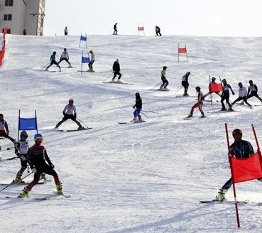
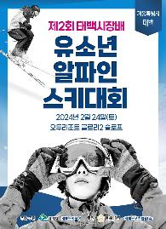
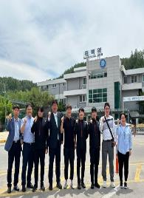
Winter City Economic Activities:
Taebaek's Winter Tourism
Main Content
Winter Sports in Taebaek
Taebaek Mayor’s Cup
National Youth Alpine Ski Competition
Purpose
To broaden the base of recreational sports and position the city as a host for winter sports events.
Event Date: February 3, 2024
Event Date: February 24, 2024
Total Budget: KRW 40 million
Organizer: Participation by 200 people
Location: O2 Resort
Operation of the Workplace Sports Department
(Biathlon Team)
Purpose
To expand the base of winter sports.
Event Period: Year-round
Contents: Support for accommodation, vehicle operation, salaries,
and training expenses for 4 coaches and athletes
Total Budget: KRW 288 million
10
Notes:
Next, National youth alpine ski competition was held on 24th of February 2024 with 200 players.
For the last, by operating Taebaek city biathlon team, We are trying to expand the base of winter sports and
Also with the continuous supports in the future, we are going over newly operating different City sports Team.

Slide 12

Come and experience winter
Tourism that you can only
enjoy in Taebaek!
THANK YOU
Notes:
Now I’d like to end up my presentation.
Thank you.

