Slide 1
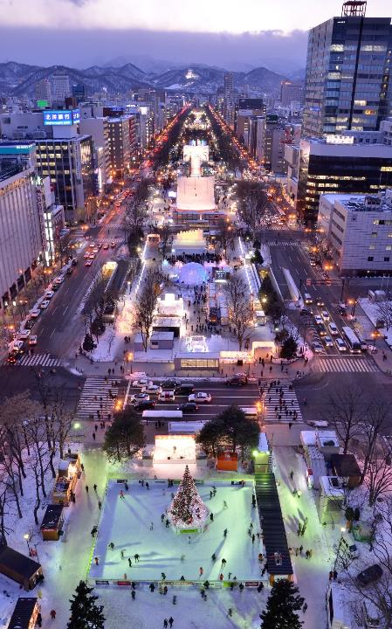

Environmental Action Goals Midterm Report
17th December 2024
World Winter Cities Association for Mayors
20th World Winter Cities Conference for Mayors
Environmental Bureau, Sapporo City
Notes:
○札幌市長の秋元克広です。
○本日は、「脱炭素都市国際フォーラム」にお招きいただき、誠にありがとうございます。
○私からは「札幌市の脱炭素化に向けた取組」についてお話させていただきます。

Slide 2

Progress of Initiatives towards “Green Capital, SAPP‿RO”
Sapporo Climate Change Action Plan formulated
Sapporo Climate Emergency Declaration
Team Sapporo‐Hokkaido launched
Hokkaido‐Sapporo
Declaration
towards a Decarbonized Future
“Green Capital, SAPP‿RO ” Declaration
Selected as a SDGs Future City
2008
2018
2020
2021
2022
2023
2024
Formulation of the second Sapporo City Basic Environmental Plan
Zero Carbon City Declaration
Selected as a Decarbonization Leading Area
Hokkaido/Sapporo is declared a “Special Zone for GX Financial and Asset Management”

Slide 3
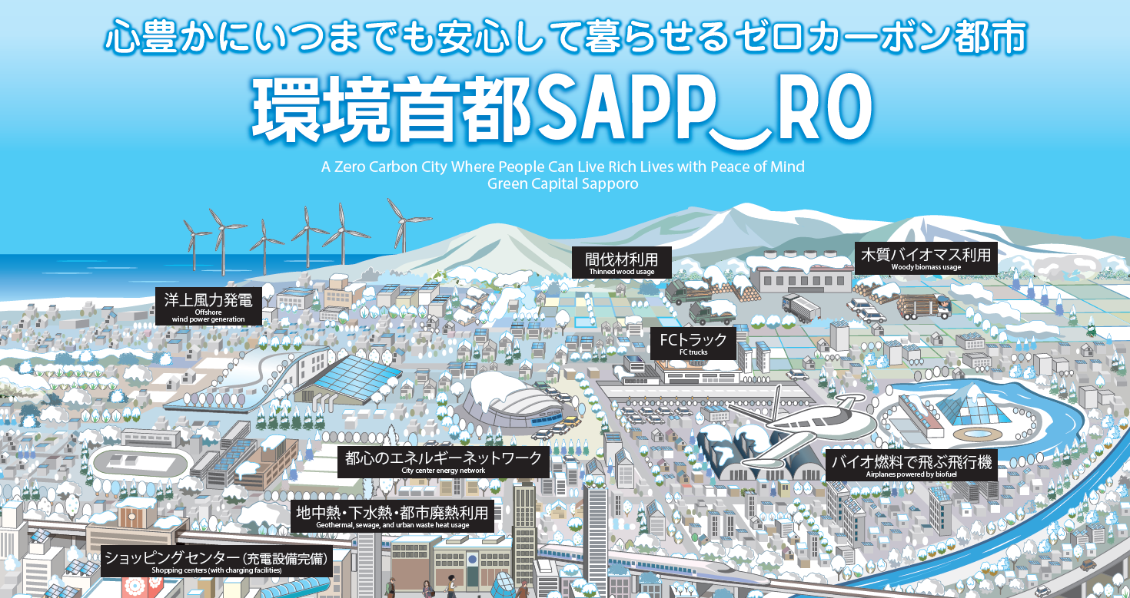

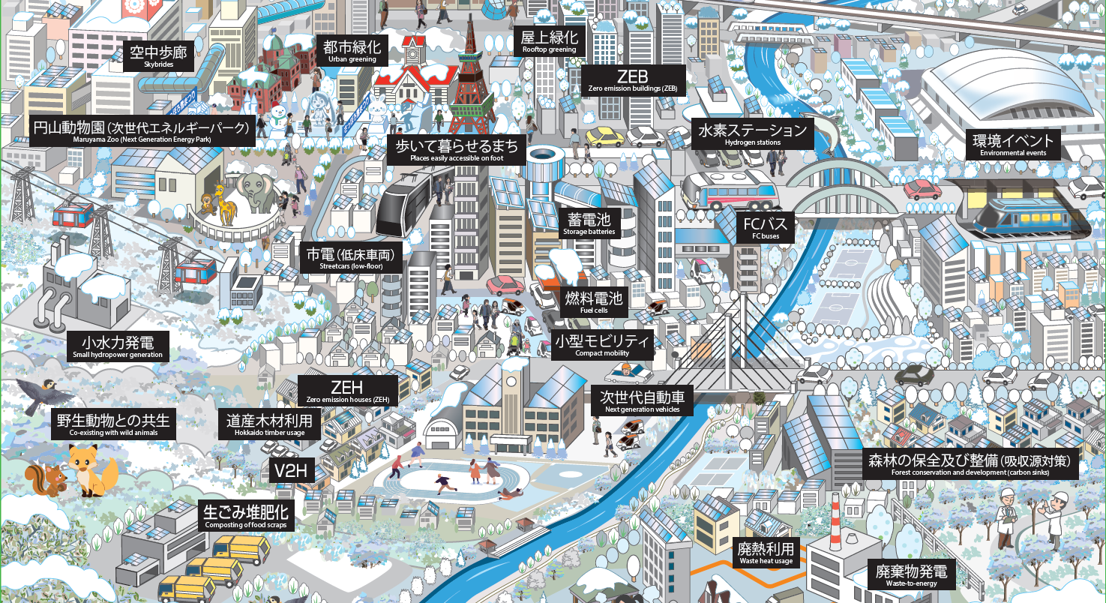
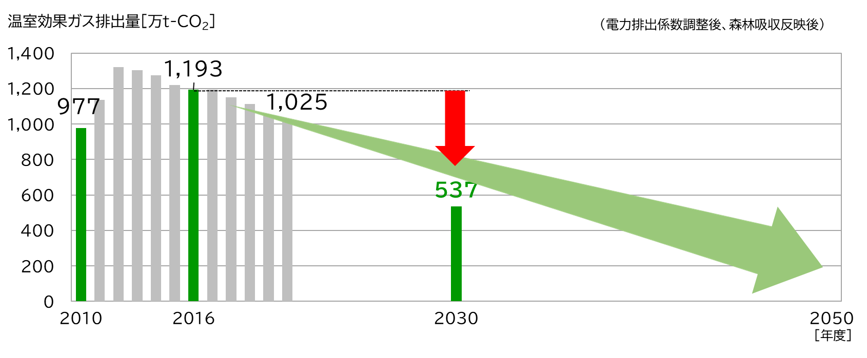
Sapporo Climate Change Action Plan (established in March 2021)
Overview
The plan sets out Sapporo’s vision and goals for 2030 and 2050, as well as the steps we are/will be taking to build a sustainable decarbonized society.
GHG emission reduction target
Achieve 55% emission reduction by 2030 (compared to the 2016 levels) and transform Sapporo into a zero-carbon city by 2050.
Reduction targets and performance indicators set in the following four areas: 1) Energy Conservation Measures, 2) Expanding the Introduction of Renewable Energy, 3) Decarbonizing Transportation, and 4) Resource Recycling and Carbon Sink Measures.
55% reduction,
compared to 2016 levels

Slide 4
Environmental Action Goals (set based on the Sapporo Climate Change Action Plan) Midterm Report
①Energy Conservation Measures
②Expanding the Introduction of Renewable Energy
○Promote Net Zero Energy Houses (ZEH) and Net Zero Energy Buildings (ZEB)
Percentage of new houses & buildings meeting ZEH/ZEB energy efficiency standards or higher
○Introduce the use of renewable energy in more buildings and localities
Renewable energy percentage of total electrical energy consumption
Start：2016
Detached House/Residence
ZEH ： 54%
Apartment Building/Housing Complex
ZEH ： ー%
ZEB ： ー％
Midterm：2022
Detached House/Residence
ZEH ： 87%
Apartment Building/Housing Complex
ZEH ： 6%
ZEB ： 8％
Target：2030
Detached House/Residence
ZEH ： 80%
Apartment Building/Housing Complex
ZEH ： 80%
ZEB ： 80％
Start：2016
24％
Midterm：2022
27％
Target：2030
50％
③Decarbonizing Transportation
④Resource Recycling and Carbon Sink Measures
○Promote Zero Emission Vehicles
Citywide ownership percentage of next-generation vehicles
○Promote resource conservation and resource recycling
Citywide amount of waste incineration
Start：2016
10％
Midterm：2022
22％
Target：2030
60％
Start：2016
438,000 tons
Midterm：2022
440,000 tons
Target：2030
392,000 tons

