Slide 1
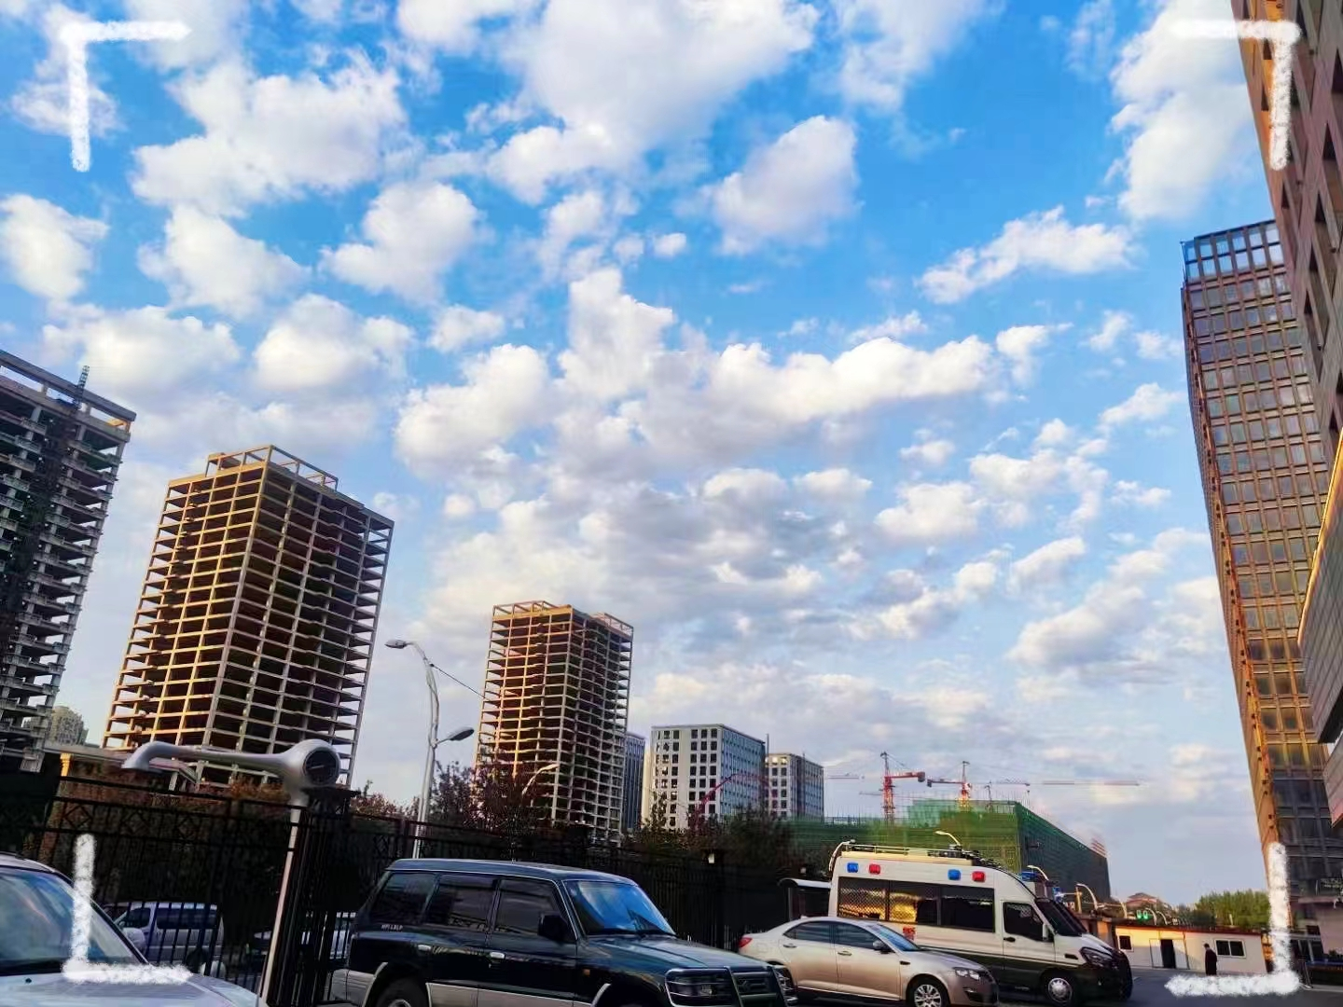
Key Measures for Shenyang
Municipal PM 2.5 Control

Slide 2
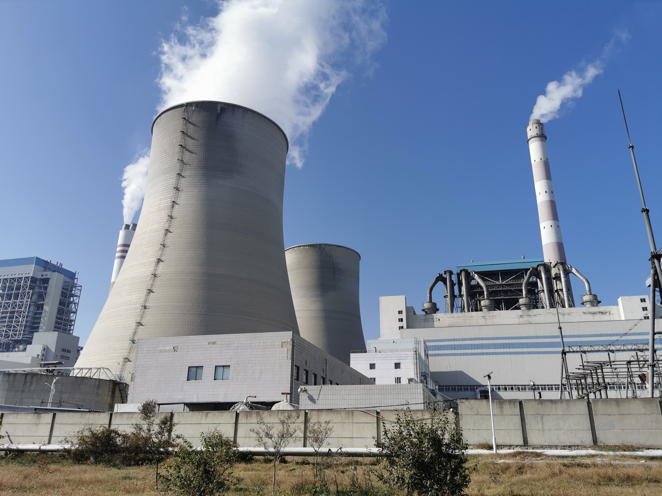
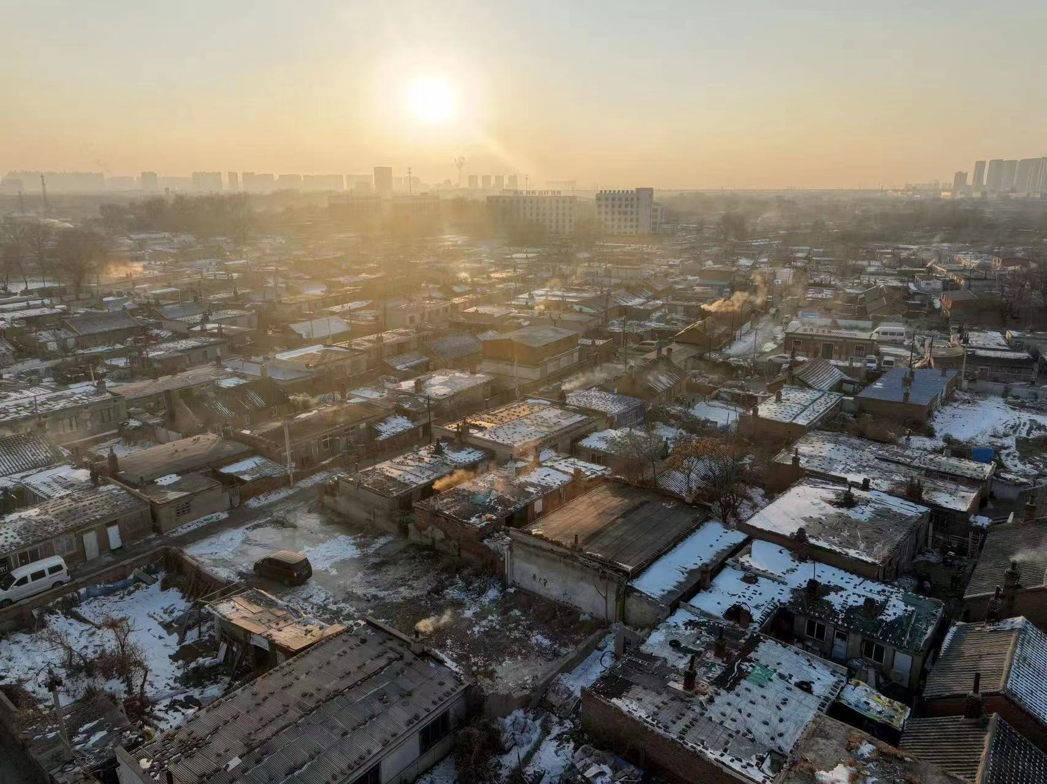
Key Measures for Shenyang Municipal PM 2.5 Control
First, implement ultra-low emission transformation of large coal-fired boilers and continuously track the flue gas emissions of coal-fired boilers with the heating capacity of more than 10,000t/h that already have ultra-low emission capacity as well as that will complete ultra-low emission transformation. Second, promote the work of "clearance and classified treatment" of small coal-fired boilers. Dynamically update the list of existing small coal-fired boilers and overhaul the problems of resurgence. Reexamine more than 580 small boilers that have completed the rectification to strictly prevent the problem of resurgence and unauthorized construction.
Deepen Pollution Control of Coal-fired Boilers
Strengthen Low-rise Non-point Sources in Village Pollution Control
We vigorously promoted the renovation of clean villages, expanded the original 33 key villages to 150, and formulated household by household renovation measures. The implementation of measures have been sped up to 10,233 households that were clearly identified to carry out the transformation of coal to clean energy while temporary transitional measures have been given priority to more than 15,000 households that weren't identified of remediation measures. We will strengthen supervision and inspection, crack down on illegal sales of bulk coal, and strictly prohibit the burning of highly polluting fuels.

Slide 3
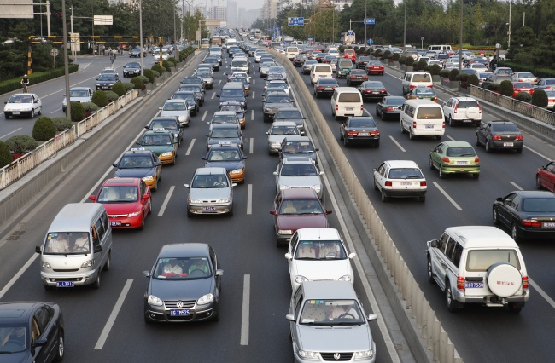
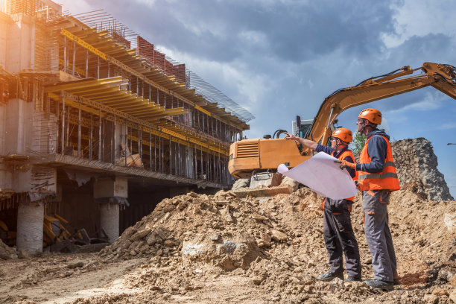
Key Measures for Shenyang Municipal PM 2.5 Control
Strengthen the Ability to Supervise and Regulate Mobile Sources
We will continue to cancel the operation qualification of diesel vehicles of and below the China National Standard 3(CN-3). On the basis of putting 8000 unqualified vehicles going off use, maximize the elimination quantity to ensure that all elimination work is completed by the end of 2025. Strengthen joint law enforcement inspections in low-emission zones, and conduct spot checks on centralized parking sites for heavy diesel and gas trucks, and basically eliminate the phenomenon of vehicles with high emissions and exceeding standards illegally going on the road.
First, constantly strengthen the supervision of dust sources such as construction sites, municipal engineering projects, urban roads, three types of debris(namely firewood pile, garbage pile and debris pile). Strictly require the implementation of various dust control measures, and constantly improve the refined, scientific and standardized management work. Second, refined management of all kinds of catering fumes, strengthen investigation and rectification, ensure the stable and effective operation of lampblack purification facilities. Carry out regular inspection and supervision to eliminate the phenomenon of open-air barbecue, realizing dynamic zero-case policy. Third, strengthen regional joint prevention and control, share information with surrounding cities, predict in advance, and carry out joint control; do joint prevention and control of adjacent areas of the city, and carry out simultaneous investigation with upwind areas to reduce the transmission impact.
Fine Management of all Kinds of Non-point Source Pollution

Slide 4
Thank you !

