Slide 1

Taebaek City
2024 Midterm Reports on Environmental Action Goals
Expansion of Renewable Energy Supply
Contributing to reducing greenhouse gas and improving energy use efficiency
Notes:
Good afternoon everyone, I’m Insug Jeong, The Director of Economy of Taebaek City.
From now on, I’ll give a presentation on Expansion of Renewable Energy Supply of Taebaek City.

Slide 2
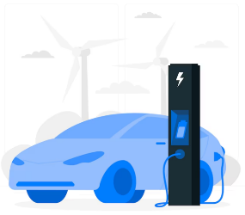
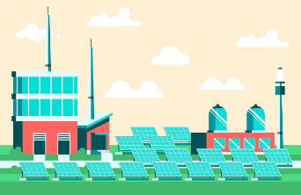
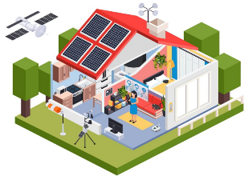


Expansion of Renewable Energy Supply
01
Renewable Energy
Local Support
Renewable Energy
Household support
Electric Vehicle
Supplement
Solar Power and Solar Heat
Energy generating System Installation
and Repair for Public Facilities
Renewable Energy
Devices Installation Support
Support on Purchasing
Electric Vehicles
Accomplishment
Accomplishment
Accomplishment
ο ~2022: Solar Power and Solar heat energy generating
System Installation and Repair for 51 Public facilities
ο 2023~2024(until the present):
- Solar Power Energy Generating System Installation
for Taebaek Public cemetery(69kw),
- Solar Power System Inverters Exchange(Repair)
for 2 Senior centers
ο 2025: Solar Power System installation for Public facilities
ο ~2022: Solar Power Energy Generating System
Installation Support for 79 Households
ο 2023~2024(until the present):
Solar Power System Energy Generating Installation Support
for 27 Households
ο 2025: 21 Solar Power, 1 Solar Heat, 2 Geothermal
ο ~2022: Support on 239 Cars, 24 Motorbikes
ο 2023~2024(until the present):
Support on 125 Cars, 3 Motorbikes
ο 2025: Support on Purchasing Electric vehicles
Future Plan
Future Plan
Future Plan
Notes:
First, I would like to speak about Expansion of Renewable Energy Supply Projects.
For the Renewable Energy Local Support, Until 2022 We completed installation and repair of Solar Power and Solar heat energy generating system for 51 public facilities and
From 2023 to 2024 present, We completed solar power system installation for Taebaek Public Cemetery and replacement of solar power system inverters for 2 senior centers.
Next, For the Renewable Energy Household support, until 2022 We supported solar power system installation for 79 households and,
From 2023 to 2024 present, We supported solar power system installation for 27 households.
Next, for the Electric vehicle supplement.
Until 2022, We supported purchasing 239 electric cars and 24 electric motorbikes.
From 2023 to 2024 present, We supported purchasing 125 electric cars and 3 electric motorbikes.
In 2025, Taebaek City will continually proceed with expansion of renewable energy supply projects.

Slide 3



Energy Welfare for the Vulnerable
02
01
Improving Electric Facilities
Accomplishment
ο ~2022: Inspection of Old Electric Facilities for 370 Low-income households
ο 2023~2024(Until Present): Inspection of Old Electric Facilities for 65 Low-Income households/ 105 Senior Centers
Future Plan
ο 2025: Inspection of Old Electric Facilities for 45 Low-Income households and Senior Centers
02
LED Replacement
Accomplishment
ο ~2022: LED Replacement for 814 Low-income Households and 124 Welfare Facilities
ο 2023~2024(Until Present): LED Replacement for 25 Low-income Households
Future Plan
ο 2025: LED Replacement for Low-income and Welfare Facilities (29 Places)
Notes:
Next, I’ll explain Energy Welfare for the Vulnerable.
First, For the improving Electric Facilities,
Until 2022, Taebaek City inspected old electric facilities of 370 low-income households.
From 2023 to 2024 present, We inspected old electric facilities of 65 low-income households and 105 senior centers.
Next, LED replacement for the low-income citizens and the vulnerable.
Until 2022, We replaced LED lights of 814 low-income households and 124 welfare facilities.
From 2023 to 2024 present, We replaced LED lights of 25 low-income households.
In 2025, Taebaek City will keep trying our best to support energy welfare for the vulnerable and to enlarge energy use efficiency.

Slide 4
Taebaek City
2024 Midterm Reports on Environmental Action Goals
Thank you
Notes:
Now, I’d like to end my presentation.
Thank you.

