Slide 1



20th WWCAM Mayors Conference - “New Possibilities for Winter Cities - Realizing a Sustainable Society”
Sapporo (Japan), December 17-21, 2024
City Networks and Culture as Drivers for Achieving a Sustainable Society
Exploring UNESCO Creative Cities of Media Arts
Dominique ROLAND
Coordinator of the Media Arts Cluster
& Director of Enghien-les-Bains’ Art Center
Anna HERMOUET
International Cooperation Manager
& UCCN Focal Point

Slide 2
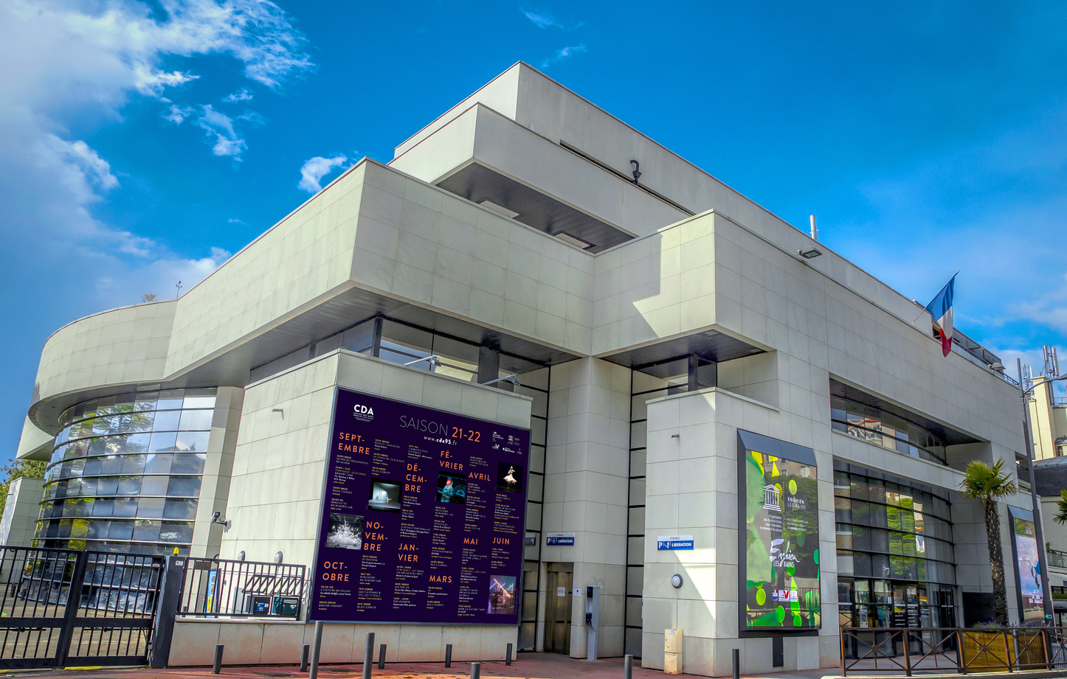
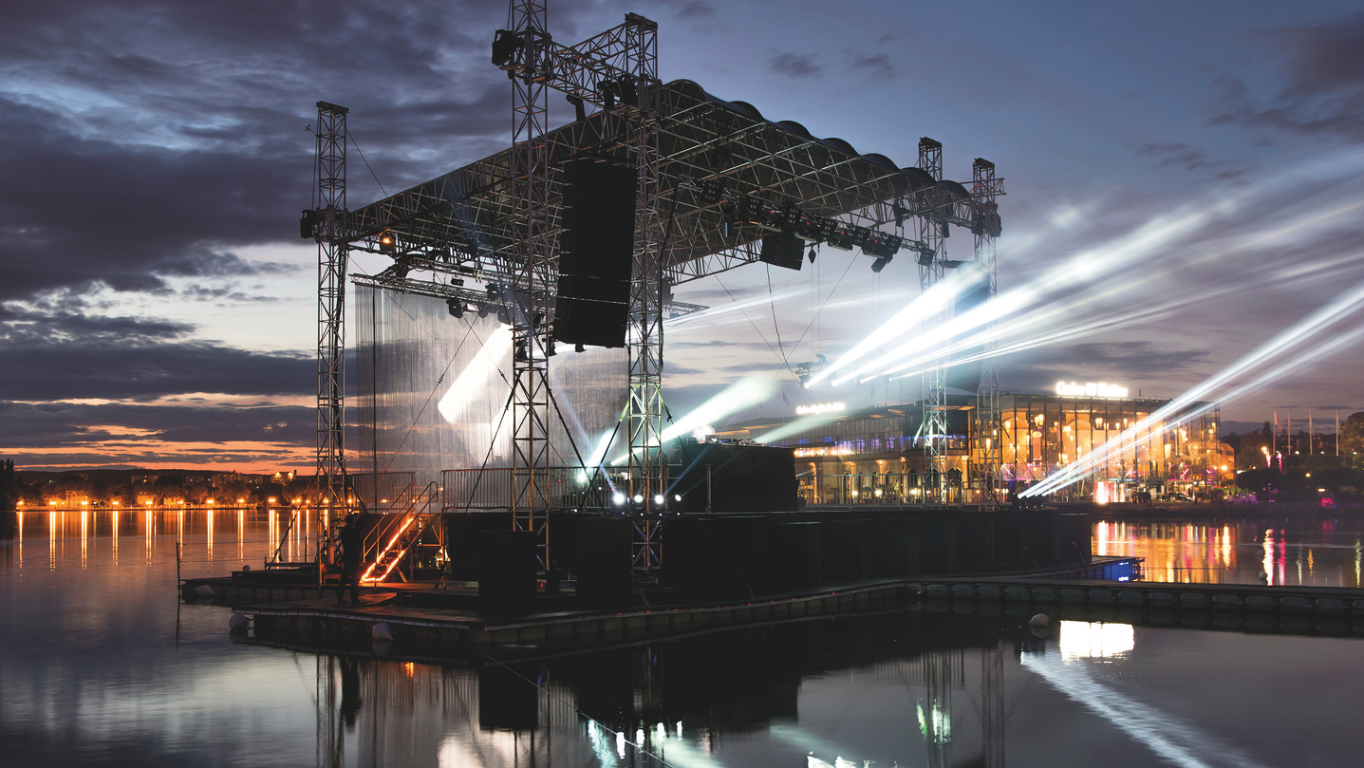

Dominique ROLAND
  Director of the Art Center in Enghien-les-Bains, a Nationally Accredited Stage for "Art and Creation in Digital Writing and Performing Arts" designated by the French Ministry of Culture
  Coordinator of the Creative Cities Network for Media Arts, Member of the Steering Committee of UNESCO's Creative Cities Network and the French Committee of Creative Cities
Anna HERMOUET
  International Cooperation Manager at Enghien-les-Bains’ Art Center and Focal Point for Enghien-les-Bains, Creative City of Media Arts

Slide 3
“New Possibilities for Winter Cities - Realizing a Sustainable Society”
Significance of City Networks such as WWCAM
The example of
the UNESCO Creative Cities Network (UCCN)
to achieve a sustainable society

Slide 4
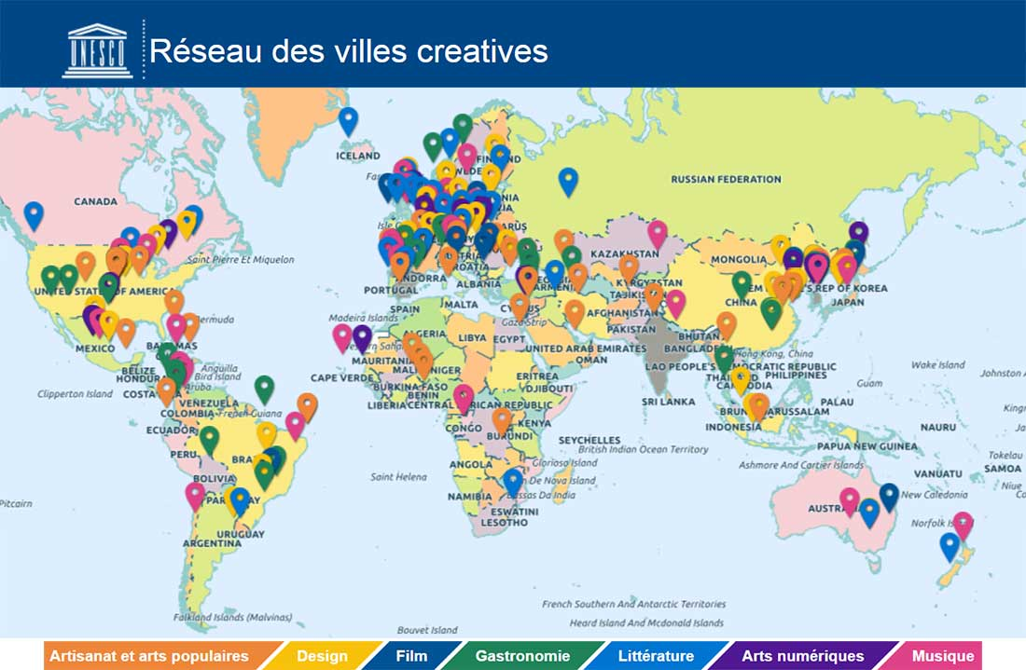
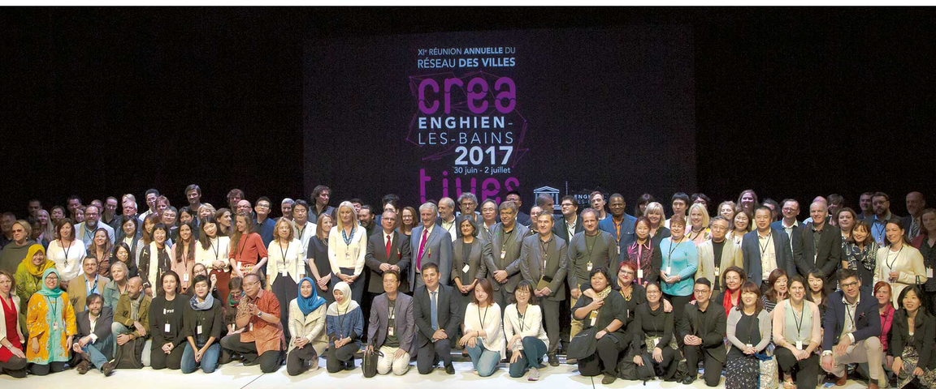
UNESCO Creative Cities Network
A Worldwide City Network
Created in 2004
Objective:
Encouraging collaboration among cities that recognize creativity as an essential drive of sustainable urban development
8 Creative Fields:
Architecture, Craft and Folk Art, Media Arts, Film, Design, Gastronomy, Literature, Music

Slide 5


Slide 6
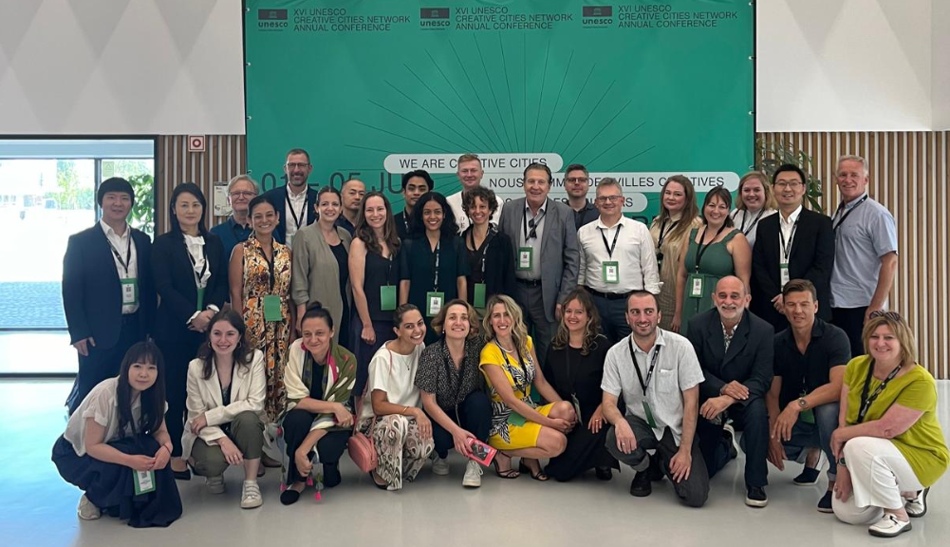
Focus on the Media Arts Cluster
25 Cities around the World Cooperating to Promote SDGs
1. Austin (USA)
2. Braga (Portugal)
3. Caen (France)
4. Casablanca (Marroco)
5. Cali (Colombia)
6. Campina Grande (Brasil)
7. Changsha (China)
8. Dakar (Senegal)
9. Enghien-les-Bains (France)
10. Guadalajara (Mexico)
11. Gwangju (South Korea)
12. Hamar (Norway)
13. Karlsruhe (Germany)
14. Kosice (Slovakia)
15. Linz (Austria)
16. Modena (Italia)
17. Namur (Belgium)
18. Novi Sad (Serbia)
19. Oulu (Finland)
20. Sapporo (Japan)
21. Tbilisi (Georgia)
22. Tel Aviv (Israel)
23. Toronto (Canada)
24. Viborg (Denmark)
25. York (England)

Slide 7
Focus on the Media Arts Cluster
25 Cities around the World Cooperating to Promote SDGs
3 Main Objectives
01
02
03
Facilitating knowledge exchange among artists, experts and city officials
to integrate media arts into public policies, in alignment with the Sustainable Development Goals (SDGs)
Supporting media artists and entrepreneurs
in the Creative and Cultural Industries
Engaging citizens in inclusive media arts initiatives
that promote access to digital technology and foster intercultural dialogue

Slide 8
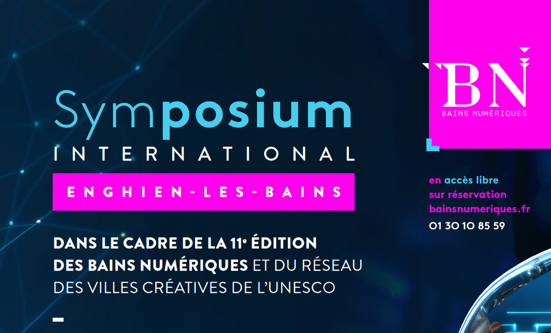
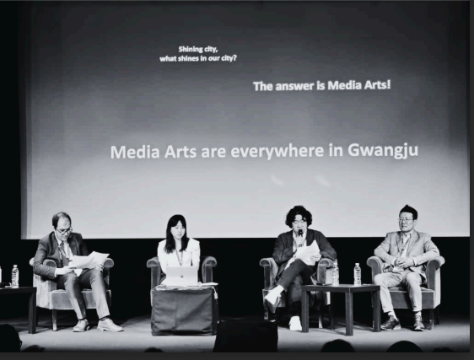
Example
June 2024 - Enghien-les-Bains’ Media Arts Biennale and its International Symposium
  Topics:
    Digital Creativity as a Tool for Urban Sustainable Developement
    How is AI Transforming Creation?
  Representatives from Gwangju, Caen, Kosice, Enghien-les-Bains, Campina Grande, Novi Sad, Namur and York contributed as Keynote Speakers

Slide 9

X
UNESCO Media Arts Cities ?

Slide 10
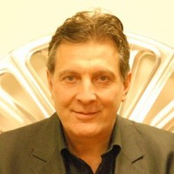
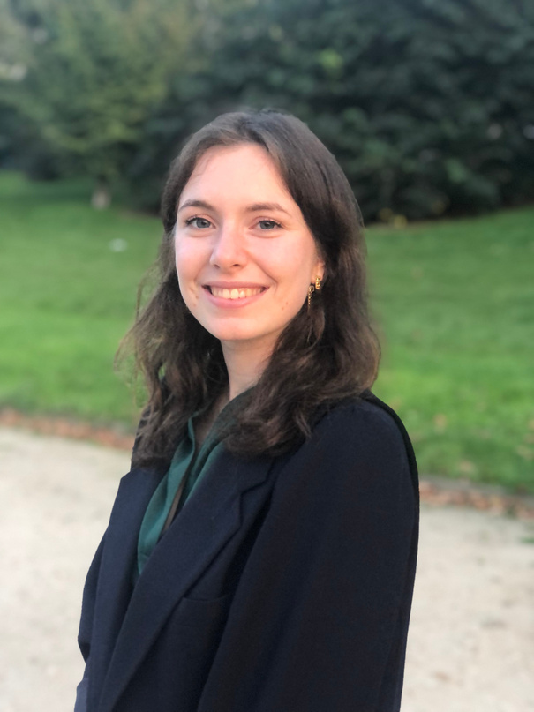
Thanks for your attention.
CONTACT
Dominique ROLAND
Coordinator of the Media Arts Cluster
& Director of Enghien-les-Bains’ Art Center
d.roland@cdarts.enghien95.fr
Anna HERMOUET
Focal Point for Enghien-les-Bains, UNESCO Creative City
International Cooperation Manager at the Art Center
d.roland@cdarts.enghien95.fr

