Slide 1
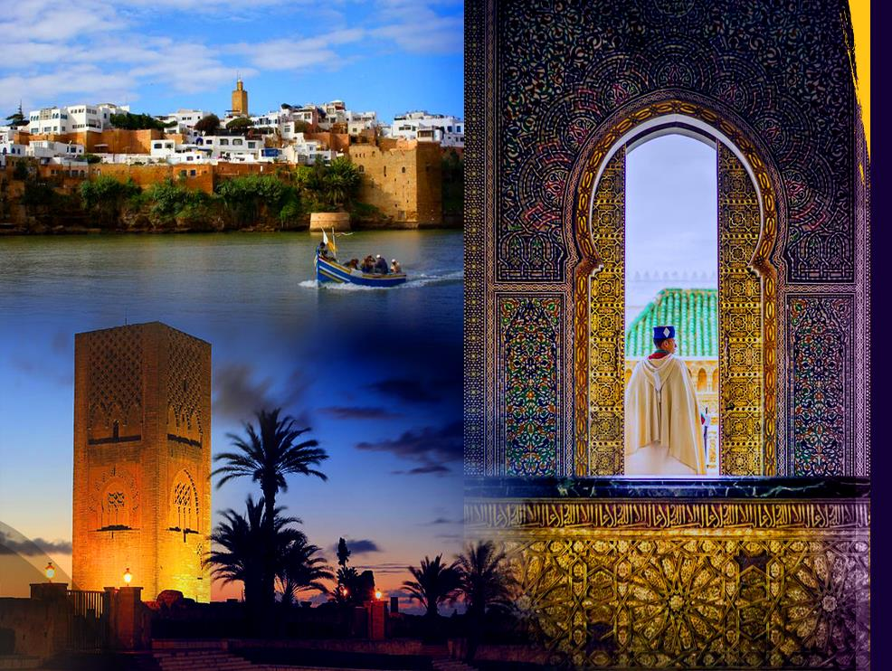
CULTURALLY SENSITIVE URBAN PLANNING
DECEMBRE 2024

Slide 2
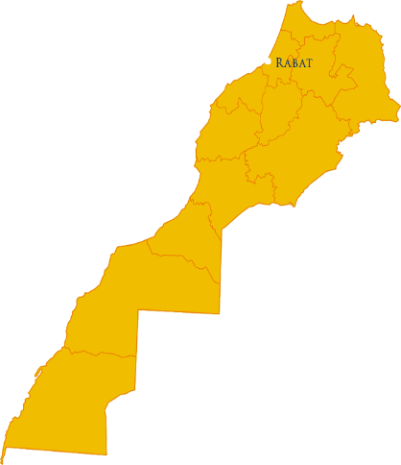
SYMMARY
GENERAL INTRODUCTION
FRAME OF REFERENCE
RABAT'S ASSETS
CULTURAL DYNAMICS
LOCAL PLANNING
CONCLUSION

Slide 3
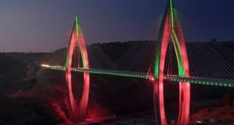
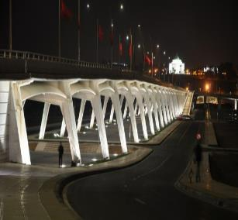
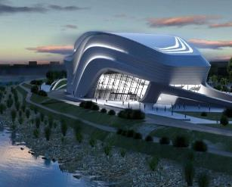
GENERAL INTRODUCTION

Slide 4
GEOGRAPHICAL LOCATION

Slide 5
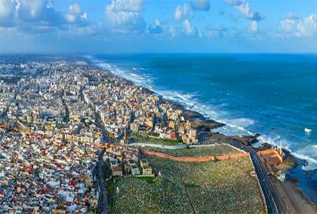
GENERALITES
A PROPOS DE RABAT
Rabat has been the capital of the Kingdom of Morocco since 1912, It is an imperial and historical city;
Capital of the RSST agglomeration;
Represents with its agglomeration the 2nd largest pole of Morocco in terms of population, and has more than 2,422,000 inhabitants, with 1275 km2 of surface area (ST dormitories);
Located on the left bank of the estuary of the river BOUREGREG on the Atlantic coast and Built in the time of the Almohads, as a great capital under the name of Ribat Al-Fath;
Crucible of civilizations: Its history dates back 2500 years when the Phoenicians, Carthaginians and Romans, as well as other civilizations settled there, including the Alawite dynasty;
Strategic position between Africa and Europe and center of the largest national economic pole Casa-Kenitra: 10 minutes from RS airport and 60 minutes from the Mohammed V Casa AE.
3
Notes:
5

Slide 6
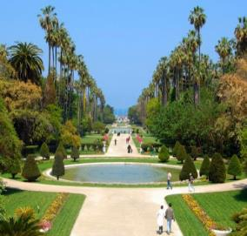
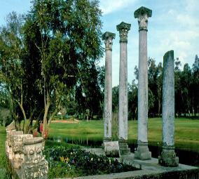
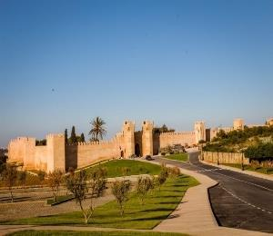
FRAME OF REFERENCE

Slide 7
FRAME OF REFERENCE
NEW CONSTITUTION 2011;
ORGANIC LAW 113-14 ON LOCAL AUTHORITIES;
MUNICIPAL ACTION PLAN AND REGIONAL DEVELOPMENT PLAN;
NATIONAL STRATEGIES AND SECTORAL PROGRAMMES;
NEW DEVELOPMENT MODEL;
INTERNATIONAL COMMITMENTS: Global Agendas (UN Agenda 2030, African Agenda 2063), the New Urban Agenda, the Paris Agreement for Climate Change, the Sendai Agenda for Risks,... etc.

Slide 8
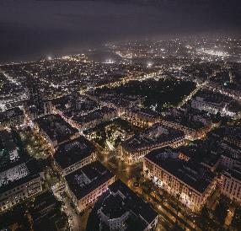
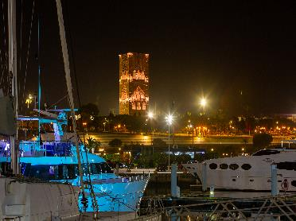
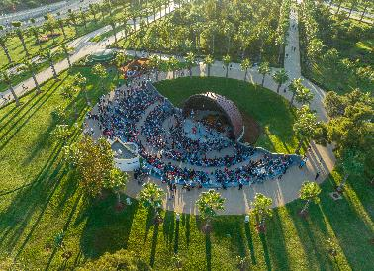
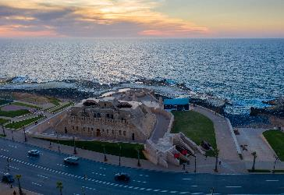
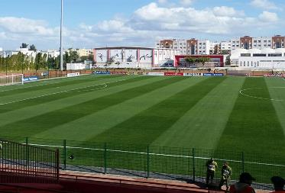
RABAT’S ASSETS

Slide 9
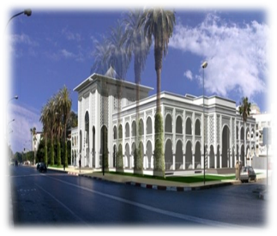
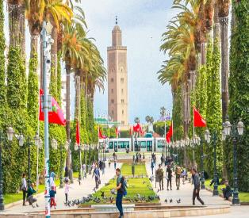
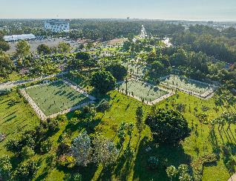
RABAT’S ASSETS
Political and Administrative Capital since 1912:
Granted the status of a city unit since 2002,
Communal space shared between 5 districts.
Headquarters of all ministerial departments, Parliament, development banks, diplomatic representations, and political parties; etc
Scientific Capital and City of Knowledge:
Home to an AL IRFANE university town with a smart campus;
National Library, Archives of the Kingdom and media libraries;
Recognized scientific institutions: Mohammed V University, AL QASSIS University, National School of Administration, Mohammedia School of Engineering, National School of Architecture, ESI, etc. …
Declared a "Green City" in 2010:
On the celebration of the 40th anniversary of Earth Day
Has 4700 hectares of green heritage with a ratio of 75m2/ha (entirely irrigated by treated and recycled water). This ratio will increase to 89m2 in the new development plan DP;
2 forests, botanical test garden, amusement parks (Mountazah HASSAN II), CITY GARDEN with its different gardens such as Nouzhat Hassan, El Majd garden, El Kifah, , Ibn Rochd, Ibn Toumert ... etc
9

Slide 10
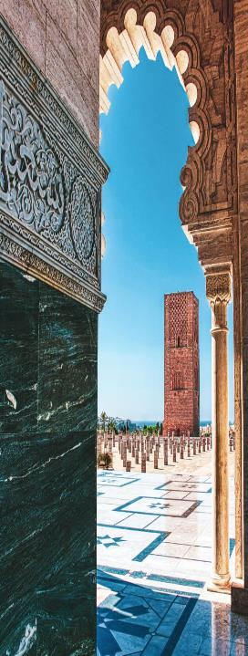
RABAT’S ASSETS
Historic City, declared by UNESCO "World Humanitarian Heritage" in 2012
Symbolic cultural heritage rich in historicity:
(Emblematic sites: Chellah, the Kasbah of the Oudayas, the Andalusian Wall, the Hassan Tower, the Mohammed V Mausoleum, the Almohad ramparts and gates, etc.
Cultural Capital par excellence: Tangible and intangible heritage
It is home to a large number of cultural and historical sites: Big Theatre, Mohammed V Theatre, Mohammed VI Museums of Modern Arts, Museum of Adornment, Villa of arts, Bank al Maghrib Museum; Earth Science Museum, Museum of photography...;
Teeming with international cultural and artistic meetings: exhibitions and festivals recognized worldwide: Book Festival, Mawazine International Festival, and Chellah Jazz Festival, International Festival of Auteur Cinema, Mediterranean Festival of Women's Writings, Water Sports Festival, Al Madih Festival, Nomadic Sports Festival (tbourida) etc.
10

Slide 11
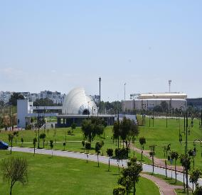
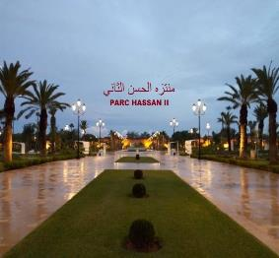
Safe, inclusive and sustainable city
Sustainable projects (REUZE, seawater desalination, energy efficiency, sustainable mobility, etc.) etc
Gendre Initiatives that address the issue of women, girls and children in public spaces (the Rabat City Protector of its Children Project and the Rabat City Safe and Free of Violence against Women and Girls Project);
A territory of living together, integration and citizenship
Inclusive infrastructure: Municipal swimming pool, Local courts, local theatres, Youth centers, Guest houses, amusement parks with sports facilities (skateboarding, basketball, ball section, bowls, jogging, hiking,... etc
Events : Hosts sporting events (jetsky water sports, golf, etc.), world forums and international congresses,
Hosts a large number of students from the African continent and other nationalities, while being aware of the need to enhance its value as a basis for the creation of wealth and co-development
11

Slide 12
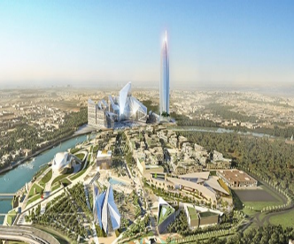
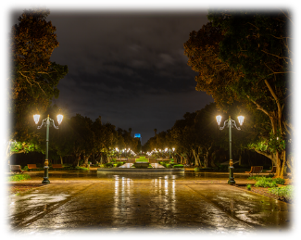
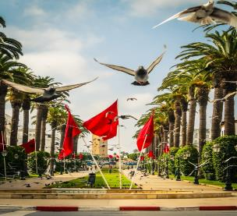
RABAT’S ASSETS
Open and international city
Strengthening the bonds of friendship and fraternity between communities (Twinning with more than 25 cities around the world and in partnership with several cities and capitals of the 5 continents),
Member of several international organizations and networks of cities (UCLG, UCLGA, AIMF, METROPOLIS, STRONG CITIES, LUCI, AIVE, OVA, OICC, Observatory of Living Together OVE, OIDP, ICLEI, WEGO...).
"City of Light, Moroccan Capital of Culture" (2014)
Integrated regeneration project that mobilized many actors with a specific and participatory financial package;
Realization of a multitude of structuring projects in various sectors of activity with the creation of socio-economic co-development at various scales.
12

Slide 13
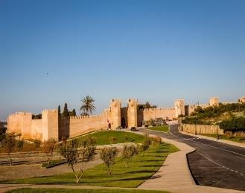
CULTURAL DYNAMICS

Slide 14
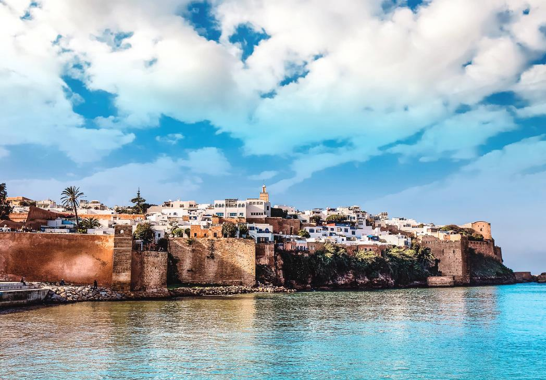
HISTORICAL HERITAGE

Slide 15
HISTORICAL HERITAGE
The Kasbah of the Oudayas which has been restored and rehabilitated;
The botanical test garden enhanced and preserving the landscape and architectural attribute of the garden;
The old medina of rabat which is a historical urban fabric and our role is to preserve and enhance it;
The ramparts and gates refurbished in a way that preserved their long historical years;
The site of Chellah, which was probably the oldest human settlement at the mouth of the Bouregreg river, which dates back to 700 BC and today this emblematic site receives a large part of national and international tourists,...;
The habous Diour Jamaa district is a totally preserved and enhanced city;
The Hassan Mosque and the Mohammed V Mausoleum, ... Etc;
The heritage components of the buffer zone have also benefited from several rehabilitation and development actions.

Slide 16
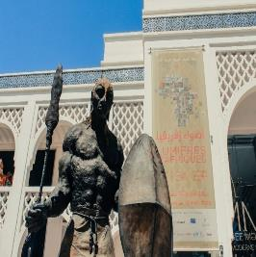
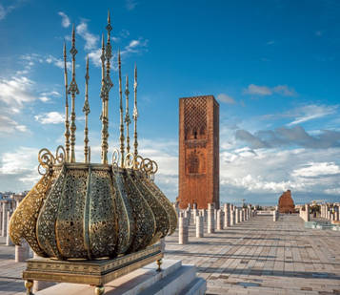
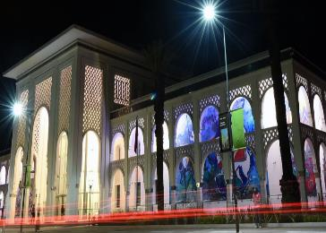
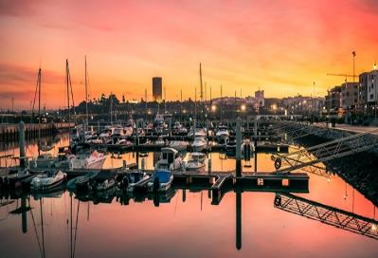
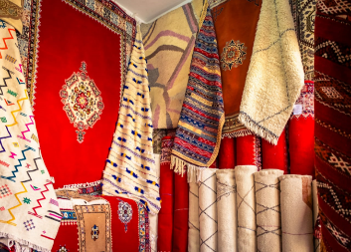
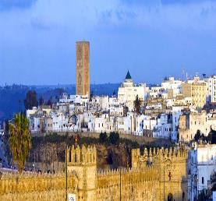
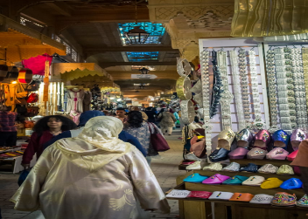
HISTORICAL HERITAGE

Slide 17
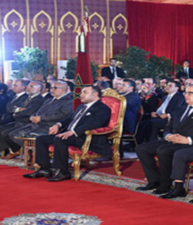
RABAT CAPITAL OF CULTURE
« Rabat City of Light, Moroccan Capital of Culture»
His majesty the king mohammed vi may god assist him, launched TWO DEVELOPMENT PROGRAMS THAT SHAPED THE CITY OF RABAT, the BOUREGREG VALLEY DEVELOPMENT PROGRAM (2006) AND THE RABAT CITY OF LIGHT, MOROCCAN CAPITAL OF CULTURE PROJECT (2014).

Slide 18
INTEGRATED ROYAL PROGRAM
« RABAT CITY OF LIGHT, MOROCCAN CAPITAL OF CULTURE »
This project is structured around seven main AREAS, namely
Improving access to local social services and facilities
Strengthening governance
consolidation
and the modernization of transport equipment
Enhancement of cultural and civilizational heritage
Preservation of green spaces and the environment
Requalification of the urban landscape
Improving access to local social services and facilities

Slide 19
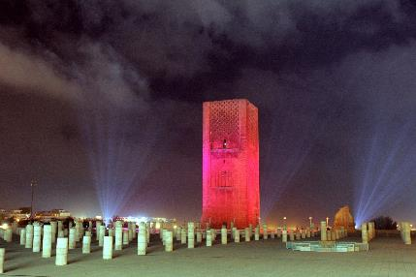
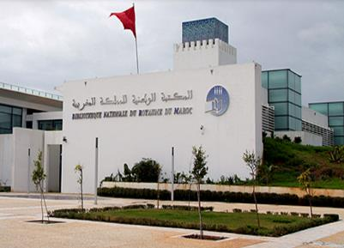
RABAT CAPITAL OF CULTURE
CULTURE
LITERATURE
present in its main languages:
French, Arabic, Darija and Amazigh,
through the whole range of means of expression:
novels, theatre, poetry recitals, storytelling jousts, cinema, rappers, festivals of women's writings, and cultural events.
Rabat has always been a cultural cradle, through its writers, painters and many artists in various fields.
It has always promoted culture as the 4th pillar of development.

Slide 20
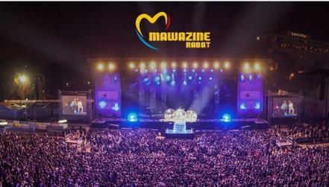
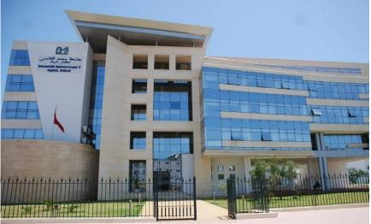
RABAT CAPITAL OF CULTURE
FESTIVALS
ACADEMIC ACTIVITIES
The most famous of which are the Mawazine International Festival, the FESTIVAL OF BOOK, Jazz Festival, the Festival of Women's Writings, Al Madih Festival, ... etc
A city of knowledge through its universities and schools of great renown: (Mohammed V University, Abu cassis University, International University of Rabat, ENA, ENSA, ESIG, EMI, ENSIM, ,....)

Slide 21
CULTUREL MONUMENTS
Under the impetus of HIS MAJESTY KING MOHAMMED VI, MAY GOD ASSIST HIM, Rabat aims to be the symbol of Moroccan culture, home to many cultural monuments with the Mohammed V National Theater, its cultural institutes, its exhibition galleries, its HOME OF ARTS, its Universities and HIGH SCHOOLS, the National Library and its Museums which highlight the cultural richness of the capital.

Slide 22
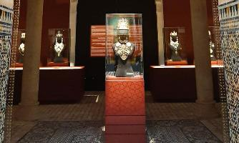
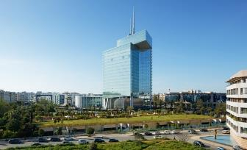
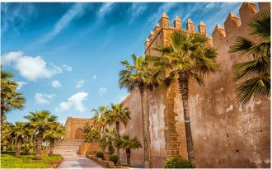
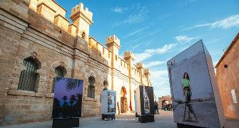
SOME MUSEUMS IN RABAT
National Museum of JEWERLLY
Morocco Telecom Museum
National Museum of Photography
OUDAYA MUSEUM

Slide 23
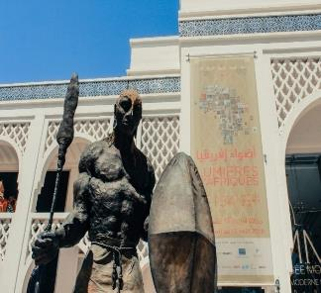
Mohammed VI Museum of Modern and Contemporary Arts
The Mohammed VI Museum of Modern and Contemporary Art (MMVI)
presents four hundred works by Moroccan artists, established in Morocco or abroad, from the twentieth and twenty-first centuries.
It is the first independent museum in Morocco dedicated to national modern art, and the first major national museum built in Morocco
since THE independence.

Slide 24
RABAT 1ère CAPITALE AFRICAINE DE LA CULTURE RCAC
CAPITALE CULTURELLE DANS LE MONDE ISLAMIQUE
NOMINATIONS OF RABAT
2022-2023
1st African Capital
of Culture
Cultural Capital in the
Islamic World

Slide 25
CULTUREL COOPERATION
PARTNERSHIPS AROUND CULTURE
Partnership agreement signed between the Ministry of Youth, Culture and Communication and the Municipality of Rabat with the aim of:
Upgrade, equipment and management of cultural affairs at the level of the cultural centers of the city of Rabat,
Creation of local theatres in each district to allow children and young people to practice the art of theatre, with different international languages.

Slide 26
These projects were initiated under the enlightened strategic vision of HIS MAJESTY KING MOHAMMED VI MAY GOD ASSIST HIM, who guided the Cherifian Capital Rabat towards the development of an inclusive and resilient urban landscape,
in harmony with the aspirations of the people.
WILAYA OF RABAT SALE KENITRA REGION
MINISTERIEL
DEPARTEMENTS
CITY OF RABAT
Participative Approch
PRIVATE SECTOR
(LOCAL DEVELOPMENT COMPAGNIES)
LOCAL ACTORS
Notes:
Il est important de relever que ces projets ont été initiés sous la vision éclairée de SM LE ROI MOHAMMED VI QUE DIEU LE GLORIFIE, et La réussite de ces programmes de développement est le résultat d’une bonne gouvernance et d’une collaboration stratégique étroite avec la Wilaya de la Région Rabat-Salé-Kénitra, les SDL, les départements ministériels clés et les acteurs locaux, suivant une approche cohérente et concertée.

Slide 27
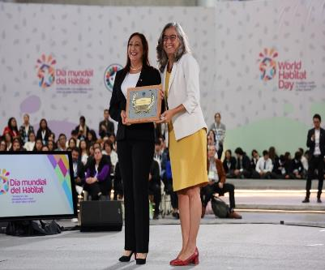
NOMINATIONS OF RABAT
UN HABITAT SCROLL OF HONOUR 2024
MEDITERRANEAN AWARD OF EXCELLENCE 2024
Notes:
Ces efforts ont été reconnus mondialement, ce qui a valu à la ville de Rabat en 2024 le prix d’honneur d’ONU HABITAT en termes de planification urbaine durable, et le prix d’excellence méditérneen en matière de d’inclusion sociale et de développement culturel

Slide 28
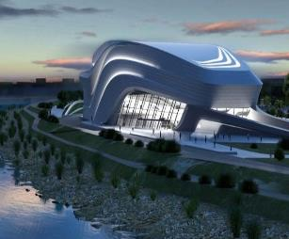
GENDERED AND CULTURALLY
LOCAL PLANNING

Slide 29
COMMUNAL ACTION PLAN
Tool for building the municipal institution-1st stage of a process of structuring a real territorial governance-Integrative tool at the center of a system of actors;
ALLOW THE CITY COUNCIL TO
Launch a reflection on the structuring of the territorial administration as a whole with the anchoring of the proximity policy;
Formalize a framework of association between the State and the Region, with the aim of sharing the local prism for the definition of priority policies, prepare the implementation of own, shared and transferred competences, and then strengthen the deconcentration of State services;
Establish the "participatory mechanisms for dialogue and consultation" provided for in the articles of Law No. 113-14 and in particular the three "consultative bodies responsible for the study of local affairs relating to the implementation of the principles of equity, equal opportunities and the gender approach; questions relating to the interests of young people; regional affairs of a social, cultural and economic nature";
Prepare for the establishment of a territorial conference with the region and the prefecture, as part of a participatory process.

Slide 30
COMMUNAL ACTION PLAN
Defining development priorities while preserving the legacy and capitalizing on what has been achieved and what already exists;
Highlighting the "Environment-Sustainable Development" dimension and the Gender approach, in a transversal way in all local projects and initiatives;
Building a Harmony and convergence with the strategic orientations of the State and public bodies of the SRAT, PDR, PDP, PDI, etc. ;
Allowing the installation of mechanisms for dialogue and consultation with the various local actors (elected officials, standing committees, IEECAG, officials and civil servants of the municipality, heads of public bodies, civil society, etc.);
Satisfying the needs of the citizens of the municipality by providing them with the local services they aspire to;
Defining the adequacy of human and material resources with the needs of the municipality;
Allowing the evaluation of the resources and expenses of the municipality during the first 3 years within the framework of the programming.

Slide 31
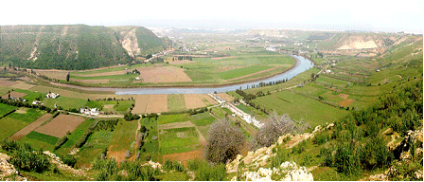
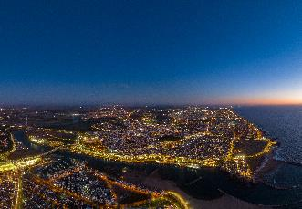
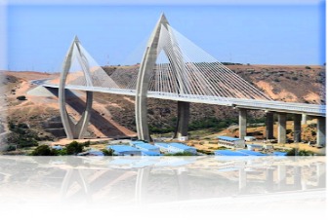
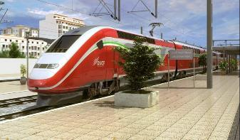
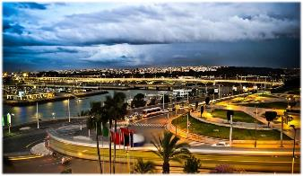
SECTOR-WIDE APPROACH TO SUSTAINABLE AND INTEGRATED PLANNING

Slide 32
SUSTAINABLE PLANNING APPROACH
The adoption of the concept of sustainable development has led to a reconsideration of interactive planning methods to allow the adoption of the principles of strategic, dynamic, innovative and proactive planning
Articles: 1, 2, 13 and 20 of Framework Law No. 99-12 on the National Charter for the Environment and Sustainable Development
Local authorities shall ensure that sustainable development measures are integrated into the public and sectoral policies, taking into account the specificities of each department
Articles: 1, 31, 35 and 136 of the Moroccan constitution of 2011
The TCs are led to adopt new missions regarding to :
- The approach of development program policy as a democratic choice;
- Good governance in terms of territorial planning.
Organic laws relating to local authorities

Slide 33
CONCLUSION
Culture plays a crucial role in local development. It is a source of employment, exports and income at the national and local levels.
Culture is an essential component of the living environment, a source of income linked to tourism, as well as a lever of creativity for the production of new goods and services.
Culture continues to be a powerful lever for social integration for communities in difficulty, contributing to the effective implementation of sustainable development and the implementation of the world's social agendas.
RABAT IS A CITY OF THE PAST, THE PRESENT AND LOOK FOR THE FUTURE,
it is a hotbed of meetings of civilizations and a cradle of culture;
Rabat is also an eco-responsible city, which preserves its rich and varied tangible and intangible heritage, and promotes cultural, social and economic development through integrated and resilient planning.

Slide 34
MERCI POUR VOTRE ATTENTION

