Slide 1
札幌国際芸術祭
Sapporo International Art Festival ( SIAF )
The 20th World Winter Cities Conference for Mayors
December 18, 2024
札幌国際芸術祭実行委員会
Sapporo International Art Festival Executive Committee
事務局長 片岡 泰
Executive Committee Secretary-General Tai Kataoka

Slide 2
What kind of city is Sapporo?

Slide 3
What kind of city is Sapporo?
City of Two Million
Sapporo’s Characteristics
Annual snowfall
of 5m
Snow removal
Underground shopping
center
City of heavy snowfall
Unique urban infrastructure
City and nature

Slide 4
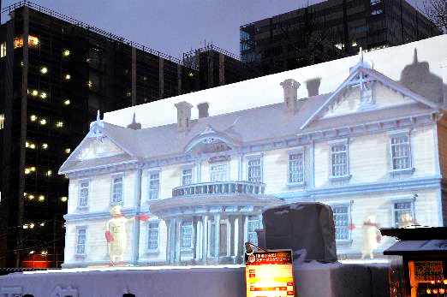
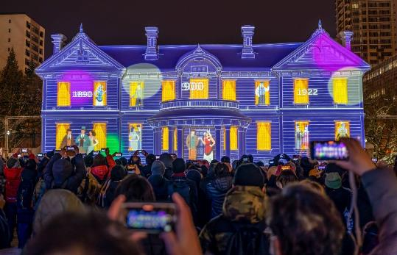
What kind of city is Sapporo?
Creativity x Industry
Development of media arts
Photo by AKITA Hidetaka
Photo by AKITA Hidetaka
Projection mapping onto large snow sculptures (Sapporo Snow Festival)

Slide 5
What kind of city is Sapporo?
“sapporo ideas city” Declaration
2006
A city where citizens rich in creativity live,
and the wisdom generated through exchange with
the outside world nurtures new industries and culture
and constantly transmits new things, ideas, and information.

Slide 6
What kind of city is Sapporo?
Work emblematic of “Creative City Sapporo”
International art exhibition
Sapporo International Art Festival

Slide 7
Joining the UNESCO Creative Cities Network
What kind of city is Sapporo?
(Nov 2013)
City is recognized as a member of the “Media Arts Cities”
Plans and exhibitions centered around media arts at SIAF

Slide 8
SIAF up to now

Slide 9
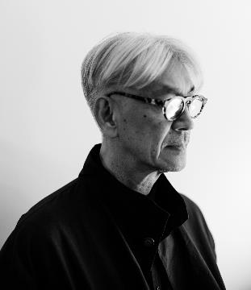
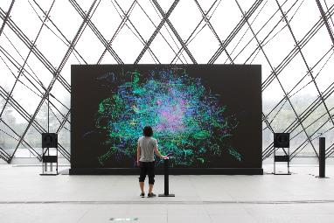
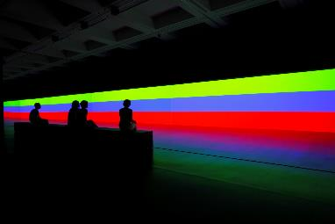
Sapporo International Art Festival 2014 (SIAF2014)
July 19th - September 28th, 2014
2014
Internationally successful artists participated in this art festival to think about how cities and nature could coexist in the future.
Various programs, such as exhibitions, performances, and open call projects, were held at various locations in Sapporo.
©2011 Kab Inc.
Photography by Rama
Guest Director
Ryuichi SAKAMOTO
Theme
City and Nature
Subtheme
Nature/City/Economy, Community and Life
▲ SAKAMOTO Ryuichi + MANABE Daito
《Sensing Streams 不可視、不可聴》
Photo by KIOKU Keizo
▲ Carsten Nicolai《unicolor》
Photo by KIOKU Keizo

Slide 10
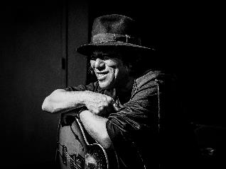
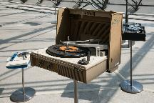
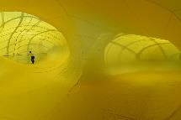
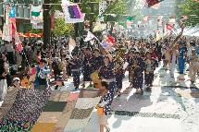
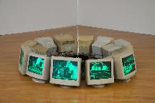
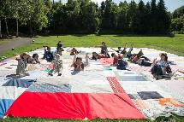
Sapporo International Art Festival 2017 (SIAF2017)
August 6th - October 1st, 2017
2017
SIAF2017 Hosted events and various artistic performances open to anyone over consecutive days.
In the citizen participation program, the O-furoshiki Project, a large furoshiki (Japanese wrapping cloth) sewn together by many citizens decorated the city throughout the duration of the event.
In addition to museums and other cultural facilities, the festival also utilized multipurpose buildings in the city's center and held exhibitions for works that did not fit into existing genres.
Photo by Peter Gannushkin
Guest Director
Yoshihide OTOMO
Theme
How do we define “Art Festival”?
Subtheme
When bits and pieces become asterisms
▲ OTOMO Yoshihide
+ AOYAMA Yasutomo
+ ITO Takayuki
《(with)without records》2017
Photo by KOMAKI Yoshisato
▲ MATSUI Shiro
《climbing time / falling
time》2017
Photo by KOMAKI Yoshisato
▲Eve of 2017:
Sapporo August Festival
Photo by KOMAKI Yoshisato
▲ Christian MARCLAY
《Recycling Circles》2005
Photo by KOMAKI Yoshisato
▲ SIAF2017 Closing event:
Music＆Art Set Free
in Moerenuma Park
Photo by KOMAKI Yoshisato

Slide 11
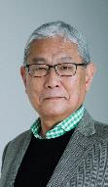
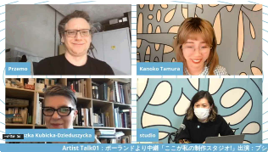
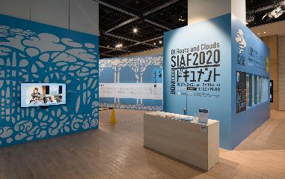
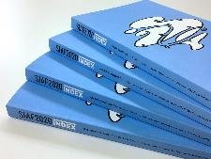
Sapporo International Art Festival 2020 (SIAF2020) Canceled
2020
Planned various initiatives to connect the art festival with audiences.
Aimed to be held in the winter for the first time but was canceled due to the global spread of COVID-19.
As a special edition of SIAF 2020, an online program and an introductory exhibition of the planned projects were held. Additionally, a record book was published in March 2021.
Director Team
Taro AMANO, Agnieszka KUBICKA-DZIEDUSZYCKA, Kanoko TAMURA
Theme:
Of Roots and Clouds: Striving to Live Here
Subtheme
Sinrit/Niskur (Ainu)
▲SIAF2020 DOCUMENT
Photo by FUJIKURA Tsubasa
Photo by TAKUMA Noriko

Slide 12
Sapporo International Art Festival 2024 (SIAF2024)
January 20th – February 25th
A major art event that reflects on the future.

Slide 13
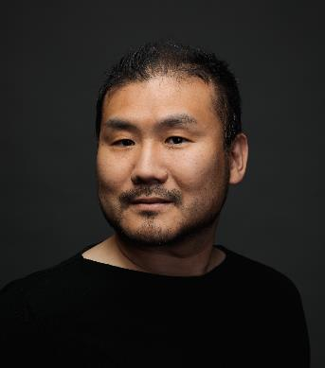
Sapporo International Art Festival 2024 (SIAF2024)
January 20th – February 25th
2024
Winter
Director
Ars Electronica Futurelab Co-Director
Hideaki OGAWA

Slide 15
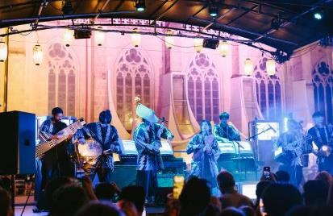
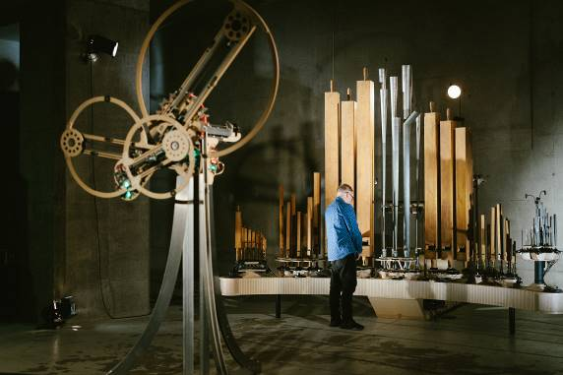
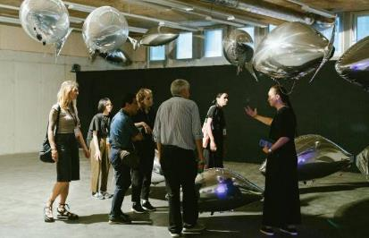
Ars Electronica Festival
2024 Exhibitions
▲ ELECTRONICOS FANTASTICOS!
▲ Bit.studio《FLOCK OF》
▲ Navid Navab, Garnet Willis《Organism＋Excitable Chaos》

Slide 17
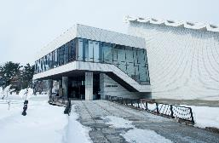
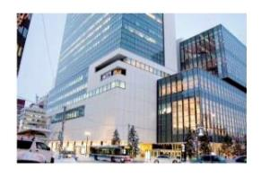
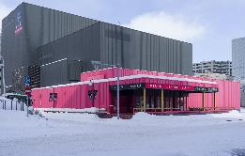
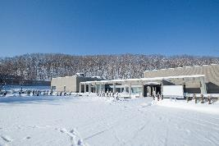
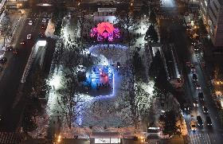
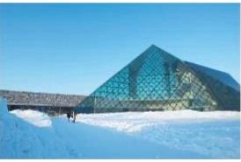
Six venues spanning from the city center to the suburbs
Photo by TAKUMA Noriko
Photo by TAKUMA Noriko
Photo by FUJIKURA Tsubasa
Hokkaido Museum
of Modern Art
The keyword is “fragile = handle with care?!”
Sapporo Cultural Arts Community Center (SCARTS)
The starting point for the SIAF2024 journey
Future Theater
(Higashi 1-chome theater)
A place to think 100 years into the future
Experimental Zone of the Future’s Winter
Photo by TAKUMA Noriko
Photo by KOMAKI Yoshisato
Photo by TAKUMA Noriko
Sapporo Art Museum
Discover the joy of media art!
Sapporo Snow Festival
Odori 2-chome Site
To the experimental zone of
snow and the future
Moerenuma Park
Snow $×$ Sports $×$ Technology:
Creating the sports of the future

Slide 18
Six venues spanning from the city center to the suburbs
Photo by TAKUMA Noriko
Photo by TAKUMA Noriko
Photo by FUJIKURA Tsubasa
Hokkaido Museum
of Modern Art
The keyword is “fragile = handle with care?!”
Sapporo Cultural Arts Community Center (SCARTS)
The starting point for the SIAF2024 journey
Future Theater
(Higashi 1-chome theater)
A place to think 100 years into the future
Experimental Zone of the Future’s Winter
Experimental Zone of the Future’s Winter
Photo by TAKUMA Noriko
Photo by KOMAKI Yoshisato
Photo by TAKUMA Noriko
Sapporo Art Museum
Discover the joy of media art!
Sapporo Snow Festival
Odori 2-chome Site
To the experimental zone of
snow and the future
Moerenuma Park
Snow $×$ Sports $×$ Technology:
Creating the sports of the future

Slide 19
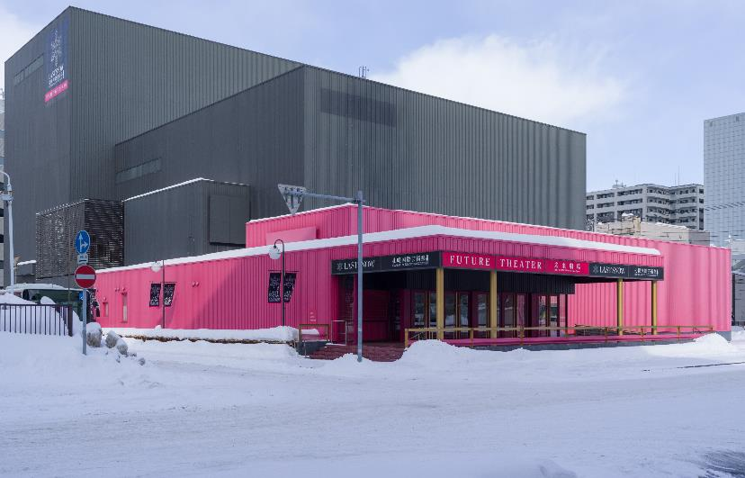
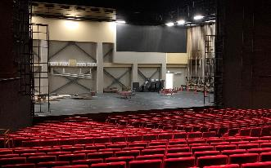
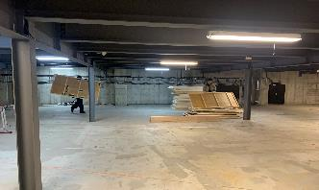
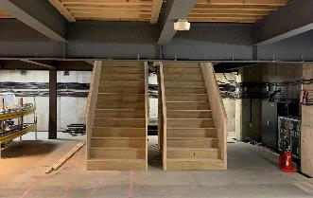
Photo by FUJIKURA Tsubasa
Sapporo International Art Festival 2024 (SIAF2024)
Future Theater
▲ The theater was transformed
into an exhibition space

Slide 20
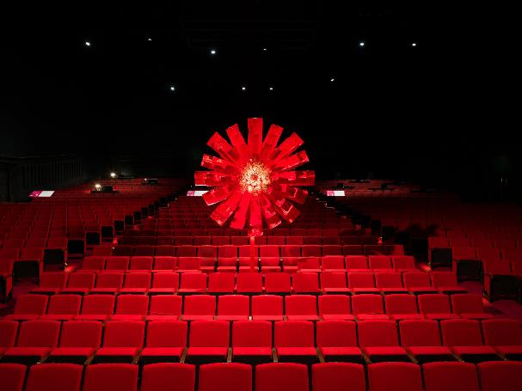
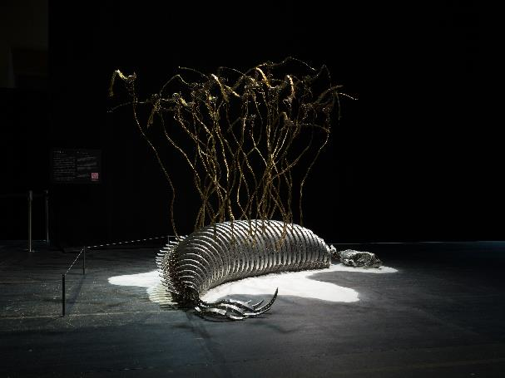
Photo by FUJIKURA Tsubasa
Photo by FUJIKURA Tsubasa
▲ A work of art installed in the auditorium.
CHOE U-Ram《Red》
▲ Installation view utilizing the main stage.
CHOE U-Ram《Custos Cavum》

Slide 21
Six venues spanning from the city center to the suburbs
Photo by TAKUMA Noriko
Photo by TAKUMA Noriko
Photo by FUJIKURA Tsubasa
Hokkaido Museum
of Modern Art
The keyword is “fragile = handle with care?!”
Sapporo Cultural Arts Community Center (SCARTS)
The starting point for the SIAF2024 journey
Future Theater
(Higashi 1-chome theater)
A place to think 100 years into the future
Experimental Zone of the Future’s Winter
Photo by TAKUMA Noriko
Photo by Yoshisato Komaki
Photo by TAKUMA Noriko
Sapporo Art Museum
Discover the joy of media art!
Sapporo Snow Festival
Odori 2-chome Site
To the experimental zone of
snow and the future
Moerenuma Park
Snow $×$ Sports $×$ Technology:
Creating the sports of the future

Slide 22
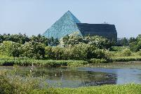
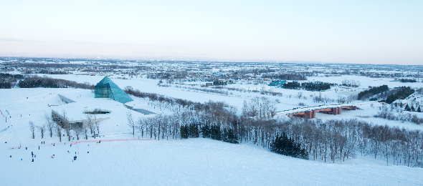
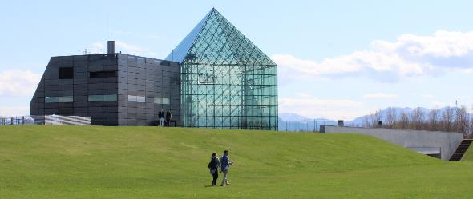
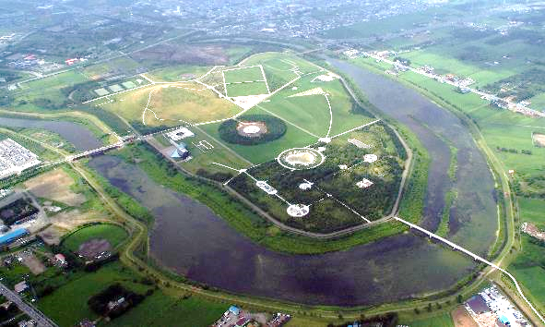
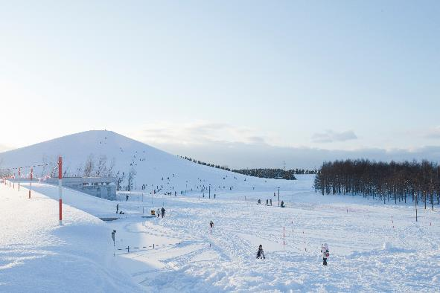
左側のグリーンシーズンの写真のみ撮影者不明（SIAF2014の頃の写真）
Photo by TAKUMA Noriko
MOERENUMA PARK
Designed by ISAMU NOGUCHI
Photo by TAKUMA Noriko

Slide 23
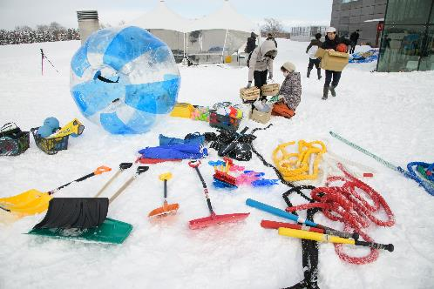
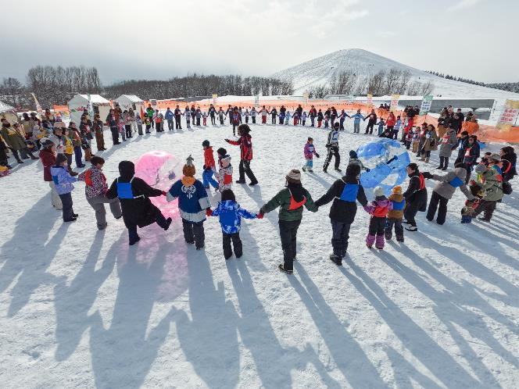
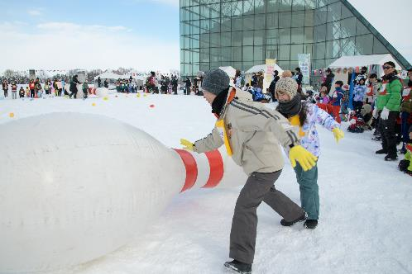
Photo by KOMAKI Yoshisato
Photo by KOMAKI Yoshisato
Moerenuma park
“Sapporo Future Undokai”
Photo by KOMAKI Yoshisato
(Undokai meaning sports day / field day in Japanese)

Slide 24
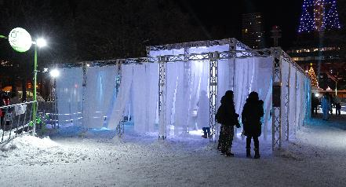
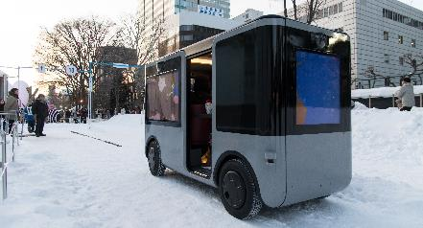
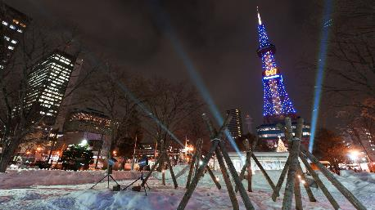
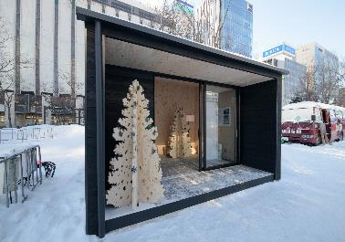
Sapporo Snow Festival Odori 2-chome Site
Photo by KOMAKI Yoshisato
Photo by KOMAKI Yoshisato
▲ Panoramatiks + NIKKEN SEKKEI LTD
《Future Snow City Signage》
▲ Ryohin Keikaku Co.,Ltd.《Local mobility》
Photo by KOMAKI Yoshisato
Photo by KOMAKI Yoshisato
▲ SAITO Seiichi + Panoramatiks《meta forest》
SAITO Seiichi + Panoramatiks《JIKU#020 SAPPORO｜ODORI》
SIAF Lab《SIAF Lab. Extreme Experiments》
▲ Ryohin Keikaku Co.,Ltd.《Compact life》

Slide 25
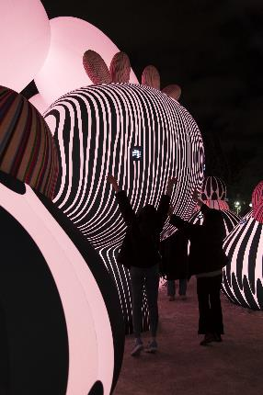
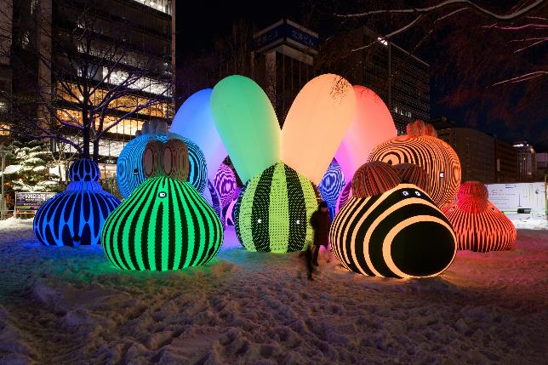
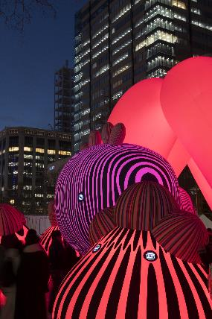
Sapporo Snow Festival Odori 2-chome Site
▲ ENESS《Airship Orchestra》
Photo by KOMAKI Yoshisato

Slide 28
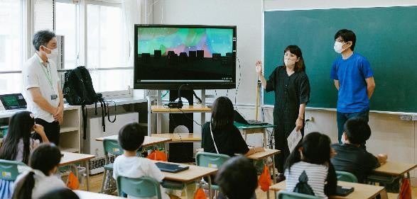
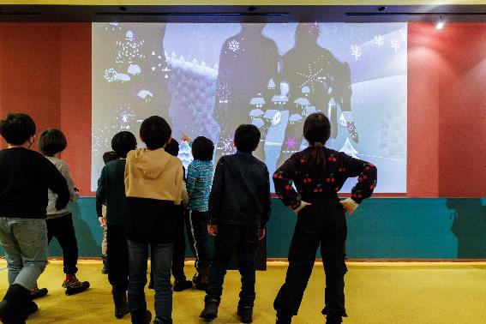
SIAF School
Project for SIAF to function as a school of the future
An example of our efforts
Artists visited elementary schools as instructors and conducted programming classes to create snowflakes.
853 students from 12 elementary schools participated
▲ A programming class
Photo by KUSUMI Erika
▲ Creating original snowflakes with programming
▲ Students viewing their created snowflakes at the Future Theater

Slide 29
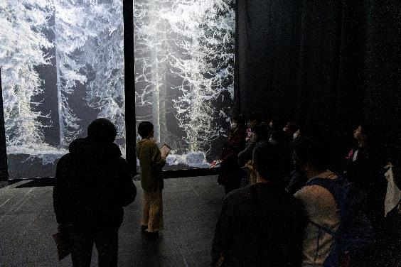
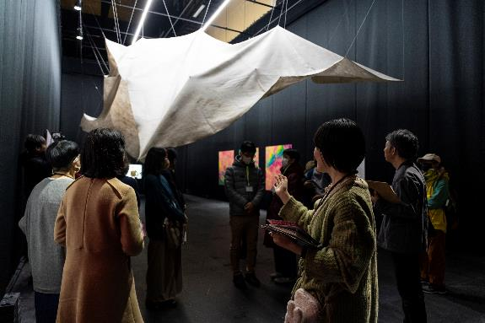
SIAF School
Project for SIAF to function as a school of the future
Photo by MOMMA Yusuke
Photo by MOMMA Yusuke
▲ Volunteers trained through guide training programs introducing Future Theater installations to visitors

Slide 30
SIAF2024 Initiative Partners

Slide 31
SONY
×
Norimichi
Hirakawa
《INTO SIGHT》
◀ Sony Design in collaboration
with HIRAKAWA Norimichi
《INTO SIGHT at SIAF2024》
HIRAKAWA Norimichi
《six-petal automata》
Photo by MOMMA Yusuke

Slide 32
WWCAM $×$ SIAF
Collaborative Exhibition
“Transforming Sapporo’s Winter!
10 Years of SIAF”
Open Now
Kita 1-jo Nishi 1-chome, Chuo-ku, Sapporo
Sapporo Cultural Arts Community Center (SCARTS)
(1F Mall A + B)
Open until Dec 19th
Photo by TAKUMA Noriko

Slide 33
Photo by KOMAKI Yoshisato
Photo by KOMAKI Yoshisato
Photo by KOMAKI Yoshisato

Slide 34
Thank you for your attention!
See you next SIAF‼

