Slide 1
札幌市・ウランバートル市の 都市間連携事業による学術協力 Academic cooperation through intercity collaboration between Sapporo and Ulaanbaatar
Taro Mori, Hokkaido Univ.
Amarbayar A. National University of Mongolia

Slide 2
Decarbonization urban planning support project for energy transition in Ulaanbaatar City ウランバートル市のエネルギー転換における脱炭素都市形成支援事業
Decarbonization urban planning support project for energy transition in Ulaanbaatar City
JCM (Joint Crediting Mechanism)
Joint research on energy saving and renewable energy in residential life between Hokkaido University and National University of Mongolia

Slide 3
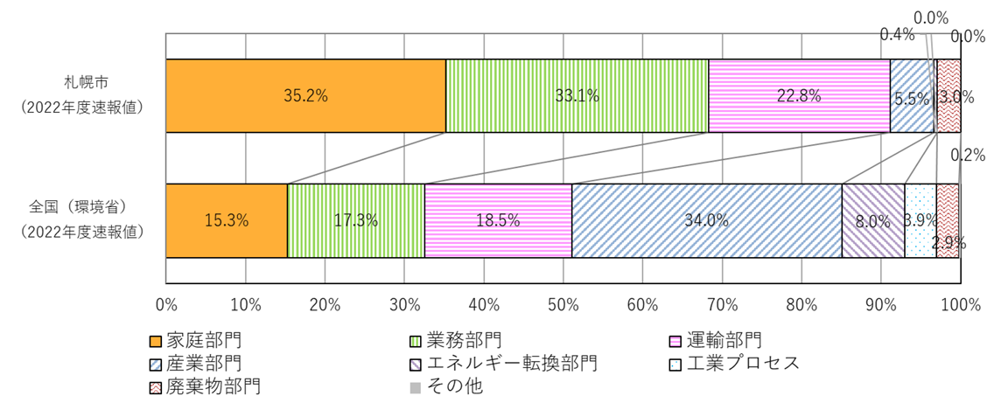
CO₂ emission in Sapporo
Household Commercial Transport
Sapporo
Industry
Japan
Household and Commercial sectors emit CO2
引用：札幌市気候変動対策行動計画 進行管理計画書2022

Slide 4
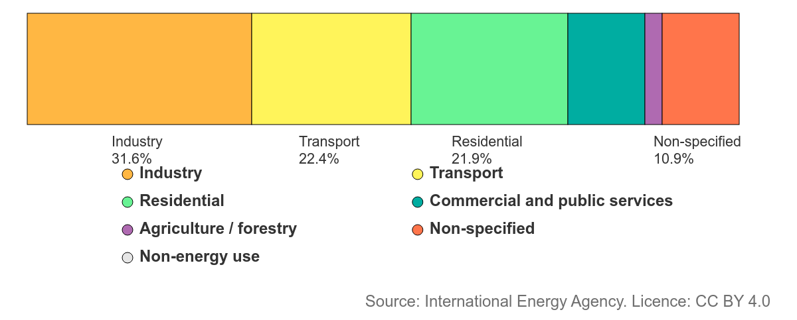
CO₂ emission in Mongolia
22.8% 35.2% 33.1% in Sapporo
Industry and transport in Mongolia emit more energy than that in Sapporo
CO2 emissions in the residential sector are at the same rate as in Sapporo

Slide 5
Building Energy Efficiency
Ulaanbaatar and Sapporo have many Common points.
Cold winter and hot summer.
Residential and commercial buildings emit GHG.
Energy Efficiency with Building insulation and air tightness is important
Sapporo: Newly built single-family homes have sufficient energy efficiency performance. However, apartment buildings need more performance.
Ulaanbaatar: Apartment buildings have sufficient energy efficiency performance (problems with heat supply, heating, and ventilation systems?). Detached houses in ger areas have a big problem.
PV is effective in Sapporo and Ulaanbaatar with mid-latitudes.

Slide 6
Sapporo eco-e house (札幌版次世代住宅)
Grade | U_{A}(overall thermal transmittance) [W/(m²・K)] | BEI (primary energy consumption) | Air tightness
Platinum 2.2 M jpy | Below 0.18 | Below 60% of standard | New building Below 0.5 cm2/m2 Renovation Below 1.0 cm2/m2
Gold 1.8 M jpy | Below 0.20 Grade 7 of national energy standard | Below 80％
Silver 0.6 M jpy | Below 0.28 Grade 6 of national energy standard
Bronze | Below 0.40 Grade 5 of national energy standard
PV system: over 1.5kW and Battery: over 2.0 kWh are needed to be resister as Sapporo eco-e house. Sapporo City provides subsidies for Sapporo Eco-E House

Slide 7
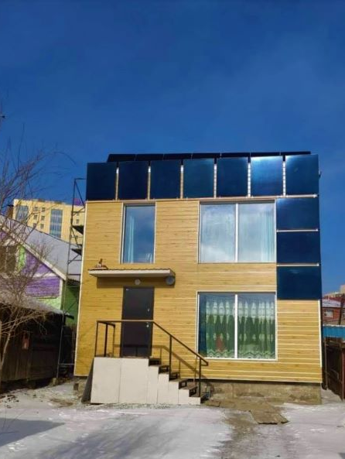
Passive Houses in Mongolia
In 2020, a 2-story 70m² apartment located in Gandan was registered as an energy-efficient apartment (LEH) for the first time in Mongolia
The results of measurements, tests, monitoring, and analysis of the NUM-RE laboratory are recorded as evidence

Slide 8
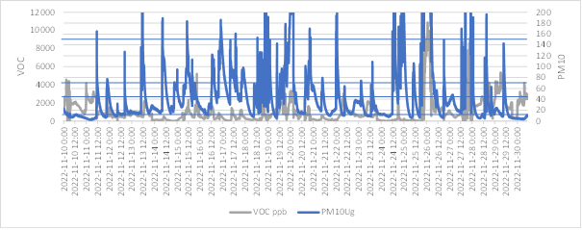
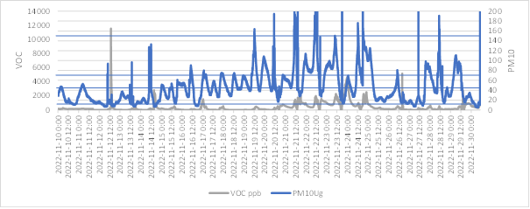
Joint research project with NUM
VOC and PM measurements in Ulaanbaatar
Indoor PM was frequently higher than the UN health standard
An air purifier should be installed.
Apartment Office

Slide 9
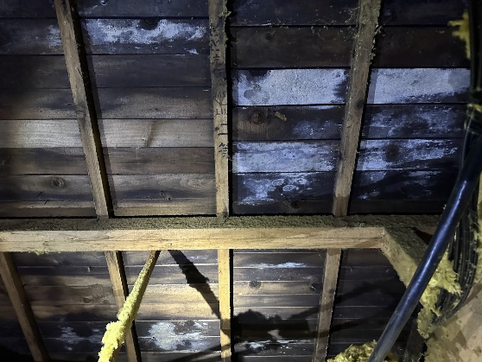
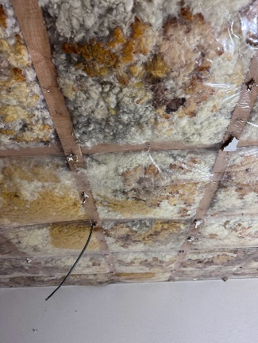
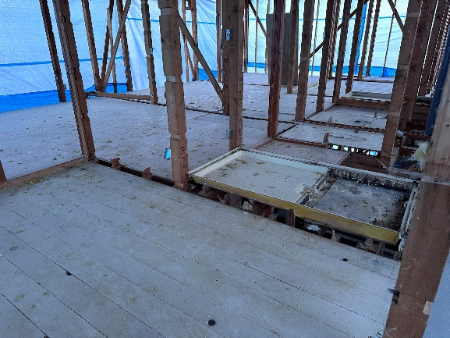
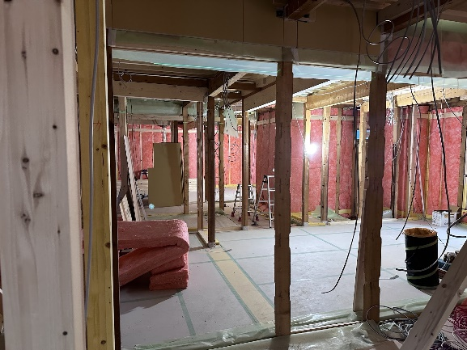
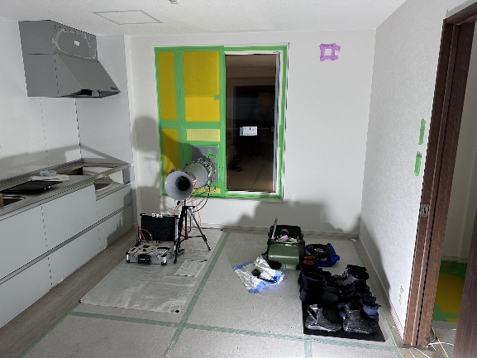
Insulation retrofit project (wooden apartment)
Sapporo has many wooden apartment buildings built in the 1980s.
Difficult to renew due to rising construction costs
Provided as a new apartment after insulation renovation
Consideration of the energy system
PV installation in combination with other facilities

Slide 10
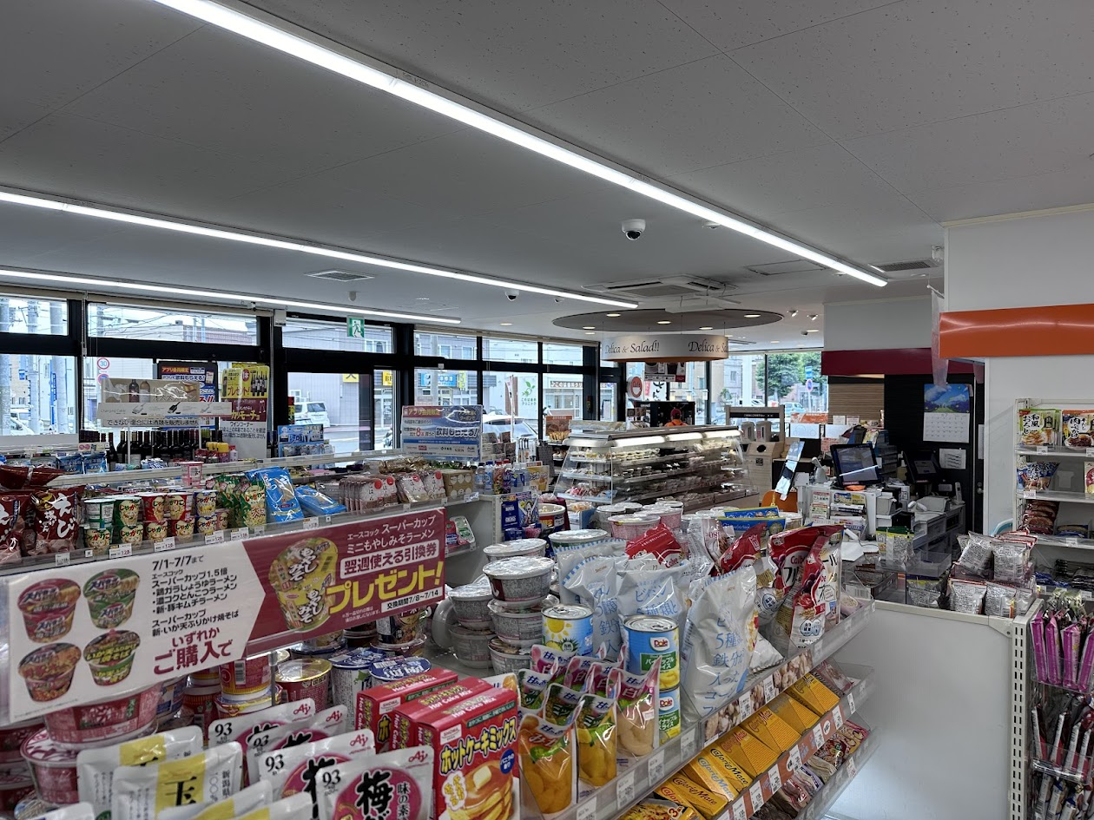
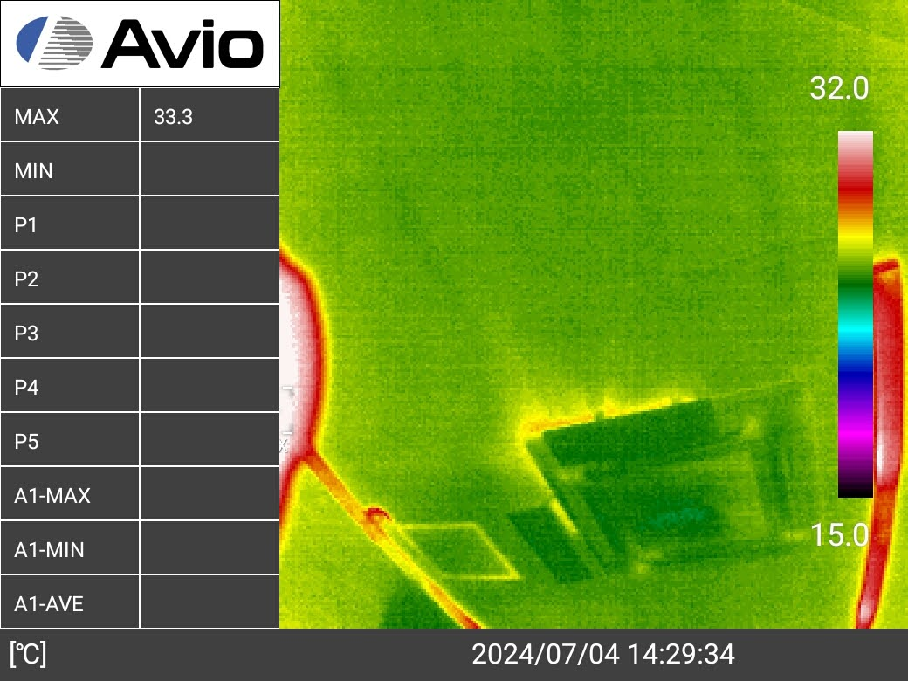
Insulation retrofit project (grocery store)
Grocery stores such as CS consume huge amounts of electricity. 30% of sales are spent on electricity bills caused by AC and Refrigeration
We found heat loss caused by poor insulation and excessive ventilation with thermal inspection
Insulation retrofit and reconsideration of the ventilation plan can decrease energy consumption.
More consideration about refrigeration would be needed.
 | insulation | Window | window area [%] | ventilation [㎥/h] | yearly hvac energy [kWh/yr] | cost
Current | FP 25mm | single 5mm | 43.3 | 1500 | 41685 | ¥970,844
case 1 | UF 50mm | single 5mm | 43.3 | 150 | 23940 | ¥557,563
case 2 | UF 50mm | double Ar 12mm | 32.06 | 150 | 18165 | ¥423,063
case 3 | UF 50mm | double Ar 12mm | 24.55 | 150 | 16485 | ¥383,936

Slide 11
Future collaboration
The Department of Green Energy and Engineering was established at the Faculty of Engineering of the National University of Mongolia in September 2024.
Pursuing only energy conservation may neglect the indoor environment.
Plans to conduct joint research on achieving both energy conservation and indoor environment through buildings

